Slide 1


Crowdsourcing Science
Martin Schweinsberg,
Neil Bearden, & Eric Luis Uhlmann
INSEAD
Notes:
Thank you so much for coming, and welcome to our class on “Crowdsourcing Science!”

Slide 2
Course Overview
The Crisis of Confidence in Science
The Replication Revolution
The Open Data Movement
Running themes:
Ethics, Incentives, and Crowdsourced Solutions
Notes:
We will cover a number of issues at the forefront of the current open science movement. These will include the crisis of confidence in science caused by increased attention on questionable research practices and publication bias, evidence that many research findings cannot be easily replicated by independent laboratories, and the movement to make the data from scientific papers publicly available for re-analysis by anyone. Our class will also have a number of running themes we will return to again and again: research ethics, incentive structures in science, and crowdsourced solutions to the problems facing science.

Slide 3

The Crisis of Confidence in Science
Martin Schweinsberg,
Neil Bearden, & Eric Luis Uhlmann
INSEAD
Notes:
Our first lecture will be on the ongoing crisis of confidence in science, the increasing sense that many of the findings in the published literature cannot be relied on to inform scientific theories and public policies.

Slide 4
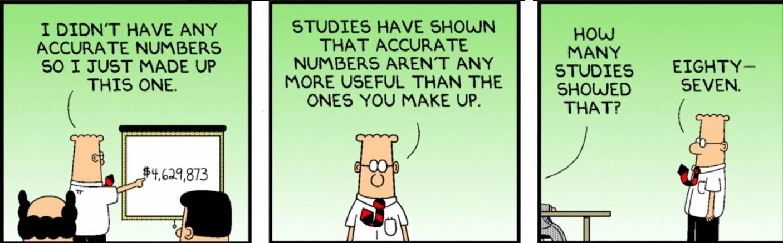
Research Methods by Dilbert
Notes:
Here is a cartoon on Dilbert’s research methods (instructor reads the cartoon).

Slide 5
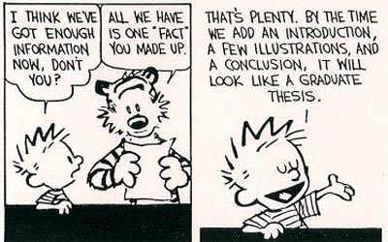
Research Methods by Calvin
Notes:
Here is a cartoon on Calvin’s research methods (instructor reads the cartoon).
Note: This slide is silenced since it was replaced with the (arguably more funny) Dilbert cartoon

Slide 6
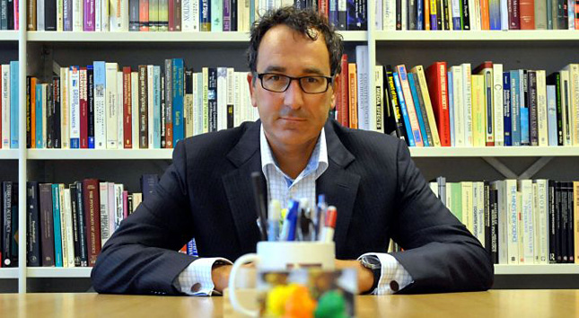
Research methods by Diederik (Stapel):
55 articles retracted for data fabrication
Notes:
Dilbert’s research standards are pretty similar to those of real-life former academic Diederik Stapel, who fabricated data in at least 55 articles. He made up entire datasets, and even fake schools where elaborate studies were supposedly run. This and other fraud scandals have led to the retraction of academic papers and major media coverage, and are a big part of what instigated the current crisis of confidence in science.
Relevant links:
Stapel autobiography in English, full text
http://nick.brown.free.fr/stapel/FakingScience-20141214.pdf

Slide 7
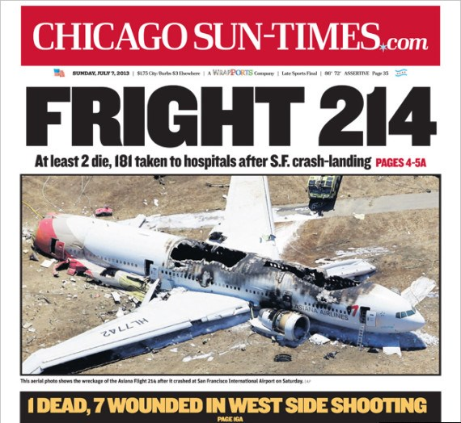
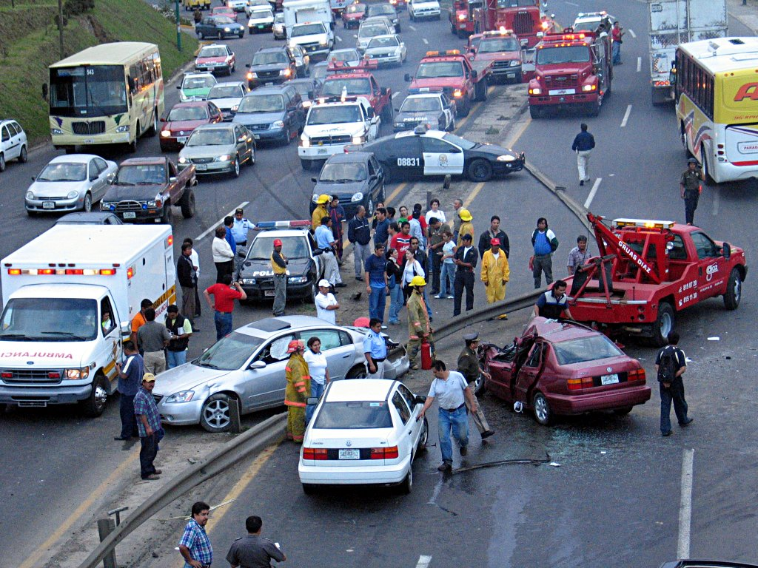
Availability Bias:
Overestimating the base rate of salient events
(Tversky & Kahneman, 1973)
People estimate that more people die in plane crashes than car crashes, but the reverse is true
Notes:
You're are all familiar with the famous availability bias, discovered by Amos Tversky and Daniel Kahneman. This is the bias such that we overestimate the likelihood and frequency of salient events. One example is that we overestimate the frequency of deaths in plane crashes relative to car crashes, since plane crashes are so much more salient.

Slide 8
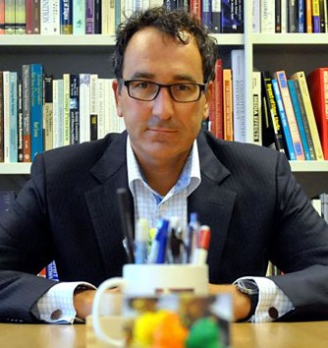
High-Profile fraud cases
are like plane crashes
Notes:
These high-profile fraud cases are kind of like plane crashes in this way, highly salient and vivid but probably very uncommon.

Slide 9
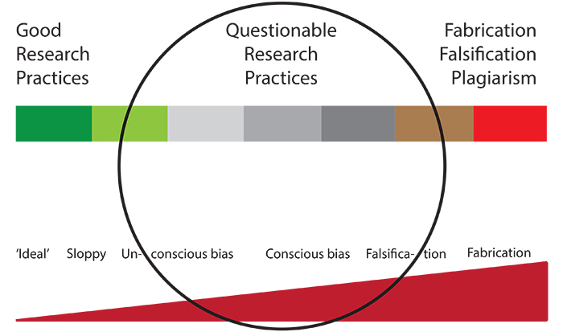
Science’s car crash:
Questionable Research Practices
Notes:
Science’s car crashes are what are called Questionable Research Practices, or QRPs. These are grey-area research practices that might be justifiable under some circumstances, but are often used in questionable ways. QRPs are way more common than fraud, and almost certainly undermine science much more.

Slide 10
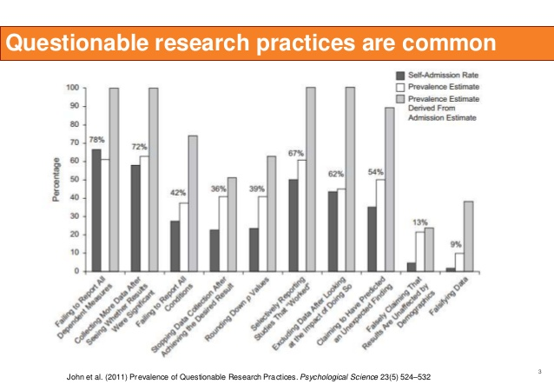
Notes:
John and colleagues find that most scientists admit to QRPs like failing to report all dependent measures and collecting more data when an effect is nonsignificant until the effect becomes significant.

Slide 11
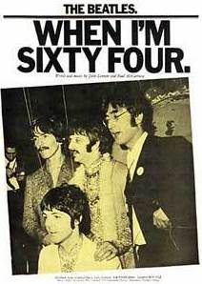
False Positive Psychology Paper
(Simmons, Nelson, & Simonsohn, 2011)
Lack of transparency in research reports makes it unclear how data were analyzed
  Facilitates use/abuse of QRPs
Without knowing how the data were analyzed, we don’t know how much confidence we should place in the finding
Use QRPs to show that listening to “When I’m 64” significantly reduces chronological age
Notes:
Have you heard of the famous false positive psychology paper by Joe Simmons, Leif, Nelson, and Uri Simonsohn? They argued that a lack of transparency in research reports makes it unclear how data were analyzed, facilitates the use of QRPs, and leads to unreliable findings. To illustrate this problem, they used QRPs to show that listening to “When I’m 64” significantly reduces research participants’ chronological age, in other words caused them to be younger, which is of course not possible. They had not broken any of the journal’s ethics rules in producing this false finding.
Relevant links:
Simmons, J., Nelson, L., & Simonsohn, U. (2011). False-positive psychology: Undisclosed
flexibility in data collection and analysis allow presenting anything as significant. Psychological Science, 22(11), 1359-1366.
Full text available open access here, http://pss.sagepub.com/content/22/11/1359.full.pdf+html, just click on “Full Text pdf”

Slide 12
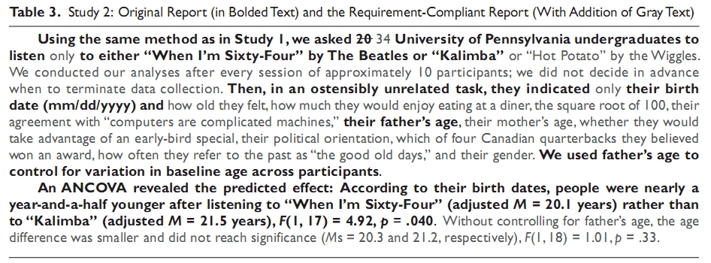
Lack of disclosure as to how data were analyzed creates false confidence in shaky findings
Notes:
Here is how they did it– by excluding subjects, dropping a condition, and using unreported covariates, they were able to get a significant effect.

Slide 13
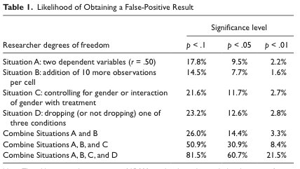
Simulations indicate that QRPs can dramatically increase the rate of false positives
Notes:
Simmons and colleagues further used simulations to show that QRPs can dramatically increase the rate of false positives. In combination, dropping a dependent measure that doesn’t “work,” controlling for gender only when it help the effect become significant, and dropping a condition when it doesn’t support the hypothesis can make it more likely than not that you find a significant effect even when there is no real effect.

Slide 14
What are some of the other
Questionable Research Practices you have heard about?
Notes:
What are some of the other Questionable Research Practices you have heard about? (students answer). There are lots of other QRPs that aren’t even here, like combining two similar pilot studies into one larger study, but only if they both show effects in the right direction. Add this and further QRPs and the false positive rate could go even higher. This is scary stuff!

Slide 15
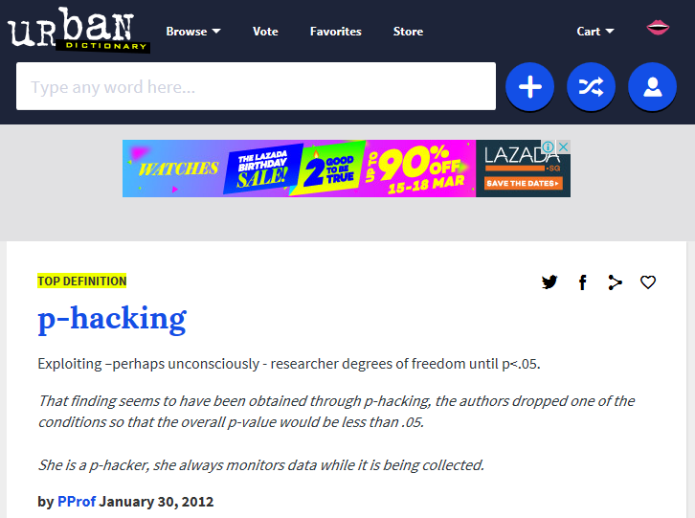
Notes:
Simmons and colleagues coined the term p-hacking: “exploiting, perhaps unconsciously, researcher degrees of freedom until p is less than .05.” Researcher degrees of freedom is the latitude researchers have to analyze the same dataset in different ways.

Slide 16
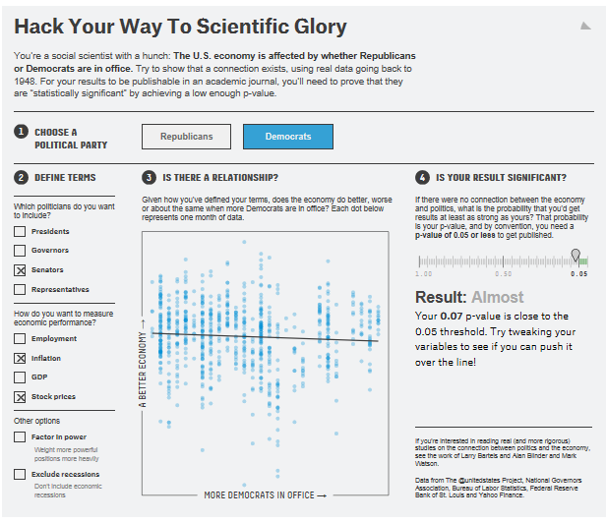
http://fivethirtyeight.com/features/science-isnt-broken/
Notes:
This is as much of an issue for the analysis of archival datasets as it is for experimental datasets, if not more so. For example, researchers can choose different ways to operationalize the same theoretical variable in a way that biases the results. Let me show you an online demonstration of the effects of p-hacking on research results from a real archival dataset. The research question is whether the U.S. economy is affected by whether Republicans or Democrats are in office. (Instructor uses this link to access the 538 online p-hacking demonstration and selects all of the options under “define terms” http://fivethirtyeight.com/features/science-isnt-broken/) As you see here, if you include everything, there is no overall effect on the economy of whether Republicans or Democrats are in office. (Under “define terms,” the instructor selects “Presidents” and “Employment” and “Inflation,” and the line becomes flat). Suppose we just use the top executive, the commander in chief, and employment and inflation as our operationalization of economic prosperity. Now Democrats have a significant positive effect on the economy! (Under “define terms,” the instructor adds “Governors”). But look what happens with almost the same specification, but adding in Governors. Now the effect reverses, and Democrats are bad for the economy! (instructor tries various other specifications and the effects flip-flop and reappear and disappear). You can try this for yourself, the link is in the slides I will send out. We will return to the effects of different analytic approaches on research results from archival data in our final lecture, on the Open Data Movement.

Slide 17
Ethnographic study of QRPs in infant cognition (Peterson, 2016)
Participants not blind anymore to manipulation
Optional stopping (data for 10 babies collected, analyzed and then data collection stopped or continued based on results)
Adding conditions post-hoc
  Experiment did not work with 14 month-olds = failure
  Next “add” 2nd age group on which intervention has an effect and publish
Notes:
Let’s review some of the direct evidence that QRPs are common across scientific fields and subfields. A recent ethnographic study of 3 infant cognition labs by a graduate student who worked in those labs notes the pervasive use of QRPs, such as optional stopping, and adding conditions post-hoc. This is obviously a small sample, but the depth of the qualitative ethnographic approach is great.
Relevant links:
Blog post regarding ethnographic study of QRPs in three infant cognition labs
https://hardsci.wordpress.com/2016/02/11/an-eye-popping-ethnography-of-three-infant-cognition-labs/
Slate article about the baby lab QRP study
http://www.slate.com/articles/health_and_science/science/2016/03/the_psychology_replication_crisis_could_be_due_to_sketchy_practices_in_the.html

Slide 18
Outcome switching at medical journals
(Goldacre, 2015)
Examined 67 clinical medical trials that predetermined analyses and outcomes
Q: How many show “outcome switching” (i.e. not analyzing something authors said they would, or adding an analysis they weren’t originally planning on doing)
Notes:
Ben Goldacre and colleagues have an initiative tracking outcome switching at medical journals, cases where the authors reported a different DV than they had originally stipulated in their study plan. How many of 67 studies they looked at do you think did this?
Relevant links:
Outcome switching at medical journals
http://retractionwatch.com/2016/02/26/top-journals-give-mixed-response-to-learning-published-trials-didnt-proceed-as-planned/#more-37075
See here for more details:
http://compare-trials.org/

Slide 19
Outcome switching at medical journals
(Goldacre, 2015)
Examined 67 clinical medical trials that predetermined analyses and outcomes
Q: How many show “outcome switching” (i.e. not analyzing something authors said they would, or adding an analysis they weren’t originally planning on doing)
A: 58/67 included outcome switching!
  Excluded 38% of planned analyses
  Included an additional 5.3 outcomes
Notes:
58 out of 67! In 58 out of 67 studies, the authors dropped a DV or added a new one between the analysis they had originally planned and the final study report.
Relevant links:
Outcome switching at medical journals
http://retractionwatch.com/2016/02/26/top-journals-give-mixed-response-to-learning-published-trials-didnt-proceed-as-planned/#more-37075
See here for more details:
http://compare-trials.org/

Slide 20
Comparing dissertations and published papers in management (O’Boyle et al., 2014)
Q: how do published papers from dissertations deviate from submitted dissertations?
A: QPRs metamorphisize initial results into beautiful articles
Ratio of supported/unsupported hypotheses?
Notes:
Another approach is to compare dissertations and published papers, as was done in the field of management. What do you think is the ratio of supported vs unsupported hypotheses as we compare dissertations to the final journal publication that came out of that dissertation? (students give estimates).
Relevant links:
Chrysalis effect (paywalled)
http://jom.sagepub.com/content/early/2014/03/18/0149206314527133.abstract
Coverage in retraction watch
http://retractionwatch.com/2014/03/25/the-chrysalis-effect-how-ugly-initial-results-metamorphosize-into-beautiful-articles/

Slide 21
Comparing dissertations and published papers in management (O’Boyle et al., 2014)
Q: how do published papers from dissertations deviate from submitted dissertations?
A: QPRs metamorphisize initial results into beautiful articles
Ratio of supported/unsupported hypotheses more than doubles!
  Dissertation: .82/1.00
  Publication: 1.94/1.00
Notes:
The ratio of supported to unsupported hypotheses more than doubles! This is called the “chrysalis effect.” It is an incredibly weak test for the presence of QRPs, since this only captures the QRPs between the final version of the dissertation and the publication in the journal.
Relevant links:
Chrysalis effect (paywalled)
http://jom.sagepub.com/content/early/2014/03/18/0149206314527133.abstract
Coverage in retraction watch
http://retractionwatch.com/2014/03/25/the-chrysalis-effect-how-ugly-initial-results-metamorphosize-into-beautiful-articles/

Slide 22
Underreporting in psychology
Time Sharing Experiments for the Social Sciences (TESS) runs national representative samples of Americans in experiments based on proposals by researchers
After an embargo period, the materials and data are made public
Franco et al. (2015) compared the published reports of the studies with what was actually done
  What percentage of final reports dropped DVs?
  What percentage of final reports dropped conditions?
Notes:
Another empirical test for QRPs, this time in psychology, leveraged the TESS, or Time Sharing Experiments for the Social Sciences. The TESS organization runs national representative samples of Americans in experiments based on proposals by researchers. After an embargo period, the materials and data are made public. Franco and colleagues compared the published reports of the studies with the TESS records of what actually happened in the study. What percentage of final reports do you think dropped DVs? What percentage of final reports do you think dropped conditions? (students give estimates).
Relevant links:
Underreporting in Psychology Experiments Evidence From a Study Registry http://spp.sagepub.com/content/early/2015/08/06/1948550615598377.abstract?rss=1
TESS website
http://www.tessexperiments.org/data/willer562.html

Slide 23
Underreporting in psychology
40% of published psych studies from TESS don't report all conditions
70% don't report all DVs
Reported effect sizes twice as large as unreported effect sizes and 3 times as likely to be p < .05
This is when everything is public!
Notes:
40% of published psychology studies from TESS didn't report all of the experimental conditions. 70% didn't report all of the dependent measures. The reported effect sizes were twice as large as the unreported effect sizes and three times as likely to be statistically significant, in other words p < .05. And this is when everything is totally public and anyone can check!
Relevant links:
Underreporting in Psychology Experiments Evidence From a Study Registry http://spp.sagepub.com/content/early/2015/08/06/1948550615598377.abstract?rss=1
TESS website
http://www.tessexperiments.org/data/willer562.html
Image from the study
https://mobile.twitter.com/ecsalomon/status/629649814427410432/photo/1

Slide 24
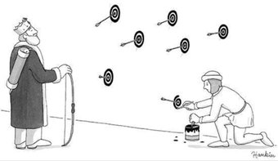
The Garden of Forking Paths
(Gelman & Loken, 2014)
Researchers do not need to actively p-hack data to get spurious results
We are often unaware of how analytic decisions driven by the observed results affect research conclusions
  Analysis chosen post-hoc based on observed pattern in the data (“is that significant?”)
  HARKing (hypothesizing after the facts are known)
Notes:
A paper by Andrew Gelman and Eric Loken emphasizes that researchers do not need to actively p-hack data to get spurious results. We often look at our results, then choose the analysis to do, which capitalizes on chance. In other words, analyses are often chosen post-hoc based on observed pattern in the data– we look at a pattern and ask,“is that significant?”. We also HARK or hypothesize after the facts are known. Gelman and Loken refer to this as walking the Garden of Forking Paths.
Relevant links:
Gelman, A., & Loken, E. (2014). The statistical crisis in science. American Scientist, 102, 460. (aka “The garden of forking paths”
Full text of draft: http://www.stat.columbia.edu/~gelman/research/unpublished/p_hacking.pdf

Slide 25
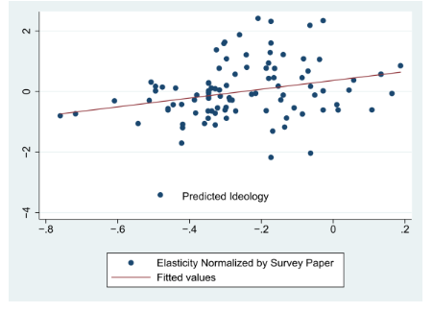
Ideological conflicts of interest
(Jelveh et al., 2015)
Analysis of data may also be affected by researchers’ political ideology
Jelveh et al. (2015) constructed language-based measure of political ideology
Found it predicted empirical results in academic papers on government spending, taxes, and the minimum wage
Notes:
Remember our p-hacking demonstration earlier? Analytic choices regarding data and the conclusions drawn may also be affected by researchers’ political ideology. Jelveh et al. found that economists’ political beliefs predicted the empirical results of their findings regarding government spending, taxes, and the minimum wage.
Relevant links:
Political Language in Economics
http://papers.ssrn.com/sol3/papers.cfm?abstract_id=2535453
Summary in 538
http://fivethirtyeight.com/features/economists-arent-as-nonpartisan-as-we-think/?utm_content=buffer94680&utm_medium=social&utm_source=twitter.com&utm_campaign=buffer

Slide 26
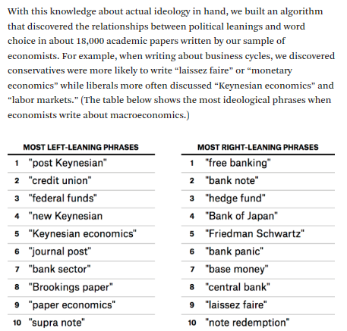
Notes:
Note: More details about the language measure, in case students ask
Relevant links:
Political Language in Economics
http://papers.ssrn.com/sol3/papers.cfm?abstract_id=2535453
Summary in 538
http://fivethirtyeight.com/features/economists-arent-as-nonpartisan-as-we-think/?utm_content=buffer94680&utm_medium=social&utm_source=twitter.com&utm_campaign=buffer

Slide 27

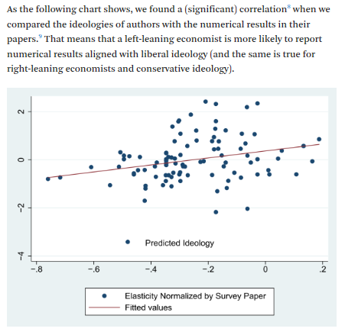
Notes:
Note: More details about what the figure means, in case students ask
Relevant links:
Political Language in Economics
http://papers.ssrn.com/sol3/papers.cfm?abstract_id=2535453
Summary in 538
http://fivethirtyeight.com/features/economists-arent-as-nonpartisan-as-we-think/?utm_content=buffer94680&utm_medium=social&utm_source=twitter.com&utm_campaign=buffer

Slide 28
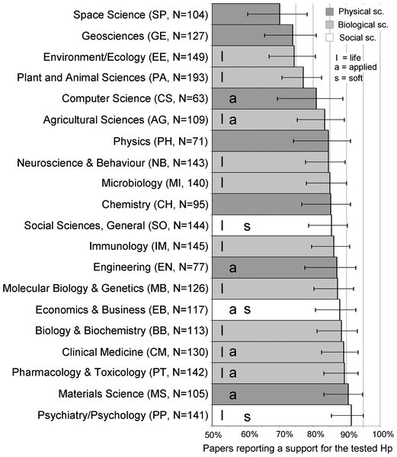
Publication Bias: Only significant effects get published
With med. power < .50
Source: Fanelli, D. (2010). “Positive” results increase down the hierarchy of the sciences. PloS one, 5(4), e10068.
Notes:
Credit: Slide from publicly posted presentation by Jelte Wicherts
Related to, but distinct from QRPs is publication bias, or the tendency to only publish statistically significant results in journals. This tendency is much stronger in some academic fields than others, with the field of psychology at the top of the list with over 90% of published papers reporting significant results.

Slide 29
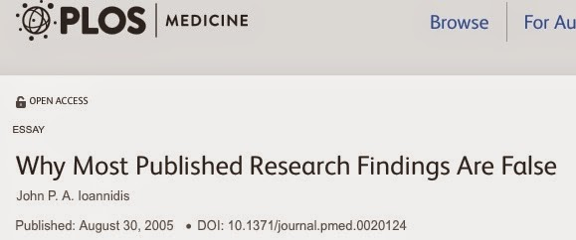
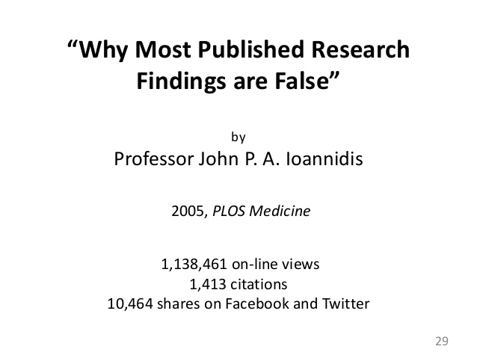
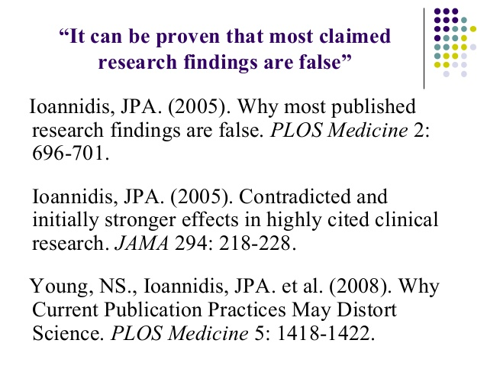
Notes:
In 2005, John Ioannides published the most read paper in the history of PLOS1, provocatively titled “Why most published research findings are false.” It has over 1 million views as well as thousands of academic citations.
Relevant links:
Ioannidis, J.P. (2005). Why most published research findings are false. PLoS Medicine.
http://www.plosmedicine.org/article/info%3Adoi%2F10.1371%2Fjournal.pmed.0020124
Full text: http://www.ncbi.nlm.nih.gov/pmc/articles/PMC1182327/

Slide 30
Test for Excess Significance
(Ioannidis, 2005; Ioannidis & Trikalinos, 2007)
Studies are underpowered to detect the reported effect sizes so consistently
There must be missing studies = publication bias
Simulations suggest that effect sizes in the published literature grossly overestimated
Conditional probability of so many studies all working very low
  See also Schimmack’s 2012 “Incredibility Index”
Notes:
Ioannidis & Trikalinos developed the Test for Excess Significance, which assesses whether the reported studies were underpowered to detect the reported effect sizes. If there is excess significance given the statistical power of the studies, there must be unreported studies with null effects, in other words publication bias. A similar logic underlies Uli Schimmack’s “Incredibility Index,” which is designed to test whether it is too incredible to believe that these were all the studies the researchers conducted.
Relevant links:
Ioannidis, J.P. (2005). Why most published research findings are false. PLoS Medicine.
http://www.plosmedicine.org/article/info%3Adoi%2F10.1371%2Fjournal.pmed.0020124
Full text: http://www.ncbi.nlm.nih.gov/pmc/articles/PMC1182327/
The Ironic Effect of Significant Results on the Credibility
of Multiple-Study Articles
http://www.ubc-emotionlab.ca/wp-content/uploads/2012/09/Schimmack-2012-Effect-of-Significance-on-Article-Credibility.pdf

Slide 31
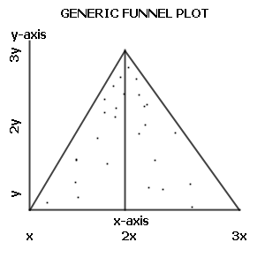
Funnel Plot
X axis = how big was effect in study X?
Y axis = how precise was study X? (function of sample size mostly)
Precise/large studies near the top = average of all other studies; imprecise/small studies spread evenly on both sides of the average
  Creating a triangular shape
Notes:
Another approach to testing for publication bias is the funnel plot, which plots effect sizes on the x axis and the study’s sample size on the y axis. If there is no publication bias, we should see a triangular shape since precise studies will cluster together at the top while imprecise studies are more dispersed at the bottom of the triangle.
References
http://handbook.cochrane.org/chapter_10/10_4_1_funnel_plots.htm
http://handbook.cochrane.org/chapter_10/figure_10_4_a_hypothetical_funnel_plots.htm
Quote From that reference: Some authors have argued that visual interpretation of funnel plots is too subjective to be useful. In particular, Terrin et al. found that researchers had only a limited ability to correctly identify funnel plots from meta-analyses subject to publication bias (Terrin 2005). A further, important, problem with funnel plots is that some effect estimates (e.g. odds ratios and standardized mean differences) are naturally correlated with their standard errors, and can produce spurious asymmetry in a funnel plot.

Slide 32
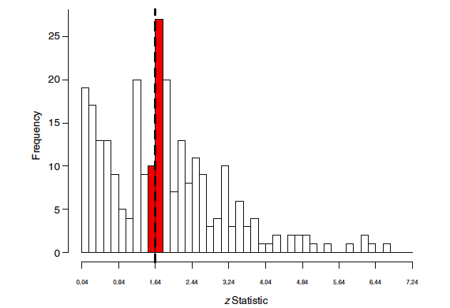
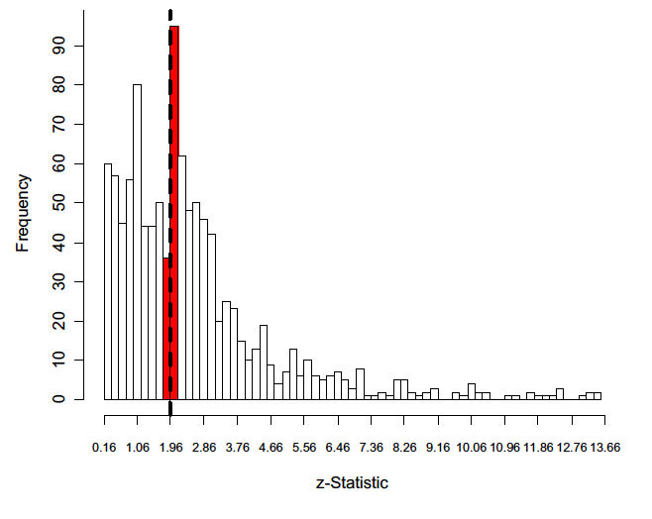
Distributions of p values in sociology and political science publications
Gerber, A. S., & Malhotra, N. (2008). Publication bias in empirical sociological research - Do arbitrary significance levels distort published results? Sociological Methods & Research, 37, 3-30.
Gerber, A. S., & Malhotra, N. (2008). Do statistical reporting standards affect what is published? Publication bias in two leading political science journals. Quarterly Journal of Political Science, 3, 313-326.
Notes:
Credit: Slide from publicly posted presentation by Jelte Wicherts
Another way to test for publication bias is looking at p value distributions. Here are the p value distributions in 3 major sociology and political science journals. As you can see, there is a “p-bump” or surplus of barely-significant findings, shown in red.

Slide 33
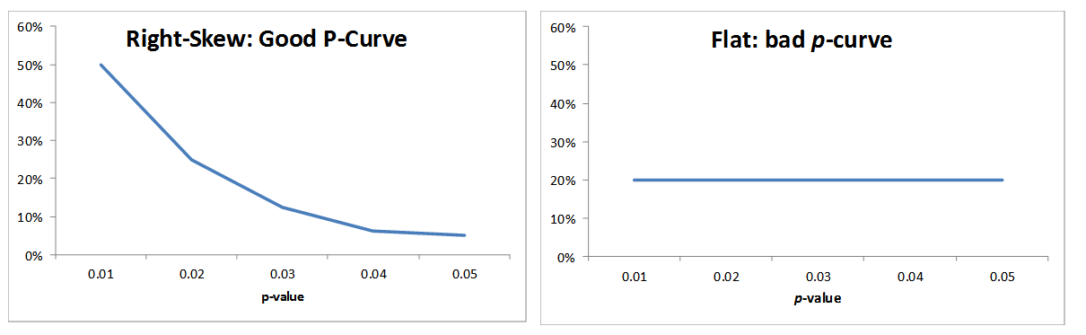
P-Curve asks: how likely are the observed p-values?
(Simonsohn et al., 2014)
Indicative of effect: more p-values close to 0, fewer closer to .05
Indicative of no effect and file drawer of non-significant studies
Notes:
Another approach is the p-curve, which plots the p-values for the primary dependent variables in a paper or set of papers. The idea here is that a right-skewed distribution of p values suggests a true finding, whereas a flat p-curve is indicative of no effect and a file drawer of non-significant studies.
Note: The previous 2 slides are mostly captured by this slide, this is why they are silenced.

Slide 34
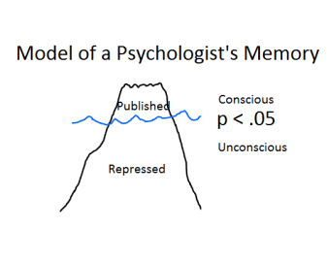
Tests for publication bias all suggest overestimated effect sizes pervasive in published literature
Test for excess significance (Ioannidis & Trikalinos, 2007)
Incredibility Index (Schimmack, 2012)
Replication Index (Schimmack, 2014)
Funnel plot (Light & Pillemer, 1984)
P-curve (Simonsohn, Nelson, & Simmons, 2014)
And all are based on statistical assumptions
Notes:
There are a number of publication bias tests, but they all suggest effect sizes in the published literature are systematically overestimated. These tests are also based on statistical assumptions and have been criticized on various grounds.
Relevant links:
Incredibility Index draft
http://www.utm.utoronto.ca/~w3psyuli/PReprints/IC.pdf
Incredibility Index: abstract of published version
http://www.ncbi.nlm.nih.gov/pubmed/22924598
Replication Index blog
https://replicationindex.wordpress.com/
Schimmack, U. (2014). Quantifying statistical research integrity: The replicabilty-index. Unpublished manuscript.
Full text: http://www.r-index.org/uploads/3/5/6/7/3567479/introduction_to_the_r-index__14-12-01.pdf
Funnel plot:
J Exp Psychol Gen. 2015 Dec;144(6):e142-58. doi: 10.1037/xge0000116. Epub 2015 Oct 26.
Romance, risk, and replication: Can consumer choices and risk-taking be primed by mating motives?
Shanks DR¹, Vadillo MA², Riedel B¹, Clymo A¹, Govind S¹, Hickin N¹, Tamman AJ¹, Puhlmann LM¹.

Slide 35
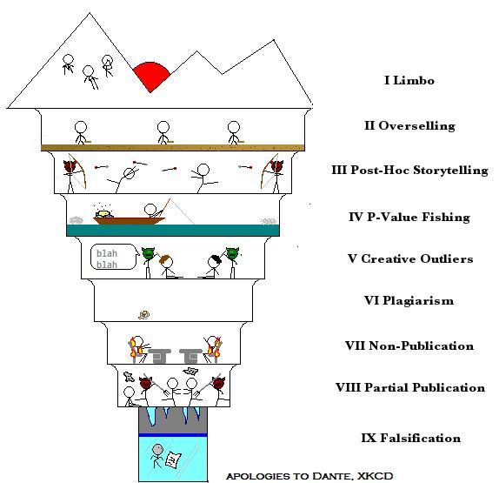
The 9 Circles of Scientific Hell
(Neuroskeptic, 2010)
Notes:
Falsification of data, publication bias, and QRPs are on a continuum which the blogger Neuroskeptic referred to as the “9 Circles of Scientific Hell,” which also includes HARKing (hypothesizing after the factors are known) and overselling one’s findings. What has led us to this? The incentive structure, the pressure to get significance and publish.
Relevant links:
The 9 Circles of Scientific Hell
http://blogs.discovermagazine.com/neuroskeptic/2010/11/24/the-9-circles-of-scientific-hell/
Academics admit feeling pressure to embellish possible impact of research
https://theconversation.com/academics-admit-feeling-pressure-to-embellish-possible-impact-of-research-56059

Slide 36
The Cobra Effect
The British government concerned about the number of cobra snakes in Delhi.
  Offered a bounty for every dead cobra
  Huge numbers of snakes were killed for the reward
But then what happened?
Notes:
Let me tell you a story about incentives. The British colonial government was concerned about the number of cobra snakes in Delhi. They offered a bounty for every dead cobra, an extrinsic incentive. Huge numbers of snakes were killed for the reward. But then what happened? (students answer).

Slide 37
The Cobra Effect
The British government concerned about the number of cobra snakes in Delhi.
  Offered a bounty for every dead cobra
  Huge numbers of snakes were killed for the reward
But then what happened? Local entrepreneurs began to breed cobras.
So what did the British do?
Notes:
Local entrepreneurs began to breed cobras to get the payments. So what did the British do? (students answer).

Slide 38
The Cobra Effect
The British government concerned about the number of cobra snakes in Delhi.
  Offered a bounty for every dead cobra
  Huge numbers of snakes were killed for the reward.
But then what happened? Local entrepreneurs began to breed cobras.
So what did the British do? Scrap the reward program.
  Cobra breeders set the now-worthless snakes free
Notes:
They scrapped the reward program. And the cobra breeders set the now-worthless snakes free. This is a story about perverse incentives and gaming the system.

Slide 39
Perverse Incentives
Gaming is problem faced by all incentive systems based on extrinsic rewards
  Publications in high-impact journals, tenure
Incentive life cycles (Obloj & Sengul, 2012)
  Outlet-level data from a Polish commercial bank
  Sales revenue from loans and employee bonuses both increased under new incentive system
  However, the bank’s share decreased dramatically over time
  Gaming the system: Salami slicing loans to get multiple bonuses, driving customers to other branches
Notes:
Gaming is problem faced by all incentive systems based on extrinsic rewards. In academia the extrinsic rewards are publications in high-impact journals, research positions at well ranked schools, and tenure promotions. Incentives also have a life cycle, such that they work best the beginning and then less and less well as people learn to game the system.

Slide 40
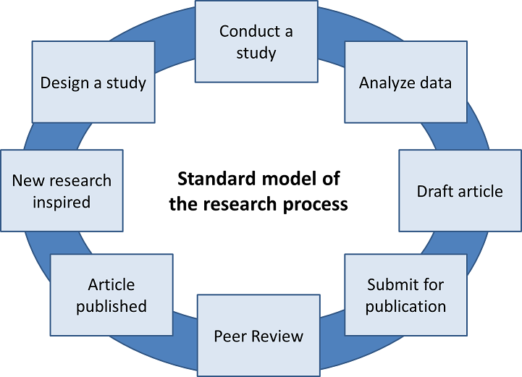
Notes:
Here is the standard model of science. A published article inspires another scientist to do new research, design a study, conduct it, analyze the data, and write their own article for consideration for publication.

Slide 41
Are we reaching the end of the incentive life cycle?
Has science just become about publishing?
Notes:
Are we reaching the end of the incentive life cycle? Has science just become about publishing? (students discuss).

Slide 42
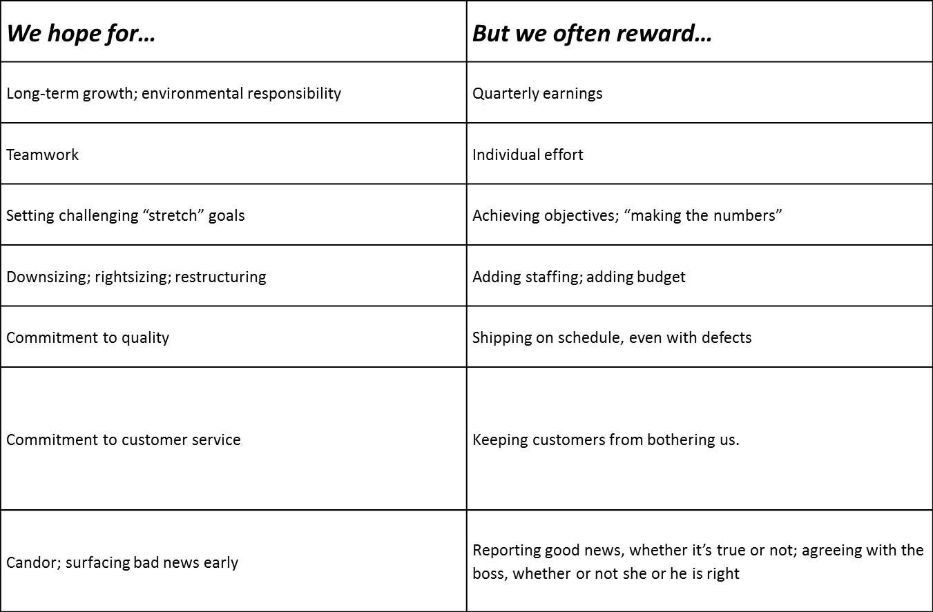
On the folly of rewarding A, while hoping for B
(Kerr, 1995)
We hope to generate reliable scientific truths,
but reward publishing in prestigious journals
Notes:
In our classes we academics often teach this classic paper, “On the folly of rewarding A, while hoping for B.” Organizations do this all the time, for example hoping for long-term sustainability but rewarding quarterly earnings. This is what we are doing with the publishing system, claiming we want scientific truth but rewarding publications in high impact factor journals.
Relevant links:
Kerr 1995
http://www.ou.edu/russell/UGcomp/Kerr.pdf

Slide 43
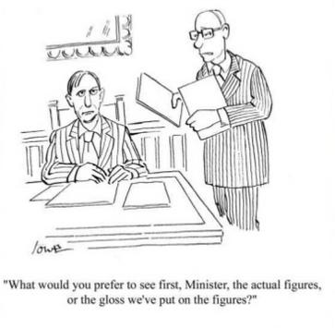
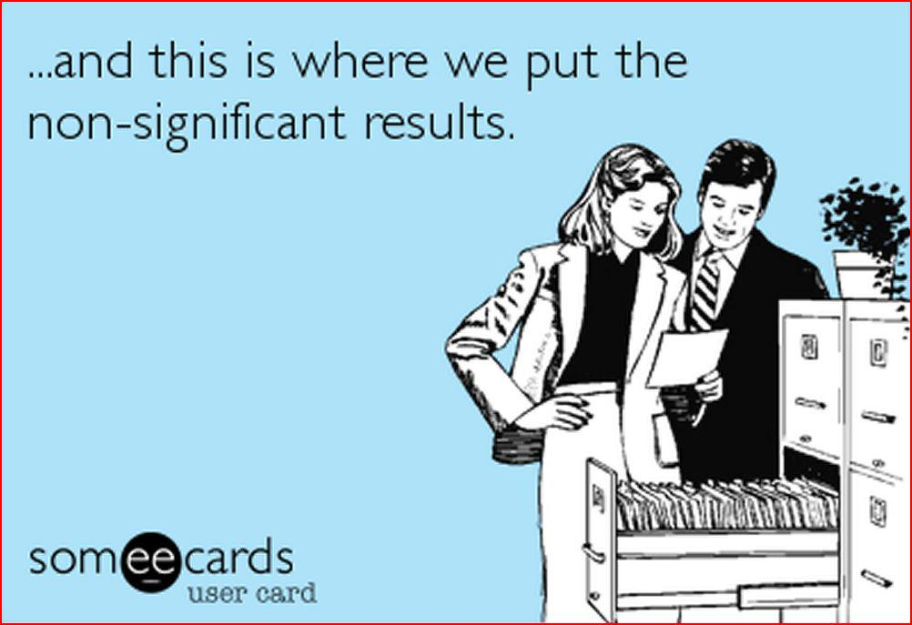
Addressing publication bias and questionable research practices
Notes:
Credit: Slide from Bowman Open Science presentation posted on OSF
Now I would like to talk to you about addressing publication bias and questionable research practices.
Note: The instructor leaves this slide up during the break, so students can read the cartoons if they want to.

Slide 44

Motivated data analysis
Remove outliers (Z > |2|)
P>.05
Call this a “failed study”
Perform
new study
?
P>.05
P<.05
Add 10 cases
P<.05
P>.05
Redo analysis with adapted
dependent var.
?
P<.05
Effect!
P>.05
Planned
analysis
P<.05
Write
paper
Bakker, M., van Dijk, A, & Wicherts, J. M. (2012). The Rules of the Game Called
Psychological Science. Perspectives on Psychological Science, 7, 543-554.
Simmons, J. P., Nelson, L. D., & Simonsohn, U. (2011). False-positive psychology.
Psychological Science, 22, 1359 –1366.
Notes:
Credit: Slide from Jelte Wicherts presentation
So we have this problem of motivated analysis of scientific data. At numerous stage, the researcher can consciously or unconsciously bias the results in favor of his or her hypothesis: deciding what measures to include, when to stop data collection, removing outliers, and finally what to write up and submit for publication.
Relevant links:
Bakker, M., van Dijk, A, & Wicherts, J. M. (2012). The Rules of the Game Called
Psychological Science. Perspectives on Psychological Science, 7, 543-554.
Full text available open access here, http://pps.sagepub.com/content/7/6/543.abstract, just click on “Full Text pdf”

Slide 45
How can we address publication bias and
questionable research practices?
Write down notes
(2 mins)
Discuss w. neighbour
(5 mins)
Share with class
Write down thoughts
for yourself
Discuss with your
neighbor – exchange
thoughts
Share with others
Notes:
Now I would like you to take two minutes to write down some notes quietly by yourselves: your ideas about how we can best address publication bias and questionable research practices (instructor gives students 2 minutes to write quietly). Ok! Now I would like you to discuss your ideas with your neighbor, get some feedback and refine them (instructor gives students 5 minutes to discuss with neighbor). Ok, time’s up! Let’s hear at least one idea from each pair of students. (students share some of their ideas and the class discusses).
Note: This is a “buzz group” technique designed to get students to process issues more deeply and also to participate more actively in class discussions.

Slide 46
Increased statistical power
(Simmons, Nelson, & Simonsohn, 2011)
Studies with small samples provide lots of statistical noise that facilitates poor research practices and spurious findings
The median experimental study in social psychology has an N of 20 per cell
What can you reliably detect with this sample size? N=20 per cell is enough for:
  Men taller than women (N=6)
  People above median age closer to retirement (N=10)
  Women own more shoes than men (N = 15)
Notes:
Credit: Slide adapted from Simonsohn et al “Life after p-hacking” presentation
One approach to improving the reliability of research findings is to increase the sample sizes and therefore statistical power of our studies. Studies with small samples provide lots of statistical noise that facilitates poor research practices and spurious findings. The median experimental study in social psychology has an N of only 20 participants per cell. What can you reliably detect with this sample size? N=20 per cell is enough to reliably detect huge effects, for instance that men are taller than women, that people above median age closer to retirement, and that women own more shoes than men.
Relevant links:
Simmons, J., Nelson, L., & Simonsohn, U. (2011). Life after p-hacking. Presentation at the Meeting of the Society for Personality and Social Psychology, New Orleans, LA, 17-19 January 2013
Full text available at: http://papers.ssrn.com/sol3/papers.cfm?abstract_id=2205186

Slide 47
N = 20 per cell is not enough to detect that
People who like spicy food are more likely to like Indian food (N = 27 per cell)
Liberals rate social equality as more important than do conservatives (N = 34 per cell)
People who like eggs report eating egg salad more often (N = 47 per cell)
Men weigh more than women (N = 47 per cell)
Smokers think smoking is less likely to kill someone than do non-smokers (N = 146 per cell)
Notes:
Credit: Slide adapted from Simonsohn et al “Life after p-hacking” presentation
However, N = 20 per cell is not enough to detect intuitively fairly big effects such that people who like spicy food are more likely to like Indian food, that liberals rate social equality as more important than do conservatives, and that men weigh more than women.
Relevant links:
Simmons, J., Nelson, L., & Simonsohn, U. (2011). Life after p-hacking. Presentation at the Meeting of the Society for Personality and Social Psychology, New Orleans, LA, 17-19 January 2013
Full text available at: http://papers.ssrn.com/sol3/papers.cfm?abstract_id=2205186

Slide 48
Increased statistical power
(Simmons, Nelson, & Simonsohn, 2011)
Are you studying a bigger effect than “Men weigh more than women?”
If not, use more than 50 subjects per cell
Notes:
Credit: Slide adapted from Simonsohn et al “Life after p-hacking” presentation
One recommendation from Simmons and colleagues is that if you are NOT studying an effect bigger than men weighing more than women, you should use more than 50 subjects per cell.
Relevant links:
Simmons, J., Nelson, L., & Simonsohn, U. (2011). Life after p-hacking. Presentation at the Meeting of the Society for Personality and Social Psychology, New Orleans, LA, 17-19 January 2013
Full text available at: http://papers.ssrn.com/sol3/papers.cfm?abstract_id=2205186

Slide 49
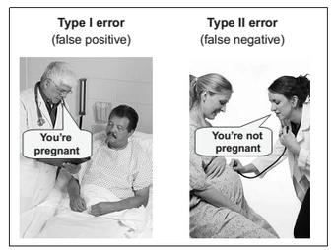
Increased statistical power
(Simmons, Nelson, & Simonsohn, 2011)
Increases precision
Guards against both false positives and false negatives
Requires resources
Notes:
Increased sample sizes and statistical power provide greater precision, and importantly guard against both false positives and false negatives. Statistical power prevents you from thinking you discovered something that is just noise, and at the same time prevents you from overlooking a true finding because you lacked the power to detect it. However, collecting large samples requires resources.

Slide 50
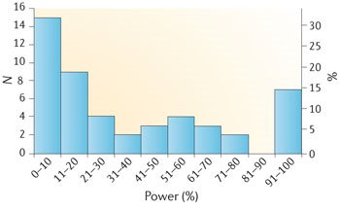
Power in neuroscience studies
(Button et al., 2013)
Median power of neuroscience studies is between 8% and 31%
Neuroimaging studies have median 8% power
Notes:
Consider that the median power of neuroimaging studies is only 8%.
Relevant links:
Power failure: why small sample size undermines the reliability of neuroscience
http://www.nature.com/nrn/journal/v14/n5/full/nrn3475.html
Caption for this figure, from Button et al. (2013): The figure shows a histogram of median study power calculated for each of the n = 49 meta-analyses included in our analysis, with the number of meta-analyses (N) on the left axis and percent of meta-analyses (%) on the right axis. There is a clear bimodal distribution; n = 15 (31%) of the meta-analyses comprised studies with median power of less than 11%, whereas n = 7 (14%) comprised studies with high average power in excess of 90%. Despite this bimodality, most meta-analyses comprised studies with low statistical power: n = 28 (57%) had median study power of less than 31%. The meta-analyses (n = 7) that comprised studies with high average power in excess of 90% had their broadly neurological subject matter in common.

Slide 51
Power in neuroscience studies
(Button et al., 2013)
Is N = 50 per cell realistic for all investigations, e.g., neuroscience ?
What about laboratories and universities with few resources?
Just an inconvenient truth?
Notes:
Is N = 50 per cell a realistic standard for all investigations, such as neuroscience studies? What about teams research where each observation requires multiple subjects? What about laboratories and universities with few resources? Is it just an inconvenient truth that underpowered studies are too noisy to draw real conclusions? (students discuss).
Relevant links:
Power failure: why small sample size undermines the reliability of neuroscience
http://www.nature.com/nrn/journal/v14/n5/full/nrn3475.html
Caption for this figure, from Button et al. (2013): The figure shows a histogram of median study power calculated for each of the n = 49 meta-analyses included in our analysis, with the number of meta-analyses (N) on the left axis and percent of meta-analyses (%) on the right axis. There is a clear bimodal distribution; n = 15 (31%) of the meta-analyses comprised studies with median power of less than 11%, whereas n = 7 (14%) comprised studies with high average power in excess of 90%. Despite this bimodality, most meta-analyses comprised studies with low statistical power: n = 28 (57%) had median study power of less than 31%. The meta-analyses (n = 7) that comprised studies with high average power in excess of 90% had their broadly neurological subject matter in common.

Slide 52
Within paper meta-analyses across smaller studies
A meta-analysis averages the results of a large number of separate investigations
You can also do a meta-analysis of the studies from a single paper
Case study: “A tale of two papers”
Notes:
Another approach is to do a small meta-analysis of all the studies from your paper. A meta-analysis typically averages the results of a large number of separate investigations. But you can also do a meta-analysis of the studies from a single paper. I would like to share a case study with you, “A tale of two papers.”

Slide 53
A Tale of Two Papers (Inzlicht, 2016)
Both received by Michael Inzlicht in his capacity as editor of The Journal of Experimental Psychology: General
“The first paper contained 7 experiments, often with outliers removed and covariates included, and reported effect sizes in the medium to large range all supporting the main hypothesis. The second paper contained 18 experiments, didn’t exclude anyone or add any covariates, and reported small effect sizes that sometimes were contrary to the hypothesis. The first paper found 7 out of 7 significant results; the second paper contained 2 significant effects out of 18.
Notes:
Two papers were received by Michael Inzlicht in his capacity as editor of The Journal of Experimental Psychology: General. He wrote a blog post about them. (Quoting from his blog post): “The first paper contained 7 experiments, often with outliers removed and covariates included, and reported effect sizes in the medium to large range all supporting the main hypothesis. The second paper contained 18 experiments, didn’t exclude anyone or add any covariates, and reported small effect sizes that sometimes were contrary to the hypothesis. The first paper found 7 out of 7 significant results; the second paper contained 2 significant effects out of 18. “
Relevant links:
A tale of two papers. http://sometimesimwrong.typepad.com/wrong/2015/11/guest-post-a-tale-of-two-papers.html

Slide 54
A Tale of Two Papers (Inzlicht, 2016)
Both received by Michael Inzlicht in his capacity as editor of The Journal of Experimental Psychology: General
“The first paper contained 7 experiments, often with outliers removed and covariates included, and reported effect sizes in the medium to large range all supporting the main hypothesis. The second paper contained 18 experiments, didn’t exclude anyone or add any covariates, and reported small effect sizes that sometimes were contrary to the hypothesis. The first paper found 7 out of 7 significant results; the second paper contained 2 significant effects out of 18. These were not two papers. They were two versions of the same paper.”
Notes:
(quoting from his blog post): “These were not two papers. They were two versions of the same paper.”
Relevant links:
A tale of two papers. http://sometimesimwrong.typepad.com/wrong/2015/11/guest-post-a-tale-of-two-papers.html

Slide 55
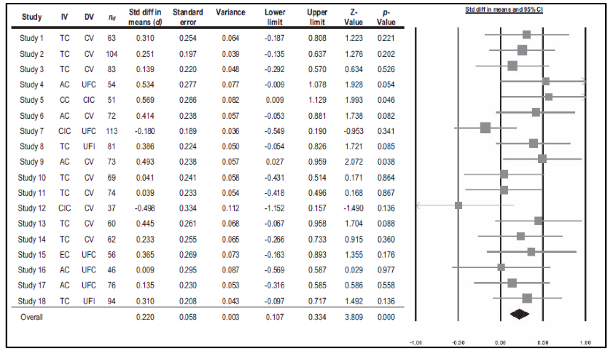
Within-paper meta-analyses across smaller studies
What do you think about this approach? Any potential downsides?
Notes:
The editor rejected the first paper because it showed signs of publication bias, specifically a high incredibility index. The authors were open about the fact they had a file drawer of weaker studies, and suggested re-submitting and presenting a within-paper meta-analyses across all of the studies. The revised paper was accepted for publication. What do you think about this approach? Any potential downsides? (instructor waits for student responses). One risk is researchers will run overly conservatives studies if everything– even pilot studies– have to be included in the final report.
Relevant links:
A tale of two papers. http://sometimesimwrong.typepad.com/wrong/2015/11/guest-post-a-tale-of-two-papers.html

Slide 56
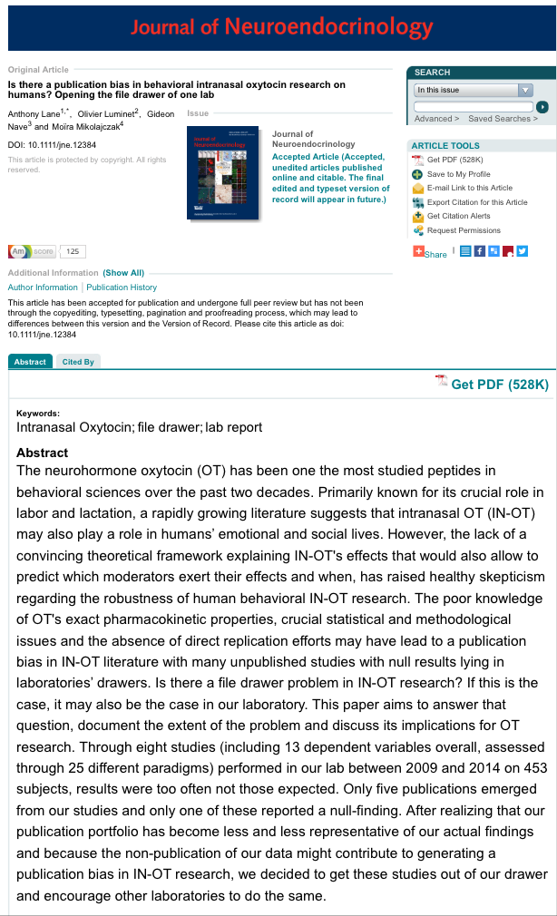
Notes:
Here is another interesting case. Oxytocin is often known as the “love drug” but there are a lot of concerns about the reliability of this subfield of research. One laboratory recently emptied its file drawer of Oxytocin research, reporting the collected null effects in a research publication. They were widely praised for doing this, even though their within-lab meta analysis overturned their prior work.
Relevant links:
Lab empties oxytocin file drawer
http://onlinelibrary.wiley.com/doi/10.1111/jne.12384/abstract?campaign=wolacceptedarticle
Coverage on Neuroskeptic blog
http://blogs.discovermagazine.com/neuroskeptic/2016/03/17/open-the-file-drawer/#.Vu6mYe0azCS
How scientists fell in and out of love with oxytocin
http://www.vox.com/2016/4/4/11348288/oxytocin-love-hormone
Sanjay S. oxytocin tweet
https://twitter.com/hardsci/status/710502718033408000

Slide 57
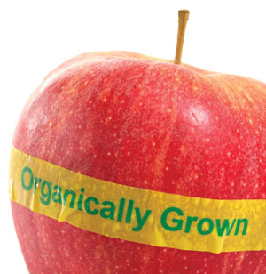
Voluntary Disclosure: The 21 Word Solution
(Simmons, Nelson, & Simonsohn, 2012)
We report how we determined our sample size, all data exclusions (if any), all manipulations, and all measures in the study.
Metaphor: Organic farmers need to disclose their products are organic
Notes:
Credit: Slide adapted from Simmons et al. presentation
Here’s a metaphor. Organic farmers advertise that their products are organic, so they can charge higher prices and justify all their efforts. If you did not use QRPs in your work. one suggestion is to advertise this so the editor and reviewers know. You could use The 21 Word Solution: “We report how we determined our sample size, all data exclusions (if any), all manipulations, and all measures in the study.”
Relevant links:
The 21 Word Solution
http://papers.ssrn.com/sol3/papers.cfm?abstract_id=2160588

Slide 58
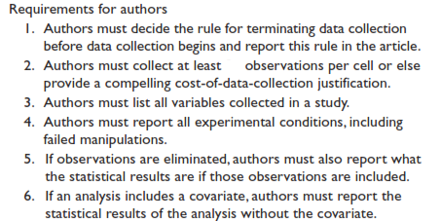
Mandatory Disclosure Rules
(Simmons, Nelson, & Simonsohn, 2011)
50
Notes:
More and more journals are adopting mandatory disclosure rules, such that you have to tell the editor, reviewers, and readers your stopping rule and whether you dropped conditions, outliers, or used covariates.

Slide 59
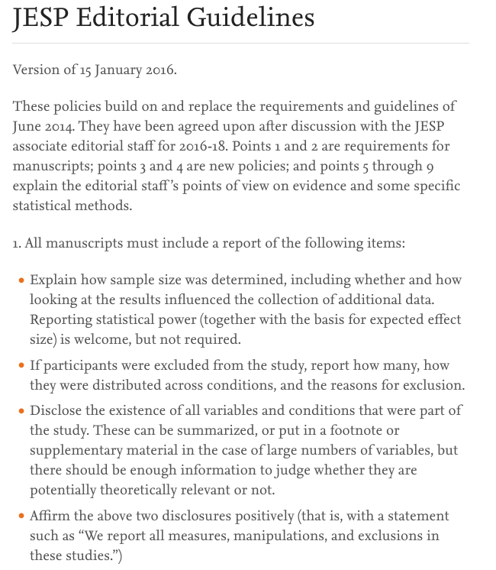
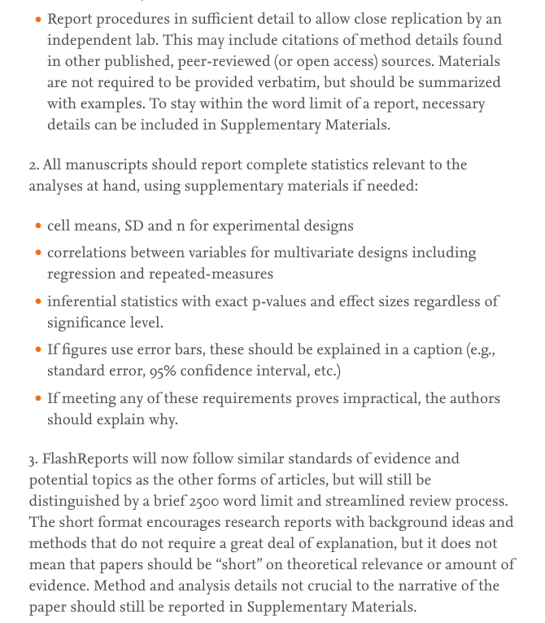
New publication guidelines at journals
Within a few years, p-hacked data may no longer be publishable
Notes:
One example is the Journal of Experimental Social Psychology. Things are changing, and within a few years, p-hacked data may no longer be publishable. But what we have at the moment is a patchwork landscape of incentives, with different policies and publication incentives at different journals.
Relevant links:
New publication standards at JESP. http://www.journals.elsevier.com/journal-of-experimental-social-psychology/news/jesp-editorial-guidelines/
Editorial on science reforms at JPSP PPID (no formal disclosure rules)
https://dl.dropboxusercontent.com/u/133567/psp_110_3_431.pdf.pdf
Simine Vazire SPPS editorial 2015
http://m.spp.sagepub.com/content/early/2015/09/29/1948550615603955.full
Simine Vazire - Getting Papers Accepted in Social/Personality Journals Post-Replicability-Crisis
https://www.youtube.com/watch?v=fDM2ZBy60f0

Slide 60
Pre-registered analysis plans
Before they collect or access the data, the researchers specify what analyses they will conduct on the dataset (Wagenmakers et al., 2012)
This plan is registered online
  Open Science Framework (https://osf.io/)
  As predicted (AsPredicted.org)
Exploratory studies can be followed by a confirmatory replication
Any issues with this approach?
Notes:
Another idea is to pre-register your analysis plan, in other words to indicate beforehand what analyses you will conduct on the dataset. This analysis plan is registered online before you collect or analyze your data. Exploratory studies that were not pre-registered can be followed by a confirmatory replication that was pre-registered. Do you see any issues or complications with this approach? (common students answers: could be too restrictive, what if you have an a priori research idea post data collection, what if you really do figure out the right analysis after collecting the data).
Relevant links:
Wagenmakers, E.-J., Wetzels, R., Borsboom, D., van der Maas, H.L.J. & Kievit, R.A. (2012). An agenda for purely confirmatory research. Perspectives on Psychological Science, 7(6), 632-638.
Full text available at: http://pps.sagepub.com/content/7/6/632.abstract, click “Full text pdf”
Blog re debating models of preregistration
http://blogs.discovermagazine.com/neuroskeptic/2015/03/13/debating-models-of-preregistration/#.VRNUd-0azCR

Slide 61
Effects of pre-registration on finding significant results
Rate of significant results for clinical trials of drugs and other supplements reduced from 57% to ??? after registration of studies required (Kaplan and Irvin, 2015)
Most hypotheses will be disconfirmed if you pre-register your analyses
Career implications?
Potential ways to incentivize pre-registration?
Notes:
What do you think happens when researchers pre-register their analysis plans before conducting their analyses? What happens to the rate of significant results? Clinical trials for drugs and other supplements report significant results 57% of the time. What about after researchers are required to pre-register their analysis plans? (students give estimates).

Slide 62
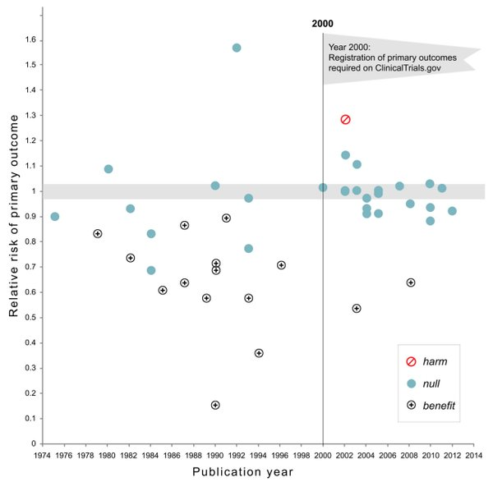
Effects of pre-registration on finding significant results
Rate of significant results for clinical trials of drugs and other supplements reduced from 57% to 8% after registration of studies required (Kaplan and Irvin, 2015)
Most hypotheses will be disconfirmed if you pre-register your analyses
Career implications?
Potential ways to incentivize pre-registration?
Notes:
After pre-registering, the rate of significant results drops from 57% to 8%.
Relevant links:
Nature story:
http://www.nature.com/news/registered-clinical-trials-make-positive-findings-vanish-1.18181
Kaplan and Irvin
http://journals.plos.org/plosone/article?id=10.1371/journal.pone.0132382

Slide 63
Effects of pre-registration on finding significant results
Rate of significant results for clinical trials of drugs and other supplements reduced from 57% to 8% after registration of studies required (Kaplan and Irvin, 2015)
Most hypotheses will be disconfirmed if you pre-register your analyses
Career implications?
Potential ways to incentivize pre-registration?
Notes:
So there is an some unfortunate professional disincentive here. Under the current incentive system, if you pre-register your analyses you will get fewer significant results, and therefore be less able to publish. How could we better incentivize pre-registration? (students give ideas).
Relevant links:
Nature story:
http://www.nature.com/news/registered-clinical-trials-make-positive-findings-vanish-1.18181
Kaplan and Irvin
http://journals.plos.org/plosone/article?id=10.1371/journal.pone.0132382

Slide 64
Registered Reports
Journal reviews the paper’s methods before data is collected, and conditionally accepts the paper before the study is run
Address both publication bias and questionable research practices
Notes:
One idea is the registered report: the journal reviews the paper’s methods before data is collected, and conditionally accepts the paper before the study is run. This removes the perverse incentive to get significant findings.
Relevant links:
Chambers (2014)
Registered Reports: A step change in scientific publishing
https://www.elsevier.com/reviewers-update/story/innovation-in-publishing/registered-reports-a-step-change-in-scientific-publishing
Chambers (2014) Psychology’s ‘registration revolution’
https://www.theguardian.com/science/head-quarters/2014/may/20/psychology-registration-revolution
Nosek, B.A., & Lakens, D. (2014). Registered reports: A method to increase the credibility of published results. Social Psychology, Vol 45(3), 2014, 137-141.
Full text available at http://psycnet.apa.org/journals/zsp/45/3/137/, click “Full text pdf”
Also available here: https://osf.io/vwfk2/

Slide 65
Registered Reports
Design
Collect & Analyze
Report
Publish
PEER
REVIEW
Notes:
Credit: Slide from Bowman open science presentation
A registered report shifts the traditional location of peer review. (click “next” to activate first animation). Specifically, peer review is shifted from right before publication (click “next” to activate second animation) to before data is collected and analyzed. Publication occurs regardless of outcome and negative results are now perfectly publishable. Peer review now focuses on quality of the idea and methods, not whether the findings are p < .05.

Slide 66

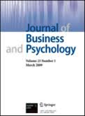
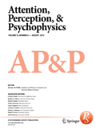
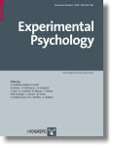
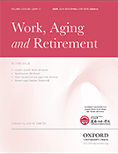

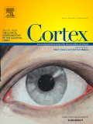
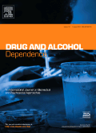


Who Publishes Registered Reports?
(just to name a few)
See the full list and compare features: osf.io/8mpji
Notes:
Credit: Slide and script from Bowman open science presentation
So.. who publishes registered reports? Here’s a partial (and growing!) list. You can view the complete list on the Registered Reports project page on the Open Science Framework. There’s even a table comparing features of Registered Reports across journals.

Slide 67
Potential problems with Registered Reports?
Notes:
Do you see any potential problems with the Registered Reports approach? (students give answers).

Slide 68
Potential problems with Registered Reports?
Reduced incentive to execute the study well if publication already guaranteed
What if odd and unexpected patterns of data turn up? Peer review phase is already over
  This issue will come again next lecture, in the Simone Schnall replication case
Incentivizes coming up with interesting ideas that find no empirical support
Notes:
One concern is there could be reduced incentive to execute the study well if a publication is already practically guaranteed. Or what if the study is run and odd and unexpected patterns of data turn up? The independent peer review phase is already over. Another danger of registered reports is that they could incentivize coming up with interesting but flaky ideas that find never find any empirical support.

Slide 69
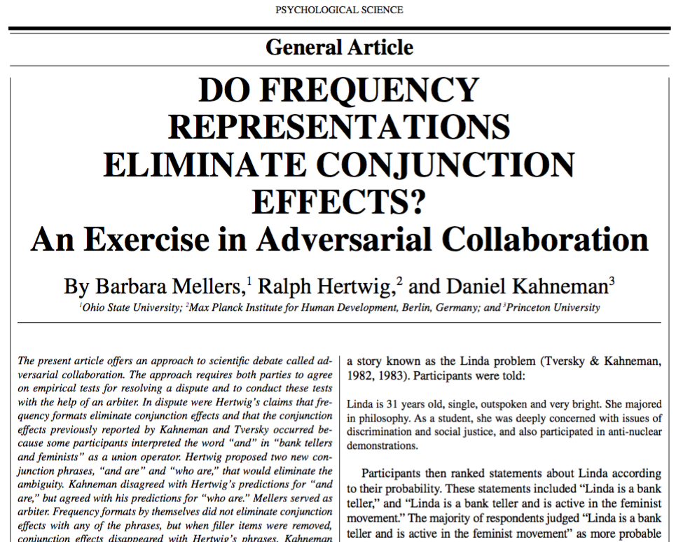
Have you heard of an adversarial collaboration?
Notes:
Have you heard of an adversarial collaboration? (students respond).

Slide 70
Adversarial Collaborations
(Meller, Hertwig, & Kahneman, 2001)
Researchers who disagree on an issue design a critical empirical test together
Publish the results together regardless of the results
An independent arbiter is also part of the research group
Notes:
In an adversarial collaboration, researchers who disagree on an issue design a critical empirical test together, and publish the results as co-authors regardless of the results. This is something you could consider doing in the future if you have a persistent theoretical disagreement with another researcher or research group.
Relevant links:
Mellers, B., Hertwig, R., & Kahneman. D. (2001). Do frequency representations eliminate conjunction effects? An exercise in adversarial collaboration. Psychological Science. Full text:
http://www.researchgate.net/profile/Barbara_Mellers/publication/11866879_Do_frequency_representations_eliminate_conjunction_effects_An_exercise_in_adversarial_collaboration/links/00b7d517b15fd87659000000.pdf
Another example of an adversarial collaboration
http://www.ejwagenmakers.com/submitted/DMatzke_EyeMovements.pdf
Neuroskeptic on adversarial collaboration
http://blogs.discovermagazine.com/neuroskeptic/2015/01/28/team-rivals-science-adversarial-collaboration/#.VMoi6u0azCS

Slide 71
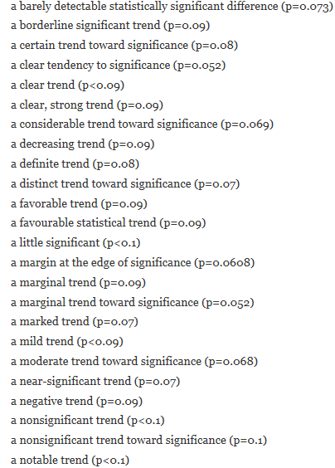
Descriptions of nonsignificant results in articles using
Null Hypothesis Significance Testing (NHST)
Notes:
These descriptions of nonsignificant results in articles using null hypothesis significance testing show the power of motivated reasoning and the clear goal on the part of the researchers to get effects they can call significant (instructor reads quotes in red box on left).
Relevant links:
Still Not Significant
https://mchankins.wordpress.com/2013/04/21/still-not-significant-2/
Tweet by Justin Wolfers
https://mobile.twitter.com/JustinWolfers/status/590918742999175169/photo/1

Slide 72
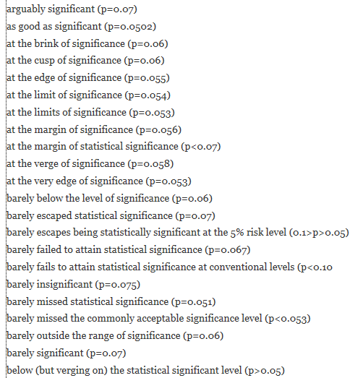
Descriptions of nonsignificant results in articles using
Null Hypothesis Significance Testing (NHST)
Notes:
Here are some more examples. (instructor reads quotes in red box on right).
Relevant links:
Still Not Significant
https://mchankins.wordpress.com/2013/04/21/still-not-significant-2/
Tweet by Justin Wolfers
https://mobile.twitter.com/JustinWolfers/status/590918742999175169/photo/1

Slide 73
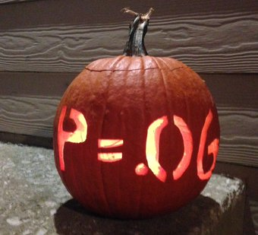
Notes:
Here is a researcher’s Halloween pumpkin: a p = .06 effect!
Relevant links:
p = .06 Halloween pumpkin
https://mobile.twitter.com/joshdeleeuw/status/660611559136370689

Slide 74

Video: Scientists can't explain p values (play off website)
http://fivethirtyeight.com/features/not-even-scientists-can-easily-explain-p-values/
Notes:
Despite the fact that our professional outcomes hinges on p-values, we often don’t truly understand them. (instructor plays video in the link below).
Scientists can't explain p values
http://fivethirtyeight.com/features/not-even-scientists-can-easily-explain-p-values/
Relevant links:
Probability of a false positive even when you have a significant p value (interactive website)
http://www.nicebread.de/whats-the-probability-that-a-significant-p-value-indicates-a-true-effect/

Slide 75
Moving away from p values
Focus on effect sizes, confidence intervals, and cumulative meta-analyses instead of NHST (Cumming, 2013, “The new statistics”)
New position statement from the American Statistical Association
Bayesian approaches can quantify evidence both for and against the hypothesis (Verhagen & Wagenmakers, 2014)
Notes:
Another potential solution to publication bias and QRPs is to move away from p values. We could focus on effect sizes, confidence intervals, and cumulative meta-analyses instead of null hypothesis significance testing. Geoff Cumming calls this “The New Statistics”
Note: The journal Basic and Applied Social Psychology (BASP) banned p values in 2016
Relevant links:
Video of Cumming talk on the new statistics
https://www.youtube.com/watch?v=iJ4kqk3V8jQ
Cumming, G. (2013). The new statistics: Why and how. Psychological Science, 25, 7-29.
Full text available at: http://pss.sagepub.com/content/25/1/7, just click “Full text pdf”
Statisticians Found One Thing They Can Agree On: It’s Time To Stop Misusing P-Values
http://fivethirtyeight.com/features/statisticians-found-one-thing-they-can-agree-on-its-time-to-stop-misusing-p-values/
Quote from 538 piece: “One of the most important messages is that the p-value cannot tell you if your hypothesis is correct. Instead, it’s the probability of your data given your hypothesis.”
http://fivethirtyeight.com/features/statisticians-found-one-thing-they-can-agree-on-its-time-to-stop-misusing-p-values/

Slide 76

Group Discussion
The crisis of confidence and early career researchers (ECRs)
Notes:
Now I would like to talk a bit about what the crisis of confidence means for early career researchers like yourselves. You are often called “ECRs” for short.

Slide 77

Less than a third of PhDs in social sciences and
less than 25% across all fields find a professorship or postdoc
Notes:
What percentage of PhDs do you think land a postdoc or professorship?

Slide 78
Less than a third of PhDs in social sciences and
less than 25% across all fields find a professorship or postdoc
Notes:
Less than a third of PhDs in social sciences and less than 25% across all fields find a professorship or postdoc. And this does NOT include doctoral students who didn’t make it through their PhD program!
Relevant links:
Weissman (2016)
How Many Ph.D.'s Actually Get to Become College Professors?
http://www.theatlantic.com/business/archive/2013/02/how-many-phds-actually-get-to-become-college-professors/273434/
Over 90% of graduate students who obtain an academic position do so at a school ranked lower than their PhD institution
http://www.slate.com/articles/life/education/2015/02/university_hiring_if_you_didn_t_get_your_ph_d_at_an_elite_university_good.html

Slide 79

Pressure to Publish
Notes:
There is a strong pressure to publish that can be overwhelming for young scientists (instructor reads caption on the cartoon).

Slide 80

Pressure to Publish
Notes:
And the publication process itself can be grueling, as shown here (instructor reads captions on the DeCaprio images).

Slide 81

Notes:
The reviews often torture your papers beyond recognition, as seen above. (instructor reads tweet).
Relevant links:
Your paper, after reviewer 3 asked for improvements to the manuscript:
https://twitter.com/DevilleSy/status/624184933154693121

Slide 82

Notes:
A recent anonymous survey of young researchers at the MD Anderson Cancer Center found that (instructor reads quote from slide) “nearly one-third had felt pressure to prove a mentor's hypothesis even though their experimental results did not support it, and nearly one-fifth had themselves published results they considered less than robust”.
Relevant links:
Robust research: Institutions must do their part for reproducibility
http://www.nature.com/news/robust-research-institutions-must-do-their-part-for-reproducibility-1.18259?WT.mc_id=TWT_NatureNews

Slide 83

Notes:
To be a good scientist, you should be skeptical, interpret the evidence carefully, publish negative results, and double-check everything. But to be in successful academic, you need to sell your findings, publish in the right places, and avoid getting scooped.
Relevant links:
Blog post: Goals of science vs Goals of scientists (& a love letter to PLOS One)
http://socialbat.org/2015/08/12/goals-of-science-vs-goals-of-scientists-a-love-letter-for-plos-one/
Blog post: “Crossroads of an early career researcher: Choosing what is important”
http://xeniaschmalz.blogspot.sg/2016/02/crossroads-of-early-career-researcher.html
Blog about working hours in academia, from an early career researcher
http://www.jolij.com/?p=399

Slide 84
How do you feel about all this as early career
researchers?
Write down notes
(2 mins)
Discuss w. neighbour
(5 mins)
Share with class
Write down thoughts
for yourself
Discuss with your
neighbour – exchange
thoughts
Share with others
Notes:
Now I would like you to take two minutes to write down some notes quietly by yourselves: How do you feel about all this as early career researchers? (instructor gives students 2 minutes to write quietly). Ok! Now I would like you to discuss your thoughts with your neighbor, get some feedback and refine them. (instructor gives students 5 minutes to discuss with neighbor). Ok, time’s up! Let’s hear some reactions from each pair of students. (students share some of their reactions and the class discusses).

Slide 85
Take-Aways:
The Crisis of Confidence in Science
Questionable research practices (QRPs) and publication bias are widespread and undermine the reliability of the scientific literature
  Much bigger (and quieter) problem than outright fraud
Perverse incentives for academics to publish in prestigious journals are the root of the problem
  Incentive structure is changing, but slowly
Challenge for early career researchers (ECRs)
Notes:
Some take-aways from our lecture on “The Crisis of Confidence in Science.” Questionable research practices (QRPs) and publication bias are widespread and undermine the reliability of the scientific literature. They are a much bigger and more pervasive problem than isolated instances of outright fraud. Perverse incentives for academics to publish in prestigious journals rather than pursue truth are the root cause. This incentive structure is changing, but slowly, which presents a huge challenge for early career researchers (ECRs) who need to make big decisions about how they will do their research and plan their career strategies. Lots to think about. Thank you so much for coming, and see you again soon.

Slide 87

Notes:
Before we do anything else please take 5 minutes or so to remember what you learnt in our last session on The Crisis of Confidence in Science. It doesn’t have to be what we taught you, but something that YOU learnt personally, what did YOU take out of the last class? We’re doing this because this is a GREAT RETURN ON INVESTMENT: we’re spending 5 minutes on this now so you don’t lose the last few hours we spent together. (students quietly write down their take-aways from the previous lecture). Ok, let’s share some take-aways (students share what they took away from the session).

