Slide 1
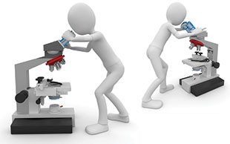
The Replication Revolution
Martin Schweinsberg,
Neil Bearden, & Eric Luis Uhlmann
INSEAD
Notes:
Today we will talk about “The Replication Revolution,” the movement to independently repeat research studies in other laboratories.

Slide 2
Direct vs. Conceptual Replications?
Notes:
Who knows the distinction between direct replications and conceptual replications? (students answer).

Slide 3
Direct vs. Conceptual Replications?
Conceptual replication: The same hypothesis is tested but with new materials
  Common practice, e.g., in most multi-study papers
  Demonstrates generalizability
Direct replication: The same study materials and protocol are used in a new subject population
  Uncommon practice until recently
  Rule out false positives
In this class, when we say just “replication”
we mean a direct replication
Notes:
In a conceptual replication, the same hypothesis is tested but with new materials. Same idea, new method, to show generalizability. This is common practice, we see it in practically all multi-study papers. In contrast, there has been little focus on direct replications until recently. Here the same study materials and protocol are used in a new subject population. If the study does not work in the new laboratory, it raises the possibility the original finding is a false positive. A note on terminology: in this class, when we say just “replication” we mean a direct replication. The replication revolution is about direct replications, not conceptual replications.
Note: Ideally students should have come up with these points themselves in the preceding discussion.

Slide 4

Direct Replications and the Crisis of Confidence
High profile replication failures of published studies
  Individual replication studies
  Crowdsourced replications of numerous studies
The reliability of even previously well-established findings now in question
Notes:
Direct replications have played a huge role in the crisis of confidence in science. We have seen high profile replication failures of published studies, findings that were in introductory textbooks and everyone’s lectures. These have occurred in two contexts: first, cases in which individual labs have failed to replicate each others’ work, and second, cases in which large crowdsourced projects involving dozens of laboratories systematically failed to replicate findings. Because of this replication revolution, the reliability of previously well-established findings, even some foundational findings, is now in question.

Slide 5
Frequency of direct replications
(Makel, Plucker & Hegarty, 2012)
Study of top 100 psychology journals
Examined complete publication history
What percentage of articles do you think were direct replications?
Notes:
A student was done of the top 100 psychology journals examining their complete publication history. What percentage of papers do you think reported direct replications of a finding from another research group? (students estimate).

Slide 6
Frequency of direct replications
(Makel, Plucker & Hegarty, 2012)
Study of top 100 psychology journals
Examined complete publication history
What percentage of articles do you think were direct replications?
Only 1.07% of all published articles contained replications
Notes:
Only 1%.

Slide 7
Standard Science Model
One laboratory conducts the study and publishes a paper with limited number of authors
Default is private data, and data-sharing is rare
Highly vulnerable to perverse incentive to publish in top journals (Lecture 1)
  Questionable research practices (QRPs)
  Publication bias
Notes:
Practically all research is conducted in the context of what you might call the "standard science" model. One research team conducts a study that is typically underpowered and publishes a paper with limited number of authors. The default is private data, and data-sharing is rare. This approach is highly vulnerable to perverse incentive to publish in top journals, as we discussed in our opening lecture on publication bias and questionable research practices.

Slide 8

Crowdsourced Science Model
Multiple labs combine resources for one huge investigation with numerous authors
Data publicly posted on the internet for further re-analysis
Facilitates transparency and reproducibility
But also has shortcomings (more on that later)
Notes:
An alternative approach is the crowdsourced science model, in which many labs combine resources for one huge investigation with numerous authors. The data is publicly posted on the internet for further re-analyses, which facilitates transparency and reproducibility. Like most things in life, the crowdsourcing approach comes with its own shortcomings, which we will discuss in greater depth shortly. Many crowdsourced projects are run through Brian Nosek’s Center for Open Science at the University of Virginia.

Slide 9
Crowdsourced Replication Projects
Numerous laboratories attempt to replicate findings
Many Labs approach: small set of original studies replicated across numerous laboratories
  Many Labs initiatives by the Center for Open Science
  Registered Replication Reports (RRRs) at Perspectives on Psychological Science
Each original effect is replicated by a single independent laboratory
  Reproducibility Project by the COS: About 100 labs each attempt to replicate one finding from JPSP, PS, and JEP:LMC from 2008
  Similar initiatives
Notes:
In crowdsourced replication projects, numerous laboratories attempt to replicate findings. A small team of project coordinators handles the logistics. So far we have seen two basic types of crowdsourced replication initiatives. The first type is the “Many Labs” approach, in which a small set of original studies is replicated across numerous laboratories. The combined sample sizes across laboratories can be huge, which radically increases statistical power and should theoretically reduce both false positive and false negative errors. The Many Labs approach can tell us a lot about how robust the original finding is. The second type is the “Reproducibility Project” approach, in which each original effect is replicated by a single independent laboratory. This tells us a lot less about whether each individual finding is true, but gives us some information about the overall reproducibility of a scientific field or subfield.

Slide 10
Studies Fail to Replicate for Many Reasons
Human populations highly heterogeneous
  Cultural and sub-cultural differences in social phenomena
  Materials carefully pre-tested in the original population may be less suited to replication sample
Small samples are noisy and p < .05 is a low evidentiary threshold
Expecting a significant effect in Population A to replicate in Populations B, C, D, E, F may be expecting something experimental research cannot deliver
  Failed replications do not mean original authors used QRPs
Notes:
It is important to emphasize that studies can fail to replicate for many reasons. Human populations are highly heterogeneous, and failed replications could just reflect cultural and sub-cultural differences in the phenomenon in question. It can also be the case that materials carefully pre-tested in the original population are less suited to replication sample. With regard to the original investigation, small samples are noisy and p < .05 is a low evidentiary threshold. Expecting a significant effect in Population A to consistently replicate in Populations B, C, D, and so on may be expecting something the standard science model cannot effectively deliver. Very importantly, failed replications do not mean the original authors used questionable research practices which has sometimes been the implicit or explicit suggestion.

Slide 11
ManyLabs 1 Results (Klein et al., 2013)
  13 published papers replicated across 36 laboratories
Notes:
In the ManyLabs 1 initiative, 36 laboratories attempted to replicate 13 published papers. How many do you think replicated? (students give estimates).

Slide 12
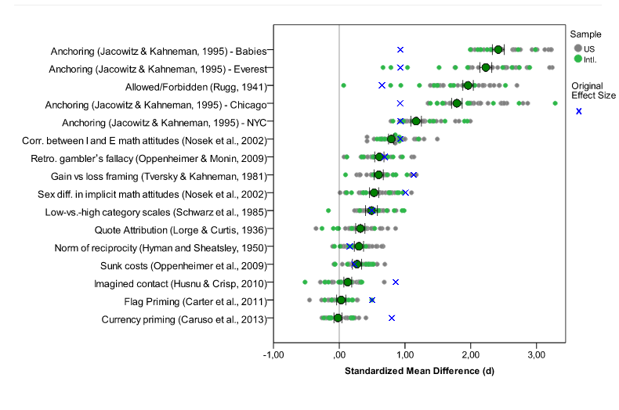
ManyLabs 1 Results (Klein et al., 2013)
  13 published papers replicated across 36 laboratories
Notes:
All but two of the original findings replicated reliably across laboratories.
Relevant links:
Klein et al., (2014). Investigating variation in replicability: A "many labs" replication project. Social Psychology, 45(3), 142–152.
Full text available open access here, http://psycnet.apa.org/journals/zsp/45/3/142/, just click on “Full Text pdf”

Slide 13
ManyLabs 3 Results (Ebersole et al., 2013)
  10 published papers replicated across 20 laboratories
Notes:
In the ManyLabs 3 initiative, 20 laboratories attempted to replicate 10 published papers. How many do you think replicated? (students give estimates).

Slide 14
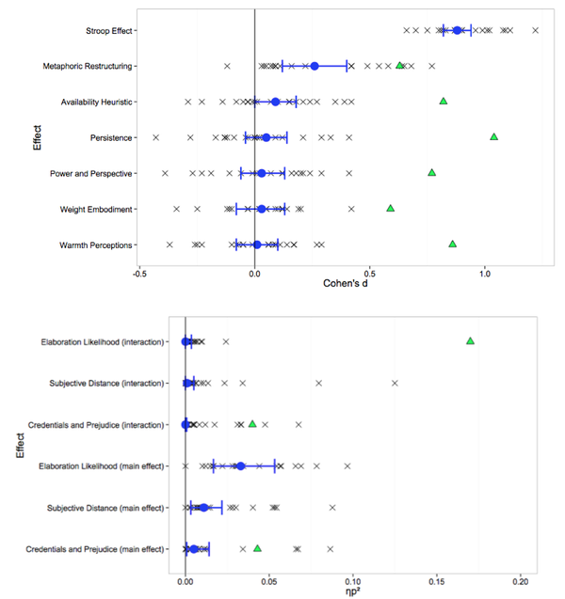
ManyLabs 3 Results (Ebersole et al., 2013)
  10 published papers replicated across 20 laboratories
Notes:
Only three out of ten this time. Remember the number of original studies is small in these projects, so you shouldn’t generalize their replication rates too far.

Slide 15
Registered Replication Reports
Initiative at Perspectives on Psychological Science
Numerous independent laboratories attempt to replicate a single published study of high interest to the field
Published as a special Replication Report in the journal
Notes:
Have you heard of Registered Replication Reports? (students answer). This is an initiative at Perspectives on Psychological Science, one of the field’s top journals. Numerous independent laboratories attempt to replicate a single published study of very high interest to the field.
Relevant links:
The value of direct replication: full text
http://www3.nd.edu/~ghaeffel/Value.pdf

Slide 16
RRR: verbal overshadowing
Original study found that verbally describing stimuli impairs subsequent recognition of the stimuli (Schooler & Engstler-Schooler, 1990 )
Cited over 700 times
Attempted replication across over 20 laboratories (Alogna et al., 2014)
Notes:
The first Registered Replication Report, or RRR for short, focused on verbal overshadowing. This is the well known finding that verbally describing something makes it more difficult to recognize it later. Jonathan Schooler, the first author on the original paper, had in subsequent years failed to replicate his own finding and was wondering how robust the effect really was. In the RRR, 20 independent laboratories attempted to replicate the original verbal overshadowing effect.
Relevant links:
Original Schooler & Engstler-Schooler paper
http://www.sciencedirect.com/science/article/pii/001002859090003M

Slide 17
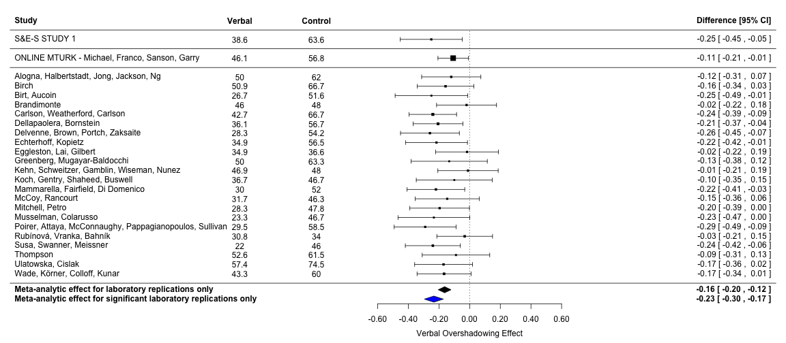
RRR results: Verbal overshadowing
Statistically significant effect!
But much smaller effect size than in original paper
Notes:
The RRR found a verbal overshadowing effect that was statistically significant, but much smaller than in original paper.
Relevant links:
Alogna et al. (2014). Registered Replication Report: Schooler and Engstler-Schooler (1990)
Full text available open access here, http://pps.sagepub.com/content/9/5/556.full, just click on “Full Text pdf”

Slide 18
RRR: language and intentionality
Actions described using imperfective aspect (i.e., what a person was doing) seen as more intentional than when perfective aspect is used (i.e., what a person did) (Hart & Albarracín, 2011)
Attempted replication across 12 independent laboratories
Notes:
The second Registered Replication Report looked at the effects of language use on perceived intentionality. Twelve independent laboratories attempted to replicate the original finding that using the imperfective aspect to describe an action (what a person was doing) leads the act to be seen as more intentional than when the perfective aspect is used (what a person did).
Relevant links:
Full text of the RRR report in POPS
http://m.pps.sagepub.com/content/11/1/158.full
Linguistic Cues and Firing Guns: Some Background on a Registered Replication Report
http://rolfzwaan.blogspot.nl/2016/01/linguistic-cues-and-firing-guns-some.html

Slide 19
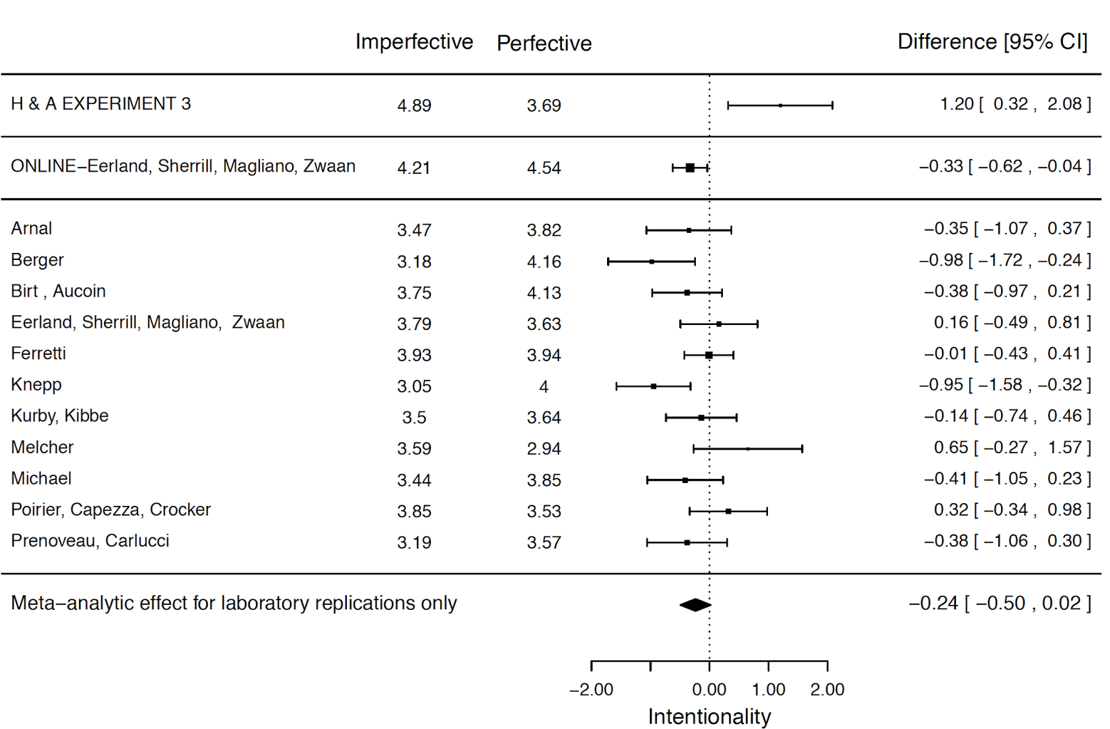
RRR results: Language and intentionality
No significant effect
Not in same direction as original finding
Notes:
The RRR found nothing in this case. The meta-analyzed effect size estimate across the twelve independent laboratories is not in the same direction as the original study.
Relevant links:
RRR: language and intentionality
http://pps.sagepub.com/content/11/1/158.short?rss=1&ssource=mfr

Slide 20
RRR for ego depletion
Famous finding that exerting self control on an initial task reduces ability to engage in self control on a later task (Baumeister et al., 1998)
Original paper cited over 3000 times as of 2016 and led to scores of follow-up studies
Meta-analysis of 83 published studies found robust effect (Hagger et al., 2010)
Critique argued the studies underpowered and showed evidence of publication bias (Carter & McCullough, 2014)
Notes:
The RRR for ego depletion has received by far the most attention so far. Ego depletion is the famous finding that exerting self control on an initial task (for example, trying not to laugh at funny cartoons) reduces ability to engage in self control on a later task (for example, squeezing a handgrip). The original ego depletion paper has been cited over 3000 times and led to scores of follow-up studies. Although a meta-analysis of 83 published studies concluded a robust effect, a critique and re-analysis suggested ego depletion effects are mostly just publication bias. The RRR was meant to empirically adjudicate between these two perspectives.
Relevant links:
Hagger et al
http://archive.is/aK7Vn
Carter, E.C., & McCullough, M.E. (2014). Publication bias and the limited strength model of self-control: has the evidence for ego depletion been overestimated? Frontiers in Psychology.
Full text: http://journal.frontiersin.org/article/10.3389/fpsyg.2014.00823/full

Slide 21
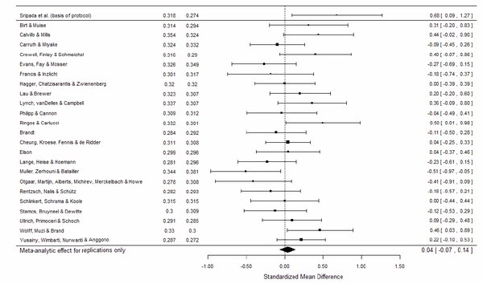
Ego depletion RRR (Alberts et al., 2016)
Notes:
And here are the results. No significant ego depletion effect across 24 laboratories.
Relevant links:
Ego depletion RRR
http://www.psychologicalscience.org/index.php/publications/rrr-the-ego-depletion-paradigm
Baumeister and Vohs response to ego depletion RRR
http://www.psychologicalscience.org/redesign/wp-content/uploads/2016/03/RRR-comment-BaumeisterVohs-revised-March17-002.pdf
R Index blog response to Baumeister and Vohs
https://replicationindex.wordpress.com/2016/03/26/open-ego-depletion-replication-initiative/
The reduction of ego depletion
http://m.huffpost.com/us/entry/the-reduction-of-egodeple_b_9554874.html

Slide 22
Reproducibility Project: Psychology
100 published studies adopted by 100 individual replication labs
Alexander A. Aarts, Nuenen, the Netherlands; Christopher J. Anderson, Southern New Hampshire University; Joanna E. Anderson, Defence Research and Development Canada; Peter R. Attridge, Mercer School of Medicine, Georgia Gwinnett College; Angela Attwood, University of Bristol; Jordan Axt, University of Virginia; Molly Babel, University of British Columbia; Štěpán Bahník, University of Würzburg; Erica Baranski, University of California, Riverside; Michael Barnett-Cowan, University of Waterloo; Elizabeth Bartmess, University of California, San Francisco; Jennifer Beer, University of Texas at Austin; Raoul Bell, Heinrich Heine University Düsseldorf; Heather Bentley, Georgia Gwinnett College; Leah Beyan, Georgia Gwinnett College; Grace Binion, University of Oregon, Georgia Gwinnett College; Denny Borsboom, University of Amsterdam; Annick Bosch, Radboud University Nijmegen; Frank A. Bosco, Virginia Commonwealth University; Sara D. Bowman, Center for Open Science; Mark J. Brandt, Tilburg University; Erin Braswell, Center for Open Science; Hilmar Brohmer, Tilburg University; Benjamin T. Brown, Georgia Gwinnett College; Kristina Brown, Georgia Gwinnett College; Jovita Brüning, Humboldt University of Berlin, Charité - Universitätsmedizin Berlin; Ann Calhoun-Sauls, Belmont Abbey College; Shannon P. Callahan, University of California, Davis; Elizabeth Chagnon, University of Maryland; Jesse Chandler, University of Michigan; Christopher R. Chartier, Ashland University; Felix Cheung, Michigan State University, University of Hong Kong; Cody D. Christopherson, Southern Oregon University; Linda Cillessen, Radboud University Nijmegen; Russ Clay, College of Staten Island, City University of New York; Hayley Cleary, Virginia Commonwealth University; Mark D. Cloud, Lock Haven University; Michael Cohn, University of California, San Fransisco; Johanna Cohoon, Center for Open Science; Simon Columbus, University of Amsterdam; Andreas Cordes, University of Göttingen; Giulio Costantini, University of Milan-Bicocca; Leslie D. Cramblet Alvarez, Adams State University; Ed Cremata, University of Southern California; Jan Crusius, University of Cologne; Jamie DeCoster, University of Virginia; Michelle A. DeGaetano, Georgia Gwinnett College; Nicolás Della Penna, Australian National University; Bobby den Bezemer, University of Amsterdam; Marie K. Deserno, University of Amsterdam; Olivia Devitt, Georgia Gwinnett College; Laura Dewitte, University of Leuven; David G. Dobolyi, University of Virginia; Geneva T. Dodson, University of Virginia; M. Brent Donnellan, Texas A & M; Ryan Donohue, Elmhurst College; Rebecca Dore, University of Virginia; Angela Dorrough, University of Siegen, Max Planck Institute for Research on Collective Goods; Anna Dreber, Stockholm School of Economics; Michelle Dugas, University of Maryland; Elizabeth W. Dunn, University of British Columbia; Kayleigh Easey, Bristol University; Sylvia Eboigbe, Georgia Gwinnett College; Casey Eggleston, University of Virginia; Jo Embley, University of Kent; Sacha Epskamp, University of Amsterdam; Timothy M. Errington, Center for Open Science; Vivien Estel, University of Erfurt; Frank J. Farach, University of Washington, Prometheus Research; Jenelle Feather, Massachusetts Institute of Technology; Anna Fedor, Parmenides Center for the Study of Thinking; Belén Fernández, Universidad Complutense de Madrid; Susann Fiedler, Max Planck Institute for Research on Collective Goods; James G. Field, Virginia Commonwealth University; Stanka A. Fitneva, Queen's University; Taru Flagan, University of Texas, Austin; Amanda L. Forest, University of Pittsburgh; Eskil Forsell, Stockholm School of Economics; Joshua D. Foster, University of South Alabama; Michael C. Frank, Stanford University; Rebecca S. Frazier, University of Virginia; Heather Fuchs, University of Cologne; Philip Gable, University of Alabama; Jeff Galak, Carnegie Mellon University; Elisa Maria Galliani, University of Padua; Anup Gampa, University of Virginia; Sara Garcia, Universidad Nacional De Asunción; Douglas Gazarian, Bard College; Elizabeth Gilbert, University of Virginia; Roger Giner-Sorolla, University of Kent; Andreas Glöckner, University of Göttingen, Max Planck Institute for Research on Collective Goods; Lars Goellner, University of Siegen; Jin X. Goh, Northeastern University; Rebecca Goldberg, Mississippi State University; Patrick T. Goodbourn, University of Sydney; Shauna Gordon-McKeon, Hampshire College; Bryan Gorges, Center for Open Science; Jessie Gorges, Center for Open Science; Justin Goss, Colorado State University-Pueblo; Jesse Graham, University of Southern California; James A. Grange, Keele University; Jeremy Gray, Michigan State University; Chris Hartgerink, Tilburg University; Joshua Hartshorne, Massachusetts Institute of Technology; Fred Hasselman, Radboud University Nijmegen, School of Pedagogy and Educational Science & Behavioural Science Institute: Learning and Plasticity; Timothy Hayes, University of Southern California; Emma Heikensten, Stockholm School of Economics; Felix Henninger, University of Koblenz-Landau, Max Planck Institute for Research on Collective Goods; John Hodsoll, NIHR Biomedical Research Centre for Mental Health at the South London, Maudsley NHS Foundation Trust, King's College London; Taylor Holubar, Stanford University; Gea Hoogendoorn, Tillburg University; Denise J. Humphries, Georgia Gwinnett College; Cathy O.-Y. Hung, University of Hong Kong; Nathali Immelman, University of Winchester; Vanessa C. Irsik, University of Nevada, Las Vegas; Georg Jahn, University of Lübeck; Frank Jäkel, University of Osnabrück; Marc Jekel, University of Göttingen; Magnus Johannesson, Stockholm School of Economics; David J. Johnson, Michigan State University; Kate M. Johnson, University of Southern California; Larissa G. Johnson, University of Birmingham; William J. Johnston, University of Chicago; Kai Jonas, University of Amsterdam; Jennifer A. Joy-Gaba, Virginia Commonwealth University; Heather Barry Kappes, London School of Economics and Political Science; Kim Kelso, Adams State University; Mallory C. Kidwell, Center for Open Science; Seung Kyung Kim, Stanford University; Matthew Kirkhart, Loyola University Maryland; Bennett Kleinberg, University College London, University of Amsterdam; Goran Knežević, University of Belgrade; Franziska Maria Kolorz, Radboud University Nijmegen; Jolanda J. Kossakowski, University of Amsterdam; Robert Wilhelm Krause, University of Nijmegen; Job Krijnen, Tillburg University; Tim Kuhlmann, University of Konstanz; Yoram K. Kunkels, University of Amsterdam; Megan M. Kyc, Lock Haven University; Calvin K. Lai, University of Virginia
Notes:
Credit: Slide from Nosek presentation, posted on OSF
As noted earlier, in the second type of crowdsourced replication project, a large number of individual labs each attempt to replicate one original finding. The idea is to get an overall estimate of the replicability rate in a scientific field or subfield. The most well known example of this approach is the Reproducibility Project: Psychology from the Center for Open Science.
Relevant links:
Estimating the reproducibility of psychological science
http://science.sciencemag.org/content/349/6251/aac4716.full

Slide 23
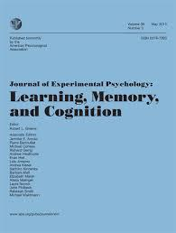
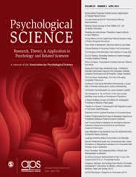

Reproducibility Project: Psychology
Sampling frame, 2008 issues of
JEP:LMC
PSCI
JPSP
Open Science Collaboration, 2015
Notes:
Credit: Slide from Nosek presentation, posted on OSF
100 laboratories attempted to replicate 100 original studies published in 2008 in three major journals. Replicators chose a study to replicate from a long list of articles from these journals in that year. That not all of the available studies were selected for replication and that replicators were allowed to chose which study they wanted to replicate would be the basis for later critiques. We will get to the critiques later, first I want to share the results with you.

Slide 24
How many original findings do you think replicated?
Notes:
How many original findings do you think replicated, in that the replication effect was p < .05 like the original effect was?
Relevant links:
Estimating the reproducibility of psychological science
http://science.sciencemag.org/content/349/6251/aac4716.full
Scholarly kitchen on minute differences in procedure affecting replication results
http://scholarlykitchen.sspnet.org/2014/03/26/reproducible-research-a-cautionary-tale/

Slide 25
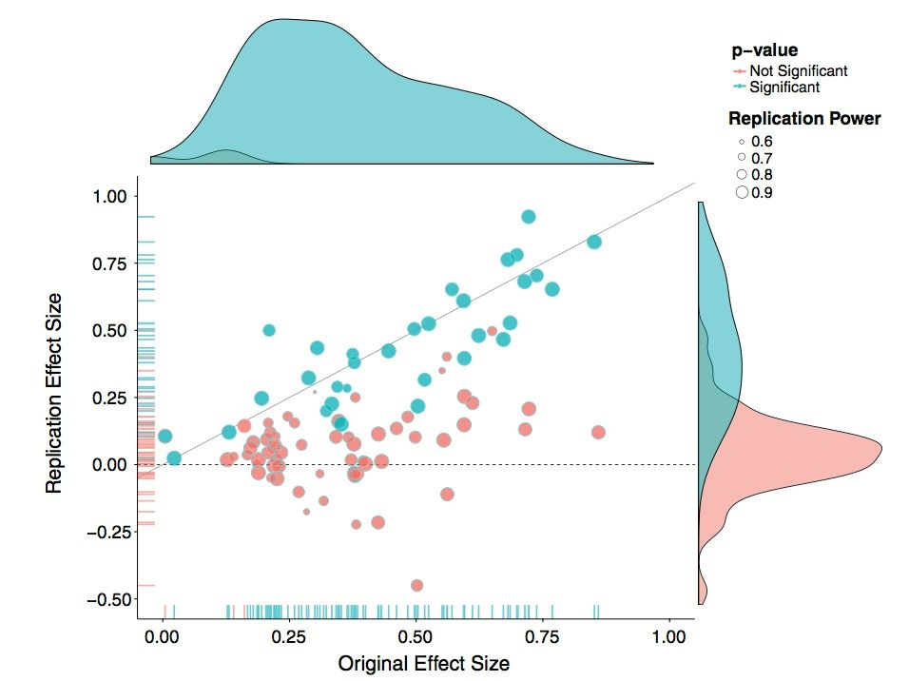
Reproducibility Project Results
37% of original effects replicate at p < .05 level
Notes:
Only 37% of the original effects replicated at the p < .05 level.
Relevant links:
Baker, M. (2015). First results from psychology’s largest reproducibility test: Crowd-sourced effort raises nuanced questions about what counts as replication.
Full text available at: http://www.nature.com/news/first-results-from-psychology-s-largest-reproducibility-test-1.17433
Estimating the reproducibility of psychological science
http://science.sciencemag.org/content/349/6251/aac4716.full
Scholarly kitchen on minute differences in procedure affecting replication results
http://scholarlykitchen.sspnet.org/2014/03/26/reproducible-research-a-cautionary-tale/

Slide 26
37%
97%
xx
P-value distributions:
Original studies
and replications
Open Science Collaboration, 2015, Science
Notes:
Credit: Slide from Nosek presentation on OSF
One rather dramatic way to illustrate the differences in results between the original studies and replications is to plot the p values. Here on the left we see the p values from the original studies: almost all significant, in other words below the .05 threshold.

Slide 27
97%
xx
37%
Open Science Collaboration, 2015, Science
Notes:
Credit: Slide from Nosek presentation on OSF
And on the right are the p values in the replications studies. Same materials and protocol, but quite different results.
Relevant links:
Estimating the reproducibility of psychological science
http://science.sciencemag.org/content/349/6251/aac4716.full
Lisa Feldman Barrett: psychology is not in crisis
http://mobile.nytimes.com/2015/09/01/opinion/psychology-is-not-in-crisis.html?referrer=
Psychology is not in crisis? Depends on what you mean by crisis
http://m.huffpost.com/us/entry/8077522?utm_hp_ref=tw

Slide 28
Replicability of Cognitive vs. Social Psychology?
Overall replicability is 37% using the p < .05 criterion.
What about by subfield?
Notes:
What subfield do you think is more replicable overall, cognitive or social psychology?
Note: In the RP:P, cognitive n = 43 studies, social-personality n = 57 studies)
Relevant links:
Estimating the reproducibility of psychological science
http://science.sciencemag.org/content/349/6251/aac4716.full

Slide 29
Replicability of Cognitive vs. Social Psychology?
25% of social psychology effects replicated by the p < 0.05 criterion
50% of cognitive psychology replicated by the p < 0.05 criterion
But we should expect more variability in social phenomena across different populations
Notes:
Cognitive psychology was twice as replicable as social psychology. This makes sense, we should expect more variability in social phenomena across different populations.
Relevant links:
Estimating the reproducibility of psychological science
http://science.sciencemag.org/content/349/6251/aac4716.full

Slide 30
P values in original studies predict replicability
18% of original studies with p-values greater than .04 replicated
63% of original studies with p values less than .001 replicated
Should we make the significance criterion more conservative?
  How to weigh the risk of false positives and false negatives?
Notes:
One of the predictors of replicability was the p-value associated with the original finding. 63% of original studies with p values less than .001 replicated, whereas only 18% of original studies with p-values greater than .04 replicated. Should we then make the significance criterion more conservative to avoid false positives? How about just making it p < .001? (students give their views and the class discusses). Keep in mind here that we need to balance the risk of false positives and false negatives. (class discusses further).

Slide 31
Do conceptual replications predict direct replications?
Suppose the original authors ran two, three, four, conceptual replications of their effect, as opposed to just one study
  Same idea, different methodology
  Common practice in experimental research
Are independent teams then more likely to succeed with a direct replication?
Notes:
Do you think conceptual replications predict direct replications? Suppose the original authors ran two, three, four, conceptual replications of their effect, as opposed to just publishing a single-study paper. After many conceptual replications by the original research team, are independent teams then more likely to succeed with a direct replication? (students give their predictions and the class discusses).

Slide 32
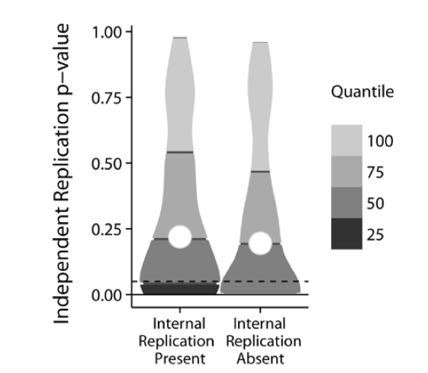
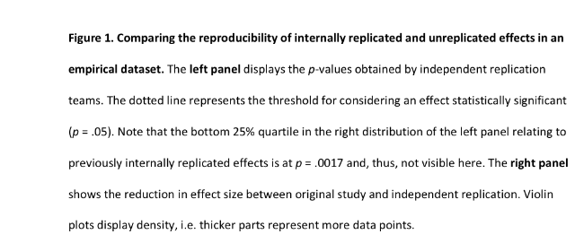
… No. (Kunert, 2016)
Notes:
No! It is remarkable, but conceptual replications are no safeguard against failed direct replications.
Note: The original figure caption is pasted to the side of the above slide.
Relevant links:
Kunert (2016). Conceptual replications don't predict direct replications
https://e8d47356-a-62cb3a1a-s-sites.googlegroups.com/site/rikunert/CV/Kunert_PRE_PRINT_v.3.1.pdf?attachauth=ANoY7cqa-yUwmgaKVrmCRaxedmgQ_r0O067IT61x80QD8QGnsYFdhDevBL4Zi07icCygA9yNzMpBqtpntz5Ea2vkIrCqNuow3Qz-RHZw0KpkH1DgW5I3Q9dI7qWUjLfGt5Q-84pHB1gL4ZVsxhaDRq47NN1Mkbj9kWrqdLKrHchVsOeqN6vOLD1hyp-T5xDe66A0Q-OqUipeInyYmPVktak1UpKnP0mxbyBzuO9pGT52j_IgsqNJk4k%3D&attredirects=0

Slide 33
Bayesian Re-Analysis of RP:P
Bayesian approaches to replication can quantify evidence both for and against the hypothesis (Verhagen & Wagenmakers, 2014)
Bayesian re-analysis of RP:P found 20% strong replication failures, 25% strong successes (Etz, 2015)
No firm conclusions can be drawn about most of the original effects
  Fairer to original authors than p > .05 is a “failed replication”
Notes:
Earlier I mentioned Bayesian alternatives to null hypothesis significance testing. Bayesian approaches to replication can quantify evidence both for and against the original hypothesis. One Bayesian re-analysis of the Reproducibility Project: Psychology found 20% strong replication failures and 25% strong successes. From a Bayesian perspective, no firm conclusions can be drawn about most of the original effects. Not only can this be defended on principled statistical grounds, it is also arguably fairer to original authors than calling every p > .05 a “failed replication.”
Relevant links:
The Bayesian Reproducibility Project
http://alexanderetz.com/2015/08/30/the-bayesian-reproducibility-project/
A Bayesian Perspective on the Reproducibility Project: Psychology
http://journals.plos.org/plosone/article?id=10.1371/journal.pone.0149794
Bayesian Tests to Quantify the Result of a Replication Attempt
http://www.ejwagenmakers.com/2014/VerhagenWagenmakers2014.pdf

Slide 34
Have you heard of a prediction market?
Notes:
Have you heard of a prediction market? (students answer).
Relevant links:
Using prediction markets to estimate the reproducibility of scientific research
http://www.pnas.org/content/112/50/15343.abstract
The scientist: gambling on reproducibility
http://mobile.the-scientist.com/article/44444/gambling-on-reproducibility
538 story on replication market paper
http://fivethirtyeight.com/features/how-to-tell-good-studies-from-bad-bet-on-them/
Atlantic: Can a futures market save science?
http://www.theatlantic.com/science/archive/2015/11/gambling-on-the-reliability-on-science-literally/414834/

Slide 35
Prediction markets
Participants trade on the outcome of an event
Market prices indicate crowd’s expected probability
Accurately predicted the results of the Reproducibility Project: Psychology (Dreber et al., in press)
Notes:
In a prediction market, participants trade on the outcome of an event, with the market prices indicating what the crowd thinks the probability of an event is. The remarkable thing is, the crowd is often pretty accurate, in other words a wisdom of the crowd effect. Prediction markets have been used to predict outcomes ranging from academy award nominations to sports matches to presidential races. And prediction markets using scientists are further able to predict whether studies will replicate or not.
Relevant links:
Using prediction markets to estimate the reproducibility of scientific research
http://www.pnas.org/content/112/50/15343.abstract
The scientist: gambling on reproducibility
http://mobile.the-scientist.com/article/44444/gambling-on-reproducibility
538 story on replication market paper
http://fivethirtyeight.com/features/how-to-tell-good-studies-from-bad-bet-on-them/
Atlantic: Can a futures market save science?
http://www.theatlantic.com/science/archive/2015/11/gambling-on-the-reliability-on-science-literally/414834/

Slide 36
Should we do this and save the effort of running the replications? How to allocate scarce resources?
Notes:
Credit: Slide from Nosek presentation
A crowd of scientists was able to accurately predict, just from the abstract of the paper, which original findings would replicate and which would not. Should we use prediction markets to save the effort of running some replications? How should we allocate scarce replication resources, to findings considered dubious, to those considered solid, or regardless of our priors? (students give their thoughts and the class discusses these issues).
Relevant links:
Using prediction markets to estimate the reproducibility of scientific research
http://www.pnas.org/content/112/50/15343.abstract
The scientist: gambling on reproducibility
http://mobile.the-scientist.com/article/44444/gambling-on-reproducibility

Slide 37
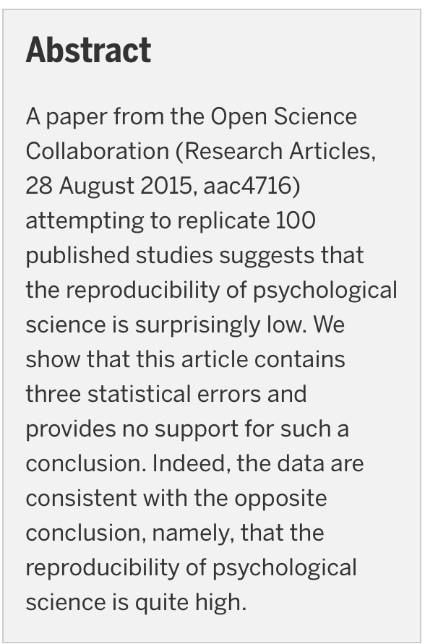
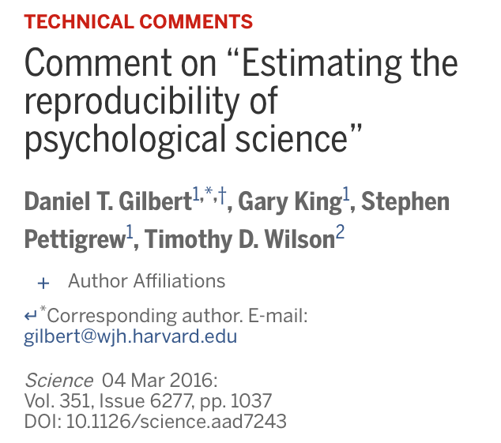
Notes:
Daniel Gilbert of Harvard University and colleagues wrote a strongly worded critique of the Reproducibility Project: Psychology.
Relevant links:
Gilbert et al commentary full text
http://science.sciencemag.org/content/351/6277/1037.2.full
Online appendix to Gilbert commentary
https://dl.dropboxusercontent.com/u/133567/gilbert_king_pettigrew_wilson_supplementary_appendix.pdf
OSC response full text
http://science.sciencemag.org/content/351/6277/1037.3
Gilbert response to OSC response
https://dl.dropboxusercontent.com/u/133567/response_to_osc_rebuttal.pdf
Data Colada commentary by Simonsohn on this debate: “Evaluating Replications: 40% full ≠ 60% empty”
http://datacolada.org/2016/03/03/47/
The Hardest Science blog post on the Gilbert critique
https://hardsci.wordpress.com/2016/03/03/evaluating-a-new-critique-of-the-reproducibility-project/
Ed Yong in the Atlantic
Psychology's replication crisis can't be wished away
http://www.theatlantic.com/science/archive/2016/03/psychologys-replication-crisis-cant-be-wished-away/472272/?utm_source=SFTwitter
Nature: Psychology's reproducibility problem is exaggerated, say psychologists
http://www.nature.com/news/psychology-s-reproducibility-problem-is-exaggerated-say-psychologists-1.19498
New York Times: new critique sees flaws in landmark analysis of psychology studies
http://mobile.nytimes.com/2016/03/04/science/psychology-replication-reproducibility-project.html?_r=1&referer=http://retractionwatch.com/2016/03/05/weekend-reads-replication-debate-heats-up-again-nejm-fooled-how-to-boost-your-alt-metrics/
Slate: Psychologists call out the study that called out the field of psychology
http://www.slate.com/blogs/the_slatest/2016/03/03/psychology_study_that_induced_the_reproducibility_crisis_was_wrong.html
Wired: Psychology is in crisis over whether it is in crisis
http://www.wired.com/2016/03/psychology-crisis-whether-crisis/
Lakens: The statistical conclusions in Gilbert et al are completely invalid
http://daniellakens.blogspot.sg/2016/03/the-statistical-conclusions-in-gilbert.html?m=1
David Funder: What if Gilbert is right?
https://funderstorms.wordpress.com/2016/03/06/what-if-gilbert-is-right/

Slide 38
Comment by Gilbert et al. (2016) in Science
A number of the replications were low in fidelity to the original study
Notes:
One of their major critiques was that a number of the replications departed in meaningful ways from the original studies.

Slide 39
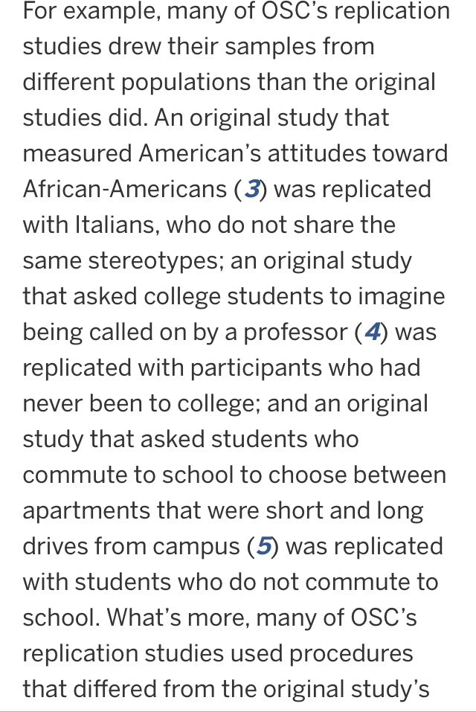
Notes:
Gilbert and colleagues argue that (instructor reads the excerpt on the slide verbatim)
Relevant links:
Response by one replicator: “Let's not mischaracterize replication studies”
http://retractionwatch.com/2016/03/07/lets-not-mischaracterize-replication-studies-authors/

Slide 40
Comment by Gilbert et al. (2016) in Science
A number of the replications were low in fidelity to the original study
Replications endorsed by the original authors as high in fidelity to the original design were more successful
Notes:
Gilbert and colleagues also note that replications endorsed by the original authors as a legitimate test of their hypothesis were considerably more likely to be successful.

Slide 41
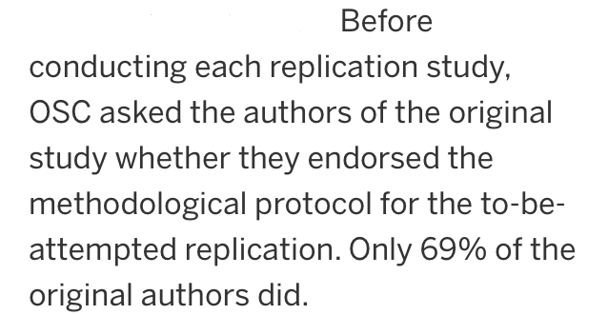
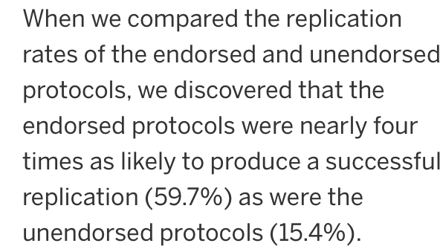
Notes:
Indeed, replications that were endorsed beforehand by the original authors were four times as likely to be successful as those that were rejected as inappropriate tests of their prediction.
Relevant links:
Many Labs 5 will attempt to respond to this particular criticism empirically
https://docs.google.com/document/d/1tnPqr2JSpODQjJ8yB-lC6sCwuWoJn0kWEfgg8mZH5nY/mobilebasic?pli=1

Slide 42
Comment by Gilbert et al. (2016) in Science
A number of the replications were low in fidelity to the original study
Replications endorsed by the original authors as high in fidelity to the original design were more successful
Most replication effect sizes fell within the confidence interval of the original effect sizes
The sampling procedure did not lead to a representative sample of psychology articles or an objective pairing with replicator laboratories
Notes:
Gilbert and colleagues further argued that most replication effect sizes fell within the confidence interval of the original effect sizes and therefore failed to overturn the original finding. Finally, their critique made the points about sampling I mentioned earlier: since replicators could choose their own study and not all studies were chosen, the final sample of studies was not necessarily representative of psychology as a whole.

Slide 43
Camerer et al. (2016, Science)
Crowdsourced initiative to replicate 18 experimental economics studies from the American Economic Review and Quarterly Journal of Economics
18 independent laboratories each attempted to replicate a single original study
  Similar approach to Reproducibility Project
Notes:
Another recent crowdsourced initiative comes from Colin Camerer and colleagues. They attempted to replicate 18 experimental studies from top economics journals. Using an approach similar to the Reproducibility Project: Psychology, 18 independent laboratories each attempted to replicate a single original study.

Slide 44
Results: Camerer et al. (2016)?
Notes:
What do you think they found? (students give estimates).

Slide 45
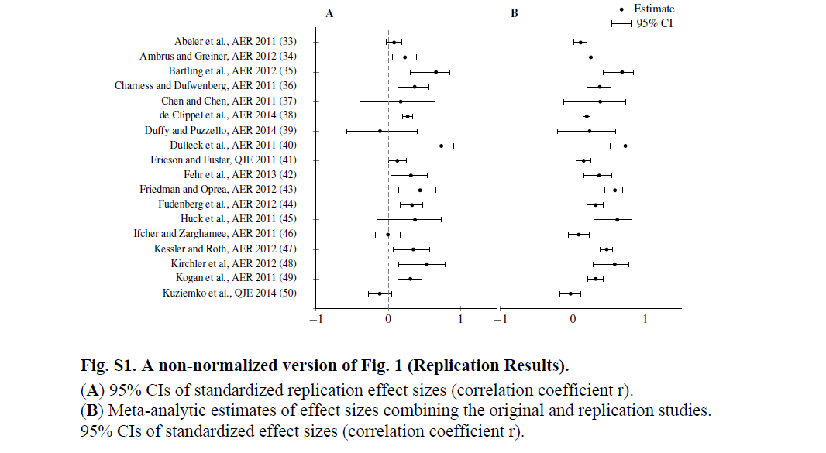
Results: Camerer et al. (2016)?
Significant effect in expected direction
for 11 (61%) of replications
Notes:
61% of the original studies replicated.

Slide 46
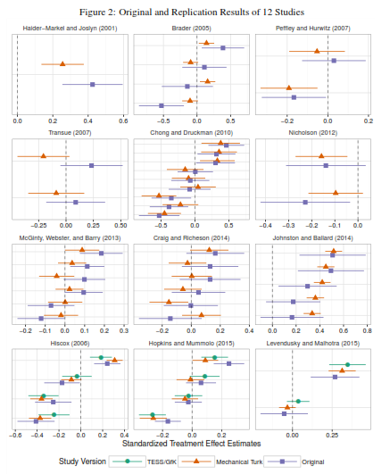
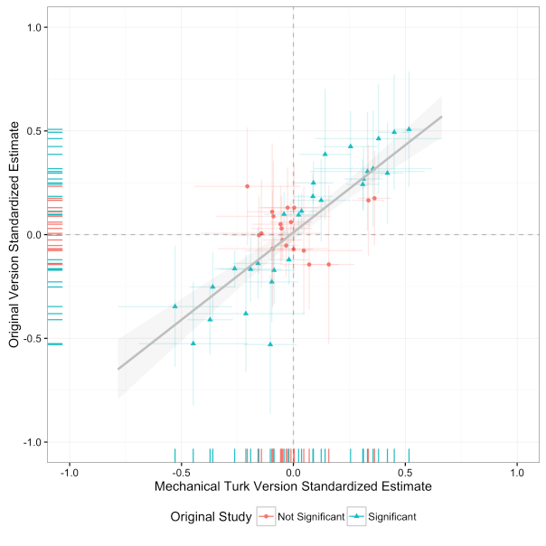
Replications of 12 studies from the Time-Sharing Experiments for the Social Sciences on Amazon’s Mechanical Turk were 72% successful (Coppock, 2016)
Notes:
Here are the results of another replication project. Calling it crowdsourced isn’t right since the replications were all run by a single graduate student who is the sole author on the paper! Alexander Coppock re-ran 12 studies originally from the Timesharing Experiments for the Social Sciences or TESS initiative, which I described in an earlier lecture. The replications were all done on Mechanical Turk. These direct replications were 72% successful.
Relevant links:
Full text: Generalizing from Survey Experiments Conducted on Mechanical Turk: A Replication Approach
https://alexandercoppock.files.wordpress.com/2016/02/coppock_generalizability.pdf
Description on website
http://alexandercoppock.com/research/generalizability/
News coverage of this and a second study
https://www.washingtonpost.com/news/monkey-cage/wp/2016/03/09/does-social-science-have-a-replication-crisis/?postshare=5761457539634667&tid=ss_tw

Slide 47
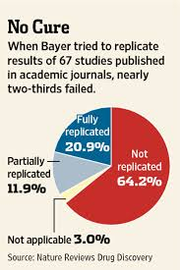
Medical studies also frequently fail to replicate
Initiative by Bayer Healthcare to replicate 67 pre-clinical studies led to a reproducibility rate of 20-30% (Prinz et al., 2011)
Researchers at Amgen were only able to replicate 6 of 53 influential cancer biology studies (Begley & Ellis, 2012)
Which studies were included cannot be disclosed due to legal agreements
Notes:
Importantly, it isn’t only the social sciences that face issues regarding replication. Indeed, medical studies– even highly influential and well cited investigations— typically fail to replicate. An initiative by Bayer Healthcare to replicate 67 medical studies led to a reproducibility rate of only 20-30%. And researchers at Amgen were only able to replicate 6 of 53 influential cancer biology studies. Which studies were included in these replication initiatives cannot be disclosed due to legal agreements the companies signed with the original investigators to get them to participate.
Relevant links:
Maybe further note JAMA paper which tracked papers and found follow ups failed to replicate or found smaller effect sizes
News coverage:
http://www.newyorker.com/magazine/2010/12/13/the-truth-wears-off
QUOTE: In 2005, Ioannidis published an article in the Journal of the American Medical Association that looked at the forty-nine most cited clinical-research studies in three major medical journals. Forty-five of these studies reported positive results, suggesting that the intervention being tested was effective. Because most of these studies were randomized controlled trials—the “gold standard” of medical evidence—they tended to have a significant impact on clinical practice, and led to the spread of treatments such as hormone replacement therapy for menopausal women and daily low-dose aspirin to prevent heart attacks and strokes. Nevertheless, the data Ioannidis found were disturbing: of the thirty-four claims that had been subject to replication, forty-one per cent had either been directly contradicted or had their effect sizes significantly downgraded.

Slide 48
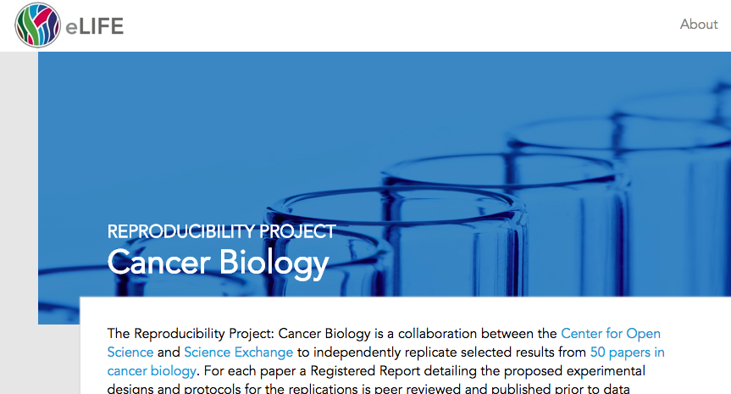


Notes:
An ongoing crowdsourced replication project that will be huge news when the results come out is The Reproducibiity Project: Cancer Biology which seeks to replicate influential studies in the field of cancer biology. In this case which findings replicated and which ones did not will be transparent.
Relevant links:
The Reproducibiity Project: Cancer Biology
https://osf.io/e81xl/
Cancer reproducibility effort faces backlash
http://news.sciencemag.org/biology/2015/06/feature-cancer-reproducibility-effort-faces-backlash
The Cancer Reproducibility Project is Incredibly Naive, Probably Useless, and Potentially Damaging
http://thefinchandpea.com/2015/07/01/the-cancer-reproducibility-project-is-incredibly-naive-probably-useless-and-potentially-damaging-2/

Slide 49
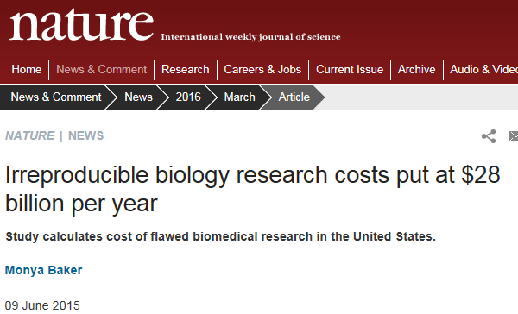
Financial costs
(Freedman et al., 2015)
This cost estimate is based on an estimated irreproducibility
rate of 53%, and just for U.S. research in one field
Notes:
Crowdsourcing scientific projects are more costly financially than standard science projects. A lot of time and energy is invested to produce a single paper. But think about all the wastefulness of standard science. The estimated financial cost of irreproducible biology research in the United States is 28 billion dollars a year. This cost estimate is just for research in one field in one country. Think about all the value we could create– and not just monetary value– if we could find better, more reliable ways to do science.
Relevant links:
Nature: Irreproducible biology research costs 28 billion dollars a year
http://www.nature.com/news/irreproducible-biology-research-costs-put-at-28-billion-per-year-1.17711
Freedman et al. 2015, PLOS:
The Economics of Reproducibility in Preclinical Research
http://journals.plos.org/plosbiology/article?id=10.1371/journal.pbio.1002165

Slide 50
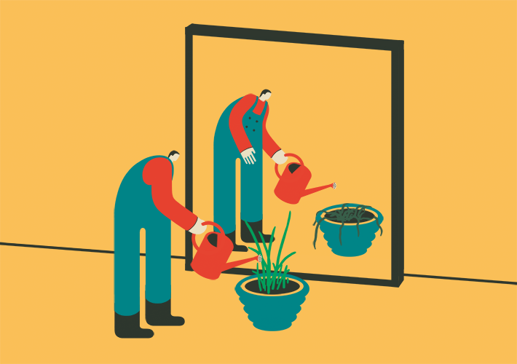
What does it mean to you when a finding fails to replicate in an independent laboratory?
Notes:
What does it mean to you when a finding fails to replicate in an independent laboratory? (students respond and class discusses).

Slide 51
Prediction market reacts to a single replication failure?
(Dreber et al., in press)
When a study fails to replicate, priors drop from a median of 8.8% to …??
When a single replication is successful, belief the hypothesis is true increases to a median of 56%
Notes:
Earlier we talked about how prediction markets can accurately forecast which studies will replicate and which one’s will not. How do you think a prediction market of scientists reacts to a single replication failure? Their median prior for each original study was 56% likelihood that the published effect is robust. What do you think happens after a single failed replication? (students make % estimates).

Slide 52
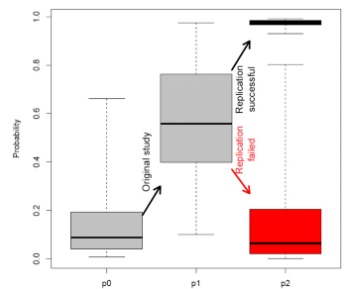
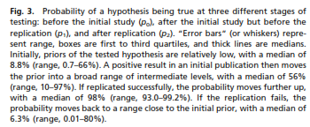
Prediction market reacts to a single replication failure?
(Dreber et al., in press)
When a study fails to replicate, priors drop from a median of 8.8% to 6.3%
When a single replication is successful, belief the hypothesis is true increases to a median of 56%
Notes:
When a single replication is successful, the crowd of scientists’ belief in the hypothesis increases to a median of 98%. A single successful replication gives the original finding a huge boost in terms of its truth value. When the original study fails to replicate, priors drop to a median of 6%. This is a pretty reasonable and measured response. In contrast, in the media we have this ritual of an original study being published and overhyped in the media and failed replications being published and overhyped in the media.

Slide 53
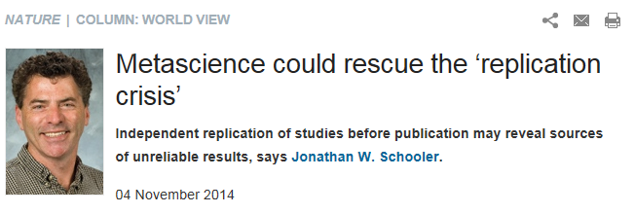
Notes:
In a commentary in Nature, Jonathan Schooler proposed an alternative. What if we seek to replicate studies in independent laboratories before, rather than after they are published?
Relevant links:
Metascience could rescue the ‘replication crisis’
http://www.nature.com/news/metascience-could-rescue-the-replication-crisis-1.16275

Slide 54
Pre-Publication Independent Replication (PPIR)
(Schweinsberg et al., 2016, JESP)
Findings replicated in independent laboratories before they are published
Original authors volunteer their finding and select expert replication labs with subject populations they expect to show the effect
Notes:
We referred to this as the Pre-Publication Independent Replication (PPIR) approach in a recent paper that attempted to systematically follow Schooler’s advice. In the PPIR approach, findings are replicated in independent laboratories before they are ever submitted for publication. Original authors volunteer their finding and select expert replication labs with subject populations they expect to show the effect.
Note: Instructors who were not co-authors on the Pipeline Project 1 will need to change the “we” language in these slides.

Slide 55
Some Benefits of PPIRs?
Notes:
What are some benefits of PPIRs? (students answer).

Slide 56
Some Benefits of PPIRs?
PPIRs increase the informational value of replications
  High replicator expertise, relevant subject population
  Effect is overestimated and even a false positive if it consistently fails to replicate in PPIRs
  Reduces post-hoc motivated reasoning by original authors
    CARKing or Criticizing After the Results are Known
Less adversarial than existing replication approaches
Ensures published findings are reliable before they are widely disseminated, rather than checking after-the-fact
Notes:
Here are a few benefits. PPIR ensures published findings are reliable before they are widely disseminated, rather than checking after-the-fact. It also increases the informational value of failed replications since the study was run by expert replicators and in locations picked by the original authors, reducing the original authors’ ability to dismiss null results post-hoc. An effect is overestimated and even a false positive if it consistently fails to replicate in PPIRs. Last but not least, PPIR is much less adversarial than existing replication approaches. Consider the Repligate case.
Note: The instructor should skip any points students have already mentioned.

Slide 57
The Pipeline Project
(Schweinsberg et al., 2016, JESP)
25 research laboratories attempted to replicate all 10 moral judgment effects the last author (Uhlmann) and colleagues had "in the pipeline" as of August 2014
Selected laboratories with directly relevant expertise (e.g., moral judgment researchers)
All laboratories used subject populations theoretically expected to show the effect
Notes:
In the Pipeline Project, 25 research laboratories attempted to replicate all 10 moral judgment effects the last author and colleagues had "in the pipeline" as of August 2014. We selected laboratories with directly relevant expertise and who had access to subject populations theoretically expected to show the effect without making any modifications to the study materials.
Relevant links:
Schweinsberg et al. (2016). The pipeline project: Pre-publication independent replications of a single laboratory’s research pipeline. Journal of Experimental Social Psychology.
http://home.uchicago.edu/davetannenbaum/documents/pipeline%20project.pdf

Slide 58
Pipeline Project Results?
Notes:
What do you think we found? How many of the 10 unpublished effects do you think replicated?
Relevant links:
Schweinsberg et al. (2016). The pipeline project: Pre-publication independent replications of a single laboratory’s research pipeline. Journal of Experimental Social Psychology.
http://home.uchicago.edu/davetannenbaum/documents/pipeline%20project.pdf

Slide 59
Pipeline Project Results?
Figure 1. Original effect sizes (indicated with an X), individual effect sizes for each replication sample (small circles), and meta-analyzed replication effect sizes (large circles). Error bars reflect the 95% confidence interval around the meta-analyzed replication effect size.
Notes:
Here are the results (instructor reads the figure caption, gesturing to relevant elements of the figure).
Relevant links:
Schweinsberg et al. (2016). The pipeline project: Pre-publication independent replications of a single laboratory’s research pipeline. Journal of Experimental Social Psychology.
http://home.uchicago.edu/davetannenbaum/documents/pipeline%20project.pdf

Slide 60
Pipeline Project Results?
Of the 10 studies, 6 replicated according to all criteria
Two studies failed to replicate entirely
One study replicated but with smaller effect size than original
One study replicated in the U.S. but not outside the U.S.
Notes:
Of the 10 original findings, 6 replicated according to all criteria. Two original findings failed to replicate entirely and are basically just false findings. One original finding replicated but with smaller effect size than original, an example of what is called the decline effect, in which effect sizes diminish between original studies and replication studies. One finding was unexpectedly moderated by culture, in that it replicated consistently in U.S. samples but not outside the United States.
Note: Links to articles on criteria for replication below
Relevant links:
The replication recipe
http://www.sciencedirect.com/science/article/pii/S0022103113001819
Simonsohn (2015) "Small Telescopes: Detectability and the Evaluation of Replication Results" Psychological Science V26(5) p.559-569
http://papers.ssrn.com/sol3/papers.cfm?abstract_id=2259879

Slide 61
A few implications of the Pipeline Project
Demonstration that PPIR approach is feasible, even on a large scale
Modest reproducibility rate despite best possible conditions
  Original and replication studies carried out by experts
  Relevant subject populations
  Original studies carried out transparently and data posted publicly on the internet (https://osf.io/q25xa/)
Irreproducible results are a natural part of science
Notes:
A few implications of the Pipeline Project. We demonstrate that PPIR approach is feasible, even on a large scale. We also find a modest reproducibility rate despite best possible conditions-- original and replication studies carried out by experts in the area, and relevant subject populations where the effect theoretically should emerge. The original studies were carried out transparently, with the data and materials posted on the internet and all conditions, measures, and observations reported. Failed replications and irreproducible results are a natural part of science.
Relevant links:
Schweinsberg et al. (2016). The pipeline project: Pre-publication independent replications of a single laboratory’s research pipeline. Journal of Experimental Social Psychology.
http://home.uchicago.edu/davetannenbaum/documents/pipeline%20project.pdf

Slide 62
Some Downsides of PPIRs?
Notes:
What are some downsides you see of PPIRs? (students give their thoughts and the class discusses).
Relevant links:
Schweinsberg et al. (2016). The pipeline project: Pre-publication independent replications of a single laboratory’s research pipeline. Journal of Experimental Social Psychology.
http://home.uchicago.edu/davetannenbaum/documents/pipeline%20project.pdf

Slide 63
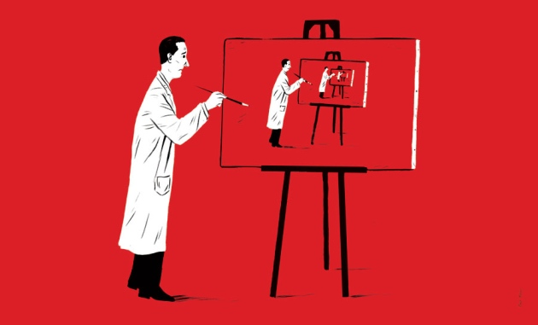
Some Downsides of PPIRs?
Deal with new findings, not foundational ones
Inefficient
Not incentivized by current publishing system
Notes:
Some downsides of PPIRs. They deal with new findings, not foundational ones. They are inefficient. And they are not incentivized by the current publishing system.
Note: Skip any points students already mentioned in the preceding discussion.
Relevant links:
Schweinsberg et al. (2016). The pipeline project: Pre-publication independent replications of a single laboratory’s research pipeline. Journal of Experimental Social Psychology.
http://home.uchicago.edu/davetannenbaum/documents/pipeline%20project.pdf

Slide 64
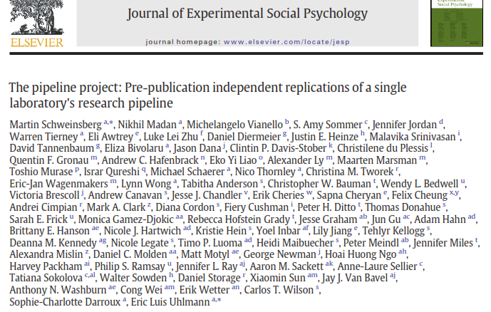
Notes:
Here is the author string for the Pipeline Project 1. When there is a crowd of researchers like this, the field does not yet figured out how to properly reward scientists for their contribution. All we can say is thank you to everyone who decided to be a part of our initiative anyway.
Relevant links:
Schweinsberg et al. (2016). The pipeline project: Pre-publication independent replications of a single laboratory’s research pipeline. Journal of Experimental Social Psychology.
http://home.uchicago.edu/davetannenbaum/documents/pipeline%20project.pdf

Slide 65
Pipeline Project 2
Objective: Open up Pre-Publication Independent Replication (PPIR) to the world
Any researcher can nominate their unpublished finding for replication by independent teams at other institutions
Graduate and undergraduate methods classes around the world will adopt them and run replication studies
Final report will include project coordinators, original authors, and instructors and students in participating classes as co-authors
Notes:
Our class today is the beginning of Pipeline Project 2. Our goal is to open up Pre-Publication Independent Replication to the world. Any researcher will be able to nominate their unpublished finding for replication by independent teams at other institutions. Graduate and undergraduate methods classes around the world will adopt them and run replication studies. The final project report will include project coordinators, original authors, and instructors and students in participating classes as co-authors.

Slide 66
Course Crowdsourced PPIR Project
You will carry out a replication of an unpublished study from researchers who have nominated their own findings
Each team will presentation their replication results in Meeting 6 (time TBD)
  We will give you the materials, funding, provide the lab space, and recruit subjects (via our SiDaT Lab)
  You will help run subjects, participate in the data analysis, and make a brief PowerPoint presentation in class
Further graduate methods courses at partner universities will likewise participate in the PPIR initiative
You will be a co-author on the Pipeline Project 2
Notes:
For our course PPIR project, you will carry out a replication of an unpublished study from researchers who have nominated their own findings for inclusion in the initiative. Each team will present their replication results in our final meeting, which will be scheduled once the replications are complete. Further graduate and undergraduate methods courses at partner universities will likewise participate in the PPIR initiative, and we will all be co-authors together on the Pipeline Project 2.

Slide 67
Take-Aways:
The Replication Revolution
Recent initiatives reveal that many findings from the published literature are difficult to replicate in other laboratories
Replications of published research can provoke controversy
Pre-publication independent replication is a complementary approach that has different advantages and disadvantages
Notes:
Some key take-aways from our lecture on the replication revolution. Recent initiatives reveal that many findings from the published literature are difficult to replicate in other laboratories. Replications of published research can provoke controversy and make it unclear what to conclude. Pre-publication independent replication is a complementary approach that has different advantages and disadvantages, as you will experience firsthand in the Pipeline Project 2. Thank you so much for coming, and see you next time!

Slide 69

Notes:
Before we do anything else please take 5 minutes or so to remember what you learned in our last session on The Replication Revolution. It doesn’t have to be what we taught you, but something that YOU learnt personally, what did YOU take out of the last class? We’re doing this because this is a GREAT RETURN ON INVESTMENT: we’re spending 5 minutes on this now so you don’t lose the last few hours we spent together. (students quietly write down their take-aways from the previous lecture). Ok, let’s share some take-aways (students share what they took away from the previous session).

