Slide 1

The Open Data Movement
Martin Schweinsberg,
Neil Bearden, & Eric Luis Uhlmann
INSEAD
Notes:
Today’s lecture is on the open data movement, the movement to make the underlying data from scientific studies publicly available to anyone.

Slide 2
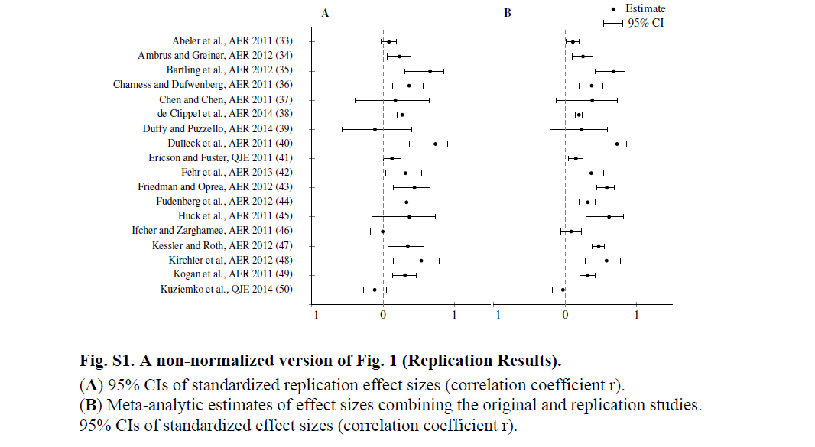
Camerer et al. (2016) study of replicability of research in experimental economics (Lecture 2)
Significant effect in expected direction
for 11 (61%) of replications
Notes:
In our lecture on the replication revolution, we discussed the results of Camerer et al.’s initiative to replicate research in experimental economics. They found that 61% of replications observed a significant effect in the same direction as the original study.

Slide 3

What percentage of non-experimental studies in economics do you think can be reproduced using the exact same dataset?
Notes:
The crisis of confidence in science has disproportionally centered on experimental research in psychology, in part because of the fraud scandals. But what percentage of non-experimental studies in economics do you think can be reproduced using the exact same dataset? Note that this is an extremely low bar for research reliability. In experimental research, replications involve re-running the same protocol in a new population with new subjects and seeing if you get the same results. As we discussed, there are a lot of reasons why that might not work out. Here the question is, can we at least get the same result with the exact same dataset as the original authors? So, what do you think? (students give % estimates).

Slide 4
Reproducibility of
Non-Experimental Findings
Two studies of macroeconomic findings reported in the Journal of Money, Credit and Banking in 1986 and 2006
  Only able to replicate 13% and 23% of original results with the same data and code (Deward et al., 1986; McCullough et al., 2006)
Attempt to replicate papers published in 13 economics journals using author-provided data and code replicated 29/59 (49%) (Chang & Li, 2015)
Notes:
Empirical estimates on the reproducibility of economics research from the same dataset range from 13% to 49% depending on the study. So there is no empirical reason to have more faith in archival research than experimental research.
Note: The findings are moderated by data availability and involvement of the original authors, see the links below for full details.
Relevant links:
Is Economics Research Replicable? Sixty Published Papers from Thirteen Journals Say “Usually Not”
http://www.federalreserve.gov/econresdata/feds/2015/files/2015083pap.pdf
W. G. Dewald, J. G. Thursby, R. G. Anderson, Replication in empirical economics: The journal of money, credit and banking project, Am. Econ. Rev. 76, 587 (1986).
B. D. McCullough, K. A. McGeary, T. D. Harrison, Lessons from the JMCB Archive, J. Money Credit Bank. 38, 1093 (2006).
Coverage in Business Insider
http://www.businessinsider.com.au/federal-reserve-paper-on-the-replicability-of-economic-studies-2015-10

Slide 5




Do researchers share data upon request?
(Wicherts et al., 2006)
Requested the raw data from 141 papers published in four psychology journals for use in a study of the effects of outliers on the outcome of data analyses
Wicherts, J. M., Borsboom, D., Kats, J., & Molenaar, D. (2006). The poor availability of psychological research data for reanalysis. American Psychologist, 61, 726-728.
Notes:
Credit: Jelte Wicherts slide from posted presentation
A decade ago, Jelte Wicherts and colleagues requested the raw data from 141 papers published in four psychology journals for a statistical study of the effects of outliers. What percentage of researchers do you think shared their data?
Note: Quote from APA guidelines: After research results are published, psychologists do not withhold the data on which their conclusions are based from other competent professionals who seek to verify the substantive claims through reanalysis and who intend to use such data only for that purpose, provided that the confidentiality of the participants can be protected and unless legal rights concerning proprietary data preclude their release.

Slide 6
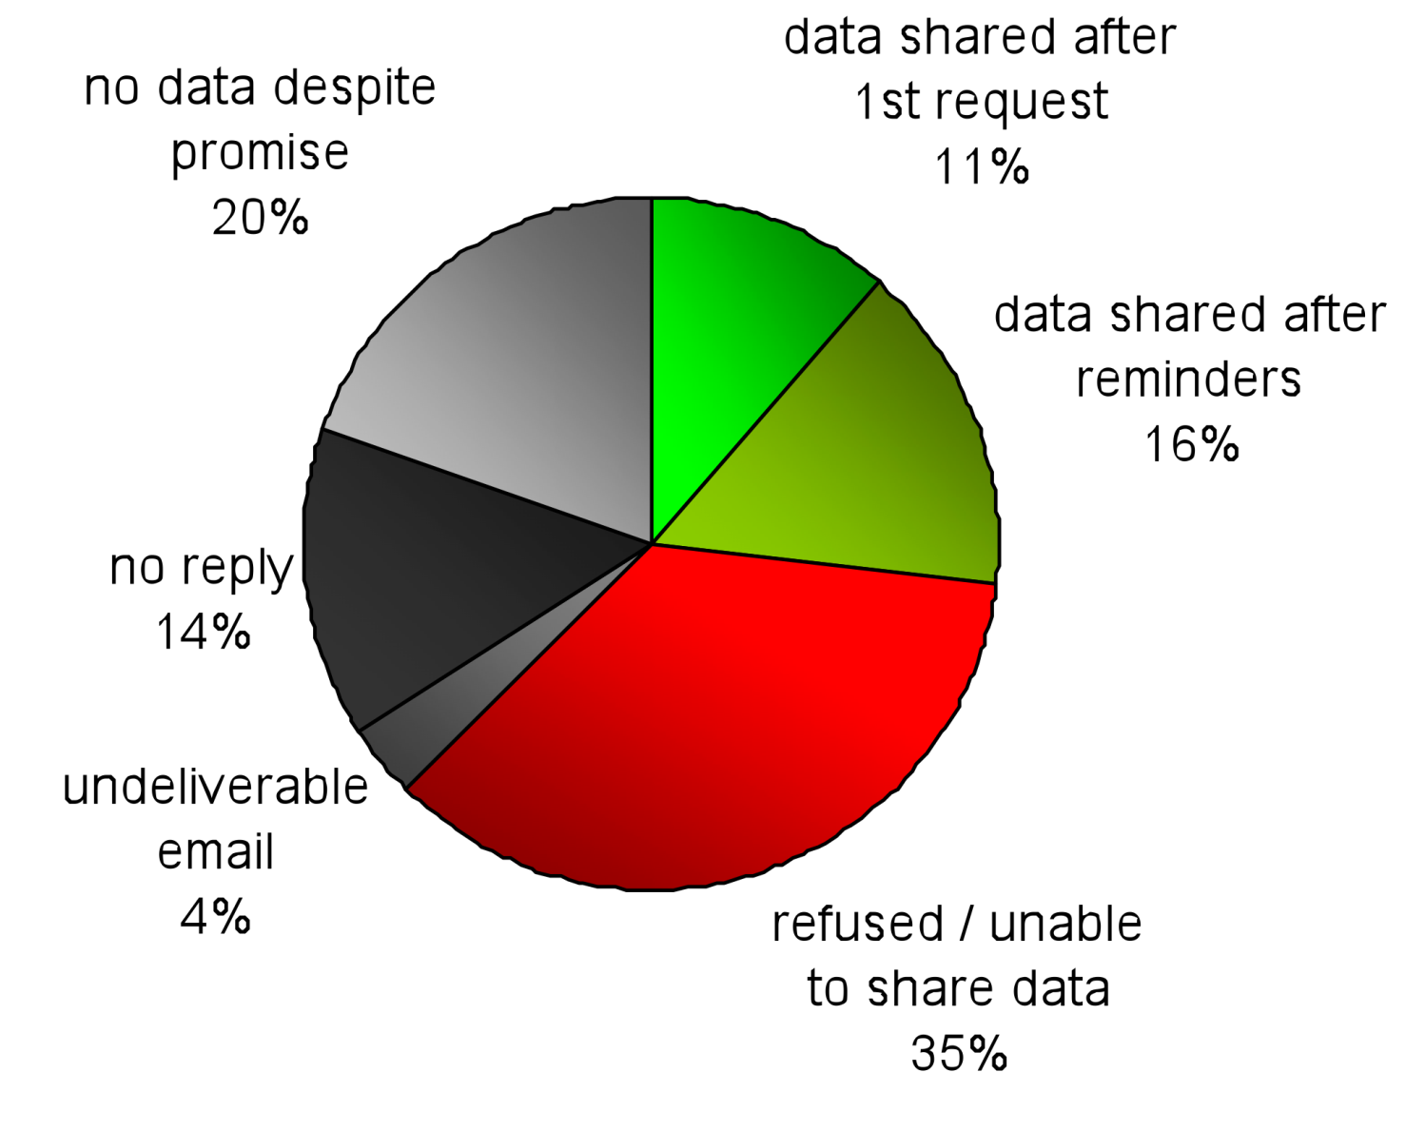
Do researchers share data upon request?
(Wicherts et al., 2006)
Notes:
Credit: Jelte Wicherts slide from posted presentation
Only 27% shared their data, and that was after repeated reminders. Only 11% of data was shared after the first request.

Slide 7
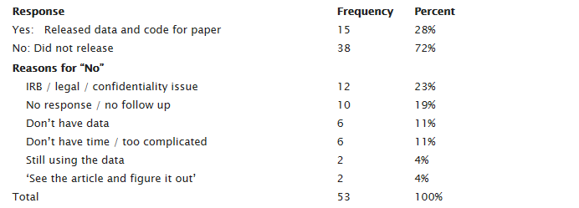
Data availability in Sociology equally low
Young & Horvath (2015) requested data from 53 sociology studies in an effort to reproduce the results
Notes:
Data availability in Sociology is practically identical to Psychology, with 28% of requests successful.
Relevant links:
Sociologists need to be better at replication – a guest post by Cristobal Young
https://orgtheory.wordpress.com/2015/08/11/sociologists-need-to-be-better-at-replication-a-guest-post-by-cristobal-young/
Coverage on Andrew Gelman’s blog
http://andrewgelman.com/2015/08/11/its-hard-to-replicate-that-is-duplicate-analyses-in-sociology/

Slide 8
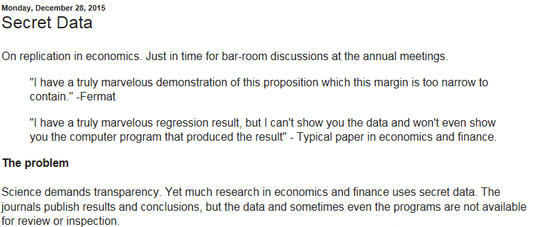
“Secret data” the norm in economics and finance
Notes:
“Secret data” is also the norm in economics and finance, which sometimes relies on proprietary data that cannot legally be publicly distributed.
Relevant links:
Economics and finance papers often use secret data
http://johnhcochrane.blogspot.co.uk/2015/12/secret-data.html?m=1

Slide 9
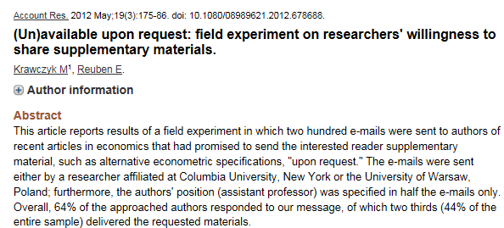
Notes:
Here is a great title for a paper, “(Un)available upon request.” The study finds that only 44% of authors who explicitly indicate in the paper further materials are available from them on request actually send the materials when requested.
Relevant links:
(Un)available upon request: field experiment on researchers' willingness to share supplementary materials. (paywalled)
http://www.ncbi.nlm.nih.gov/pubmed/22686633

Slide 10
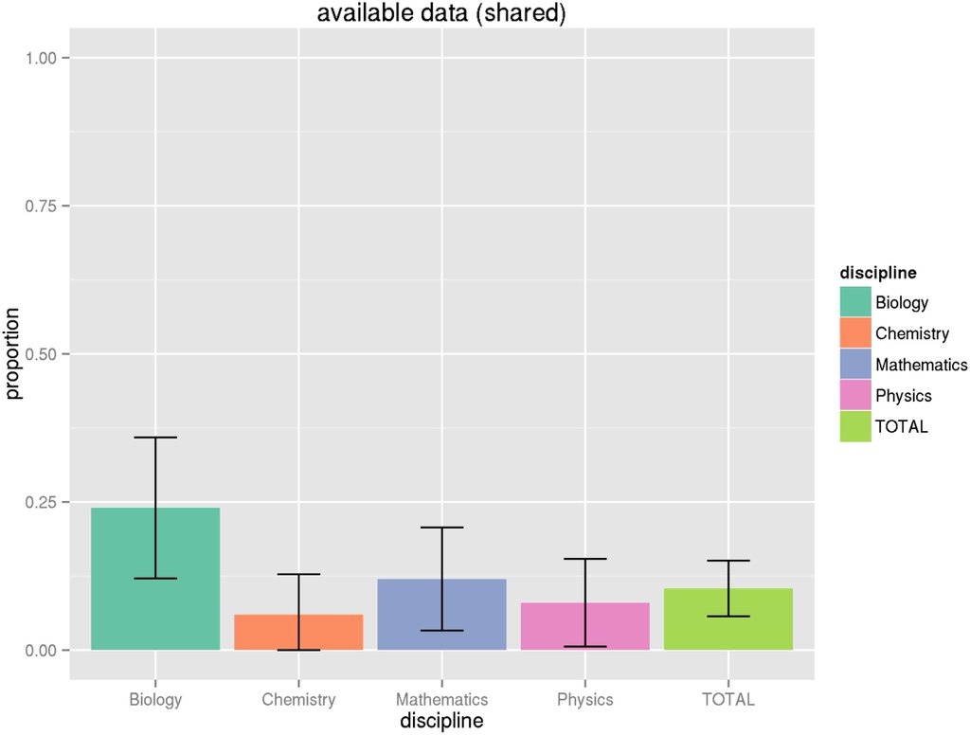
Notes:
Data availability is generally low across the sciences. Only an average of 13% of articles in top journals in biology, chemistry, math & physics have open data.
Relevant links:
Just 13% of articles in top journals in biology, chemistry, math & physics have open data http://journals.plos.org/plosone/article?id=10.1371/journal.pone.0143460

Slide 11
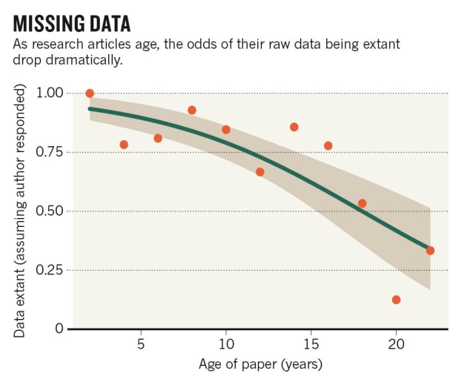
Data Half-Life (Vines et al., 2013)
Up to 80% of scientific data are unavailable after 20 years
Notes:
Datasets also have a half-life. After 20 years, up to 80% of scientific data is lost or otherwise unavailable. This means re-analyzing the data from older, foundational studies is typically not possible.
Relevant links:
Scientists losing data at a rapid rate
http://www.nature.com/news/scientists-losing-data-at-a-rapid-rate-1.14416
Majority of published scientific data not recoverabl​e 20 years later
http://www.upi.com/Science_News/2013/12/19/Researchers-say-valuable-scientific-data-disappearing-at-alarming-rate/UPI-70701387491288/
Data disappears rapidly over time
http://blogs.smithsonianmag.com/science/2013/12/the-vast-majority-of-raw-data-from-old-scientific-studies-may-now-be-missing/#ixzz2o3aXRDlX

Slide 12
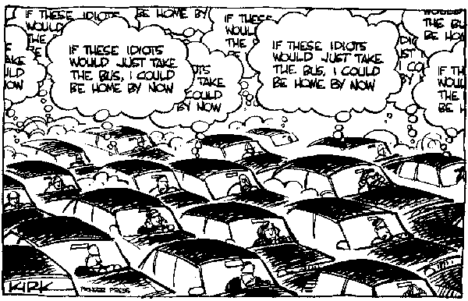
Tragedy of the commons
It would be good for science if all data were public
But individual scientists do not feel incentivized to post their data
Notes:
Credit: Cartoon taken from Jelte Wicherts publicly posted presentation
What we have here is a tragedy of the commons. It would be good for science if all data were public. But individual scientists currently lack much individual incentivize to make their data publicly available. So relatively few researchers do it.
Relevant links:
A tragedy of the academic commons
https://www.academia.edu/14162686/A_tragedy_of_the_academic_commons_Interpreting_the_replication_crisis_in_psychology_as_a_social_dilemma_for_early-career_researchers
Open science as social dilemma
http://firstmonday.org/ojs/index.php/fm/article/view/5381/4110#author
Tragedy of the commons paper regarding open science
http://journal.frontiersin.org/article/10.3389/fpsyg.2015.01152/full

Slide 13
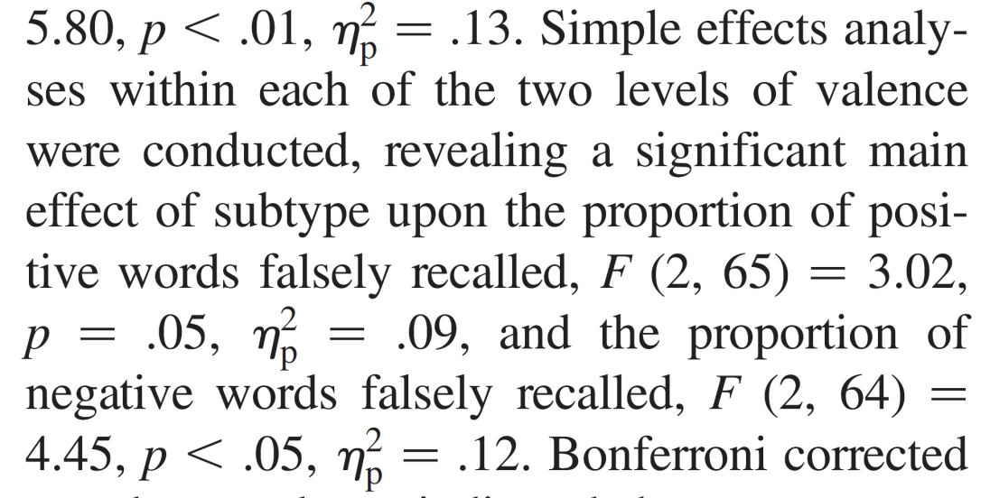
Clear errors in published psychology studies found using only the statistics reported in the paper
Method: a representative sample of 257 papers
Recomputed 4720 p-values from NHST and checked for consistency
p = .06
Results: 128 papers (50%) contained at least one error
39 papers (15%) contained at least one error related to p = .05
Conclusion: Errors predominantly led to “better” results
Bakker, M. & Wicherts, J. M. (2011). (Mis)reporting of statistical results in psychology journals. Behavior Research Methods, 43, 666-678.
Notes:
Credit: Jelte Wicherts slide from posted presentation
I would encourage you to not be too judgmental about the excel error case. Research shows data analytic errors are common in published studies. Some can be uncovered just by looking at the statistics reported in the paper. In fact, 15% of psychology papers contain an error that turns a significant effect nonsignificant or vice versa. And this is just looking at the published report, not from re-analyzing the original data.
Note: 257 papers with 4720 p-values. Of 142 high-impact papers, 53.5 % contained errors. 17.6% contained gross errors.
Relevant links:
Another relevant study from the late 1970s:
How often are our numbers wrong?
Rosenthal, Robert
American Psychologist, Vol 33(11), Nov 1978, 1005-1008. http://dx.doi.org/10.1037/0003-066X.33.11.1005
Abstract
Located 21 studies that permitted an estimate of the frequency of recording errors and/or the degree to which errors were nonrandom. The studies, summarizing data from over 300 observers making about 140,000 observations, suggest that about 1% of all observations may be in error and that about two thirds of all errors favor the hypothesis of the observer.

Slide 14
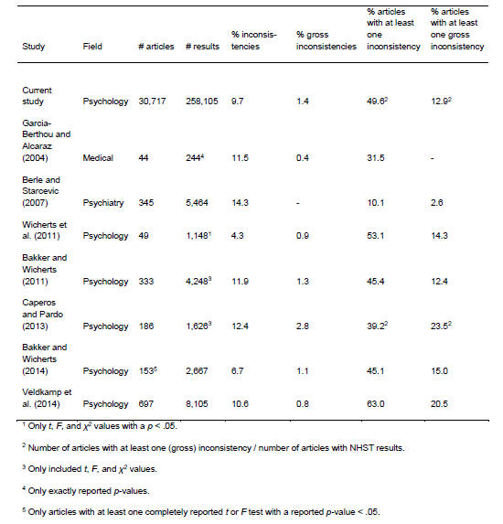
Prevalence of statistical reporting errors
(Nuijten et al., 2015)
Notes:
The prevalence of major statistical reporting errors in psychology, psychiatry, and medicine that affect the basic conclusions of the paper range from 3% to 24% depending on the investigation.
Relevant links:
Nuijten et al. (2015). The Prevalence of Statistical Reporting Errors in Psychology (1985-2013)".
https://osf.io/kym6w/
Statistical Reporting Errors and Collaboration on Statistical Analyses in Psychological Science
http://journals.plos.org/plosone/article?id=10.1371/journal.pone.0114876

Slide 15
Misidentification of Cell Lines in Biomedicine
(Hughes et al., 2007)
Between 18 percent and 36 percent of all cell lines were likely misidentified
One reason biomedical studies are difficult to replicate in other laboratories (Lecture 2)
At Nature journals scientists are supposed to test their cells as part of a submission checklist
  Only about 10 percent of the scientists check this box
Notes:
Misidentification of cell lines in biomedicine is likewise common. Subsequent investigation finds that between 18 percent and 36 percent of all cell lines were likely misidentified. So the researchers didn’t even have the right cells. This is one likely reason biomedical studies are difficult to replicate in other laboratories, as we discussed in our lecture on the replication revolution.
Relevant links:
Scientists Often Skip A Simple Test That Could Verify Their Work
http://www.npr.org/sections/health-shots/2014/12/10/368776420/scientists-often-skip-a-simple-test-that-could-verify-their-work?utm_campaign=storyshare&utm_source=twitter.com&utm_medium=social
The costs of using unauthenticated, over-passaged cell lines: how much more data do we need?
http://www.ncbi.nlm.nih.gov/pubmed/?term=PMID%3A+18072586

Slide 16

What do you think?
Are there any legitimate reasons to not make data public?
Simonsohn (2013) advocates for mandatory data posting with some exceptions and temporary embargos
Notes:
In a paper called “Just post it,” Uri Simonsohn advocates for mandatory data posting. What do you think? Are there any legitimate reasons to not make data public? (students give some potential reasons and the class debates them). One option to sometimes have a temporary embargo where only the authors have access to the data for some period (for instance three to five years), after which the data repository makes it public to everyone. What do you think of that option? (class discusses the embargo option).
Relevant links:
Simonsohn, U. (2013). Just post it: The Lesson from two cases of fabricated data detected by statistics alone. Psychological Science, V24(10), 1875-1888.
Full text:
http://papers.ssrn.com/sol3/papers.cfm?abstract_id=2114571&http://papers.ssrn.com/sol3/papers.cfm?abstract_id=2114571

Slide 17
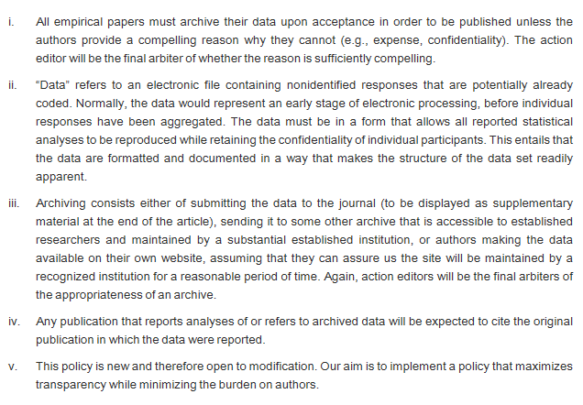
New Policy at Cognition: Mandatory Data Posting
Notes:
The journal Cognition has a new policy which makes data posting mandatory, with rare exceptions.
Relevant links:
New Cognition data posting policy
http://www.sciencedirect.com/science/article/pii/S0010027714002248

Slide 18
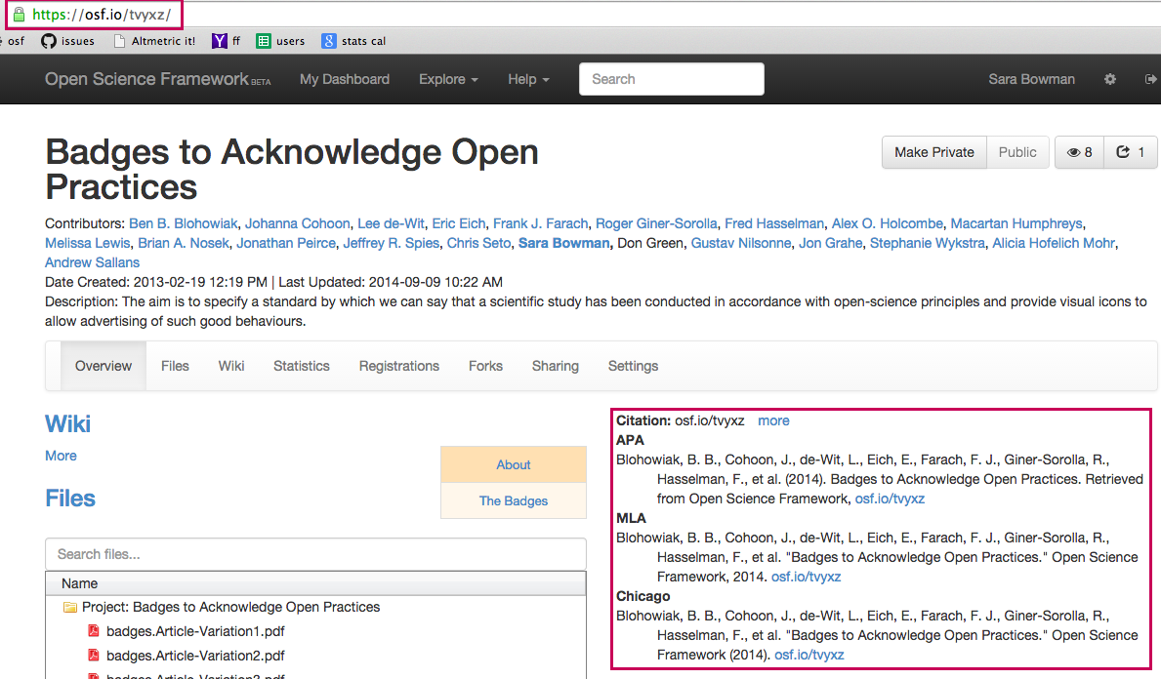
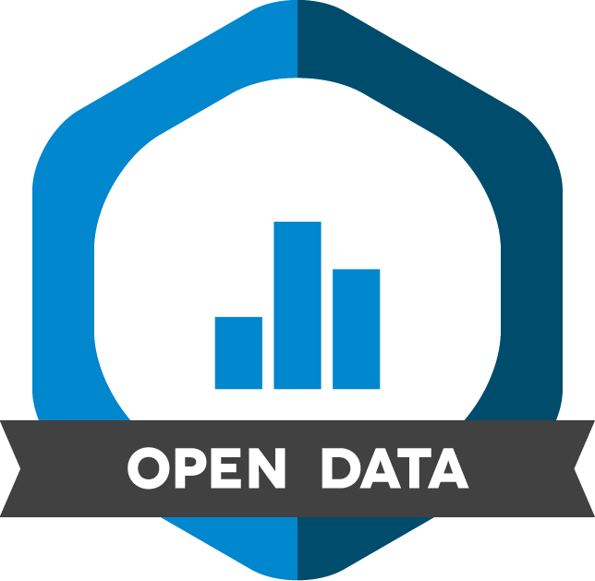
Center for Open Science Initiative: Open Data Badges
Notes:
An initiative from the Center for Open Science provides authors with open data badges visible on their paper when the publicly post their data.

Slide 19

What do you think of this approach?
Do you think this would work?
Notes:
What do you think of this approach? Do you think this would work? Seems kind of like getting a gold star back in school, if you went to a school that used gold stars. (students discuss).
Note: Gold stars in classes for small children are common in the United States. Any classroom of Americans will get the reference.

Slide 20
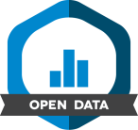
Data Availability in Psychological Science
Notes:
Credit: Slide from Bowman open science presentation posted on the OSF
The open data badge incentive clearly worked, dramatically increasing the number of papers in the journal Psychological Science with open data. Currently about half the papers in Psych Science have open data.

Slide 21
Open data citation advantage
Studies with open data receive more academic citations (Piwowar & Vision, 2013)
9% difference in citations between studies that do and do not have publicly posted data in an online repository
Notes:
There is an external incentive to post your data. Research on the open data citation advantage finds that studies with open data receive more academic citations.
Relevant links:
The open data citation advantage
http://www.ncbi.nlm.nih.gov/pmc/articles/PMC3792178/
Papers with links to data are more cited
http://arxiv.org/pdf/1511.02512.pdf
Impact of open access on citations
http://papers.ssrn.com/sol3/papers.cfm?abstract_id=2391692

Slide 22
New England Journal of Medicine
“Research Parasites” Editorial?
Notes:
Who has heard of the New England Journal of Medicine’s “Research Parasites” editorial? (students respond).

Slide 23
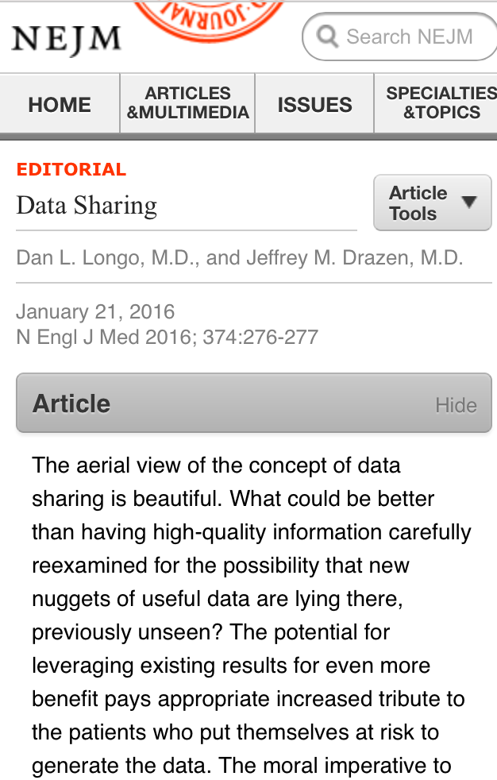
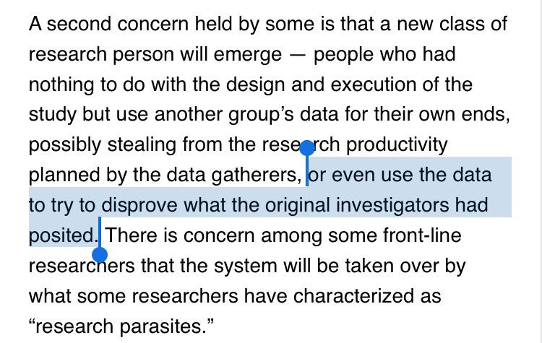
New England Journal of Medicine
“Research Parasites” Editorial?
Notes:
The editors of one of the most prestigious medical journals in the world characterized researchers who re-analyze each other’s data as research parasites.

Slide 24
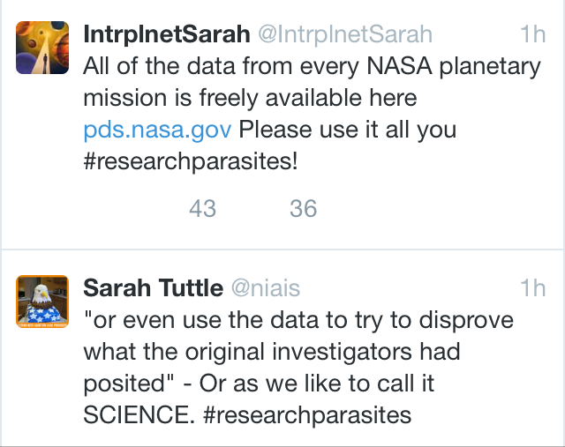

Twitter hashtag
Internet Meme:
Research Parasite Badge
Notes:
The editorial was very poorly received, leading to the hashtags #research parasite on twitter and the proposal of a “research parasite” open science badge.

Slide 25
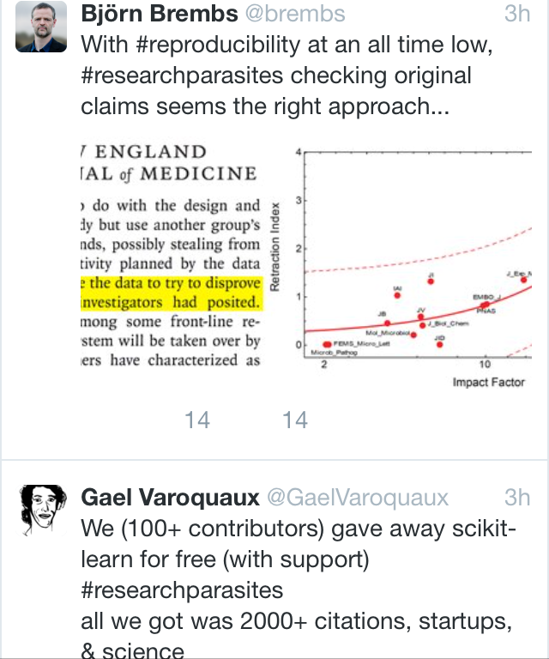
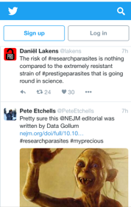
What do you think about the Research Parasites charge?
How about the Data Gollum charge?
Notes:
The counter-charge is that researchers who don’t share their data are “Data Gollums” who treat the data like it was “the precious” ring of power from Lord of the Rings. What do you think about the Research Parasites charge? How about the Data Gollum charge? (students answer and class discusses).
Relevant links:
NEJM under attack for research parasites editorial
https://www.propublica.org/article/amid-public-feuds-a-venerated-medical-journal-finds-itself-under-attack

Slide 26
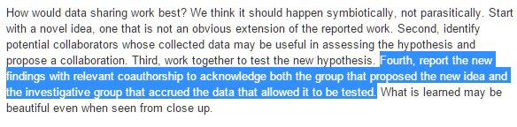
New England Journal of Medicine
“Research Parasites” Editorial
What do you think about this proposal? What should data sharing and authorship rules look like, data citation or authorship?
How about an authorship taxonomy based on contribution
(idea, data collection, analysis, write-up)?
Notes:
Other aspects of the editorial were less discussed. For instance, the New England Journal of Medicine editors suggested scientists should receive an author credit on any papers that re-use their dataset. What do you think about this proposal? What should data sharing and authorship rules look like, full authorship for re-use or is a citation to the original paper enough? (students answer and class discusses).
Relevant links:
Science careers urges that creator of dataset be author on subsequent pubs
http://sciencecareers.sciencemag.org/career_magazine/previous_issues/articles/2014_02_25/caredit.a1400052#.VULPa6oYC1c.twitter
Critiques of the APAs data sharing policy
http://jeffrouder.blogspot.sg/2015/04/brainstorming-what-is-good-data-sharing.html?m=1
Proposed authorship taxonomy
http://scholarlykitchen.sspnet.org/2014/08/20/an-interview-with-amy-brand-on-a-proposed-new-contributor-taxonomy-initiative/
A better way to share credit
https://ci.uchicago.edu/blog/better-way-share-scientific-credit

Slide 27
New England Journal of Medicine
“Research Parasites” Editorial
What do you think about this proposal? What should data sharing and authorship rules look like, data citation or authorship?
How about an authorship taxonomy based on contribution
(idea, data collection, analysis, write-up)?
Notes:
How about an authorship taxonomy based on contribution -- idea, data collection, analysis, write-up, etc? (students answer and class discusses).
Relevant links:
Science careers urges that creator of dataset be author on subsequent pubs
http://sciencecareers.sciencemag.org/career_magazine/previous_issues/articles/2014_02_25/caredit.a1400052#.VULPa6oYC1c.twitter
Critiques of the APAs data sharing policy
http://jeffrouder.blogspot.sg/2015/04/brainstorming-what-is-good-data-sharing.html?m=1
Proposed authorship taxonomy
http://scholarlykitchen.sspnet.org/2014/08/20/an-interview-with-amy-brand-on-a-proposed-new-contributor-taxonomy-initiative/
A better way to share credit
https://ci.uchicago.edu/blog/better-way-share-scientific-credit

Slide 28



Transparency and Openness Promotion (TOP) Guidelines in Science
Notes:
Credit: Bowman ppt slide
Science magazine recently published new Transparency and Openness Promotion Guidelines, the TOP Guidelines for short.
Relevant links:
The full text of the TOP guidelines can be found here: https://osf.io/ud578/
Journal Science Releases Guidelines for Publishing Scientific Studies http://www.nytimes.com/2015/06/26/science/journal-science-releases-guidelines-for-publishing-scientific-studies.html?_r=1
Solving reproducibility Stuart Buck http://www.sciencemag.org/content/348/6242/1403.full

Slide 29
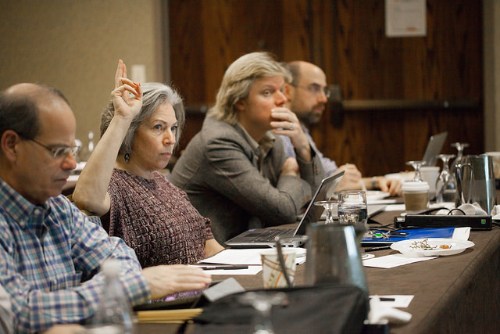
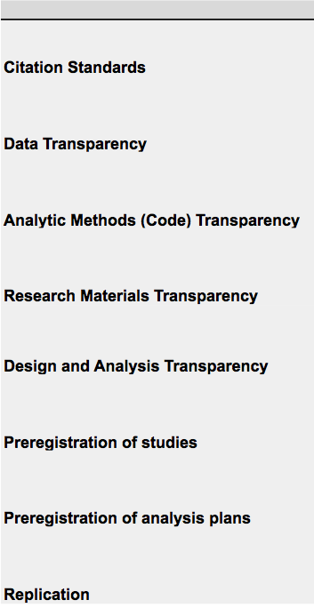


http://cos.io/top
Notes:
Credit: Jelte Wicherts slide
The guidelines cover a range of issues from citations to data to materials to preregistration and replication.

Slide 30
Data Transparency: Level 1
Summary: Article states whether data are available, and, if so, where to access them
The policy of the ___________ is to publish papers where authors indicate whether the data, methods used in the analysis, and materials used to conduct the research will be made available to any researcher for purposes of reproducing the results or replicating the procedure.
Authors must, in acknowledgments or the first footnote, indicate if they will or will not make their data, analytic methods, and study materials available to other researchers.
If an author agrees to make materials available, the author must specify where that material will be available.
Notes:
Credit: Bowman slide
In Data Transparency Level 1 the article states whether data are available, and, if so, where to access them. Many scientific journals are already at level 1.

Slide 31
Data Transparency: Level 2
Data must be posted to a trusted repository. Exceptions must be identified at article submission.
The policy of the ___________ is to publish papers only if the data used to conduct the research are clearly and precisely documented and are maximally available to any researcher for purposes of reproducing the results or replicating the procedure.
Details of:
What must be shared
Legal and Ethical Exceptions – Disclosure at onset of review
Using trusted repositories
Notes:
Credit: Bowman ppt slide
In Data Transparency Level 2 data must be publicly posted to a trusted repository like the Open Science Framework. The journal Cognition is at level 2, as mentioned earlier.

Slide 32
Data Transparency: Level 3
Data must be posted to a trusted repository, and reported analyses will be reproduced independently prior to publication.
... are maximally available to any researcher for purposes of reproducing the results or replicating the procedure. All materials supporting the claims made by the author must be made available to the journal prior to publication. The journal, or an entity acting on behalf of the journal, will verify that the findings are replicable using the author’s data and methods of analysis. Failure to replicate at this stage may result in the paper not being published.
Notes:
Credit: Bowman ppt slide
In Data Transparency Level 3 data has to be posted to a trusted repository, and the analyses reported in the analyses in the paper must be reproduced independently prior to publication as an accuracy check.

Slide 33
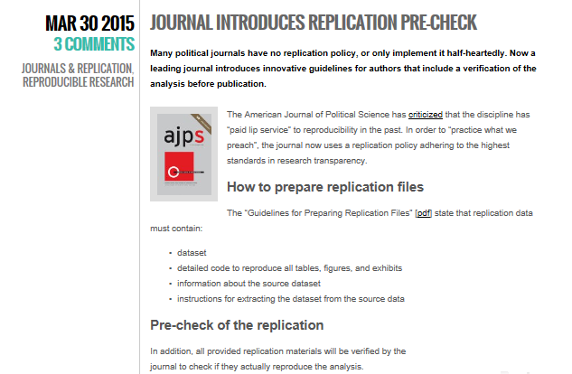
What percentage of results do you think could be reproduced by the external statistician?
Notes:
The American Journal of Political Science recently introduced the replication pre-check, in which an independent statistician reproduces all of the analysis on the paper before publication to make sure they are correct. What percentage of results do you think could be reproduced by the external statistician? (students give estimates).
Relevant links:
Journal introduces replication pre-check
https://politicalsciencereplication.wordpress.com/2015/03/30/journal-introduces-replication-pre-check/
Leading journal verifies articles before publication – so far, all replications failed
https://politicalsciencereplication.wordpress.com/2015/05/04/leading-journal-verifies-articles-before-publication-so-far-all-replications-failed/

Slide 34
What percentage of results do you think could be reproduced by the external statistician? Zero! The files were never complete.
Notes:
Zero! The files were never complete. This was for the first 15 papers subjected to a replication pre-check. The reason was the files were never complete, and the independent checkers always had to contact the original authors for help and more complete information. Ultimately all 15 findings were confirmed but this couldn’t be done just using their replication package.
Relevant links:
Journal introduces replication pre-check
https://politicalsciencereplication.wordpress.com/2015/03/30/journal-introduces-replication-pre-check/
Leading journal verifies articles before publication – so far, all replications failed
https://politicalsciencereplication.wordpress.com/2015/05/04/leading-journal-verifies-articles-before-publication-so-far-all-replications-failed/

Slide 35









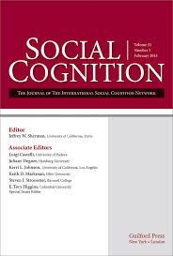


TOP Signatories
Journals, Organizations, Funders
500+ journals
45+ Organizations
http://cos.io/top
top@cos.io
Notes:
Credit: Bowman ppt slide
Over 500 journals and over 45 organizations have endorse the TOP guidelines.

Slide 36
Mandatory data posting rules at journals
TOP guidelines for journals not stringent at Level 1
  Authors must indicate where data can be obtained, e.g., by email request
If everyone has to publicly post their data (TOP level 2), the collective action problem is resolved
Open Science Framework and other online repositories are available
Notes:
The TOP guidelines for journals not especially stringent at Level 1. Authors just have to indicate where the data can be obtained, for example by email request. However if everyone has to publicly post their data (TOP level 2), the collective action problem is resolved. The professional costs of scientific transparency are no longer born by those who choose to have open data, with closed data researchers and laboratories free riding. Its true that it would impose a burden on original authors who laboriously collected dataset to make it available to anyone. But wouldn’t it be wonderful to be immediately able to access datasets from all the papers you see in journals? This would really help early career researchers and researchers at schools with limited resources.
Relevant links:
Transparency and Openness Promotion (TOP) Guidelines in Science
https://osf.io/ud578/

Slide 37
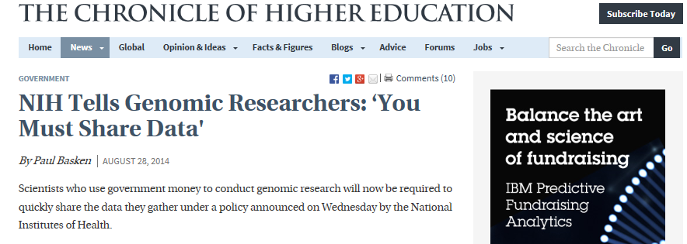
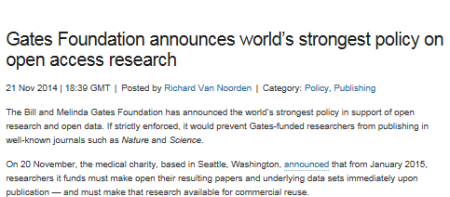
Some funders are starting to require open data
Notes:
Some funders, such as the Gates Foundation, are starting to require open data. This is another mechanism by which we will see data transparency increasing in the future. If you don’t agree to have open data, you don’t get any grant funding.
Relevant links:
Gates foundation announcement
http://blogs.nature.com/news/2014/11/gates-foundation-announces-worlds-strongest-policy-on-open-access-research.html
NSF mandates data sharing for genomics projects
http://m.chronicle.com/article/NIH-Tells-Genomic-Researchers-/148509/

Slide 38
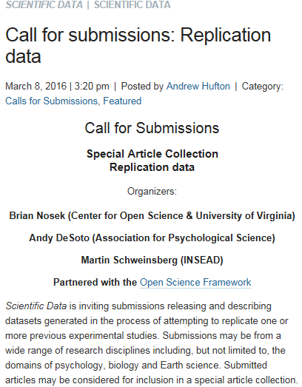
“Data Publications” approach
You can publish your dataset in
  Nature: Scientific Data
  Journal of Open Data
  Other outlets
Tierney et al. (2016) Pipeline Project Dataset is currently under review
Notes:
There is also the “Data Publications” approach. You can publish your dataset in outlets like Nature: Scientific Data and the Journal of Open Data. We are doing this with both the Pipeline Project 1 and 2 datasets, so you here in this class will soon be co-authors on a data publication.
Relevant links:
Call for submissions: Replication data
http://blogs.nature.com/scientificdata/?p=3509

Slide 39



Another way to leverage open data:
Crowdsourcing data analysis
Original dataset collected by project coordinators
Analysts recruited to independently analyze the same dataset to test the same hypothesis
Estimated effect sizes are compared
Notes:
Our research group has also developed another way to leverage open data, which we call crowdsourcing data analysis. An original dataset is collected by project coordinators. Analysts from around the world are then recruited to independently analyze the same dataset to test the same hypothesis. Estimated effect sizes from the different research teams are then compared.
Note: Wording should be changed to the third person for instructors who are not authors on the crowdsourcing data analysis project.

Slide 40
Crowdsourcing Data Analysis 1
(Silberzahn & Uhlmann, 2015, Nature;
Silberzahn et al., 2016a, under review)
Twenty nine teams involving 61 analysts used the same data set to address the same research question
Are soccer referees more likely to give red cards to dark skin toned players?
346,028 dyads of players and referees
Analytic approaches and choice of covariates varied widely
Notes:
In the first crowdsourcing data analysis project, twenty nine teams involving 61 analysts used the same data set to address the same research question: Are soccer referees more likely to give red cards to dark skin toned players? Analytic approaches varied considerably between the different teams, especially with regard to choice of control variables.
Note: The full empirical report is under review at POPS as of this writing. A brief commentary advocating for crowdsourcing data analysis was published in Nature. We were unable to include more than two authors on the Nature commentary unfortunately.
Relevant link:
Silberzahn, R., & Uhlmann, E.L. (2015). Many hands make tight work: Crowdsourcing research can balance discussions, validate findings and better inform policy. Nature, 526, 189-191. Full text: http://www.nature.com/news/crowdsourced-research-many-hands-make-tight-work-1.18508

Slide 41
Collaborator map for Silberzahn et al. (2016a) Crowdsourcing data analysis 1
29 teams of researchers analyze the same dataset independently,
then compare and debate results
Notes:
Here is the collaborator map for the project.

Slide 42
Complete Reference
Silberzahn, R., Uhlmann, E. L., Martin, D., Anselmi, P., Aust, F., Awtrey, E., Bahník, Š., Bai, F., Bannard, C., Bonnier, E., Carlsson, R., Cheung, F., Christensen, G., Clay, R., Craig, M., Dalla Rosa, A., Dam, L., Evans, M. H., Flores Cervantes, I., Fong, N., Gamez-Djokic, M., Glenz, A., Gordon-McKeon, S., Heaton, T. J., Hederos Eriksson, K., Heene, M., Hofelich Mohr, A. J., Högden, F., Hui, K., Johannesson, M., Kalodimos, J., Kaszubowski, E., Kennedy, D., Lei, R., Lindsay, T. A., Liverani, S., Madan, C. R., Molden, D., Molleman, E., Morey, R. D., Mulder, L. B., Nijstad, B. A., Pope, N. G., Pope, B., Prenoveau, J. M., Rink, F., Robusto, E., Roderique, H., Sandberg, A., Schlüter, E., Schönbrodt, F. D., Sherman, M. F., Sommer, S., Sotak, K., Spain, S., Spörlein, C., Stafford, T., Stefanutti, L., Tauber, S., Ullrich, J., Vianello, M., Wagenmakers, E., Witkowiak, M., Yoon, S., & Nosek, B.A. (2016a). Crowdsourcing data analysis: Do soccer referees give more red cards to dark skin toned players? Manuscript under review.
Notes:
And our many co-authors for this crowdsourced initiative.

Slide 43
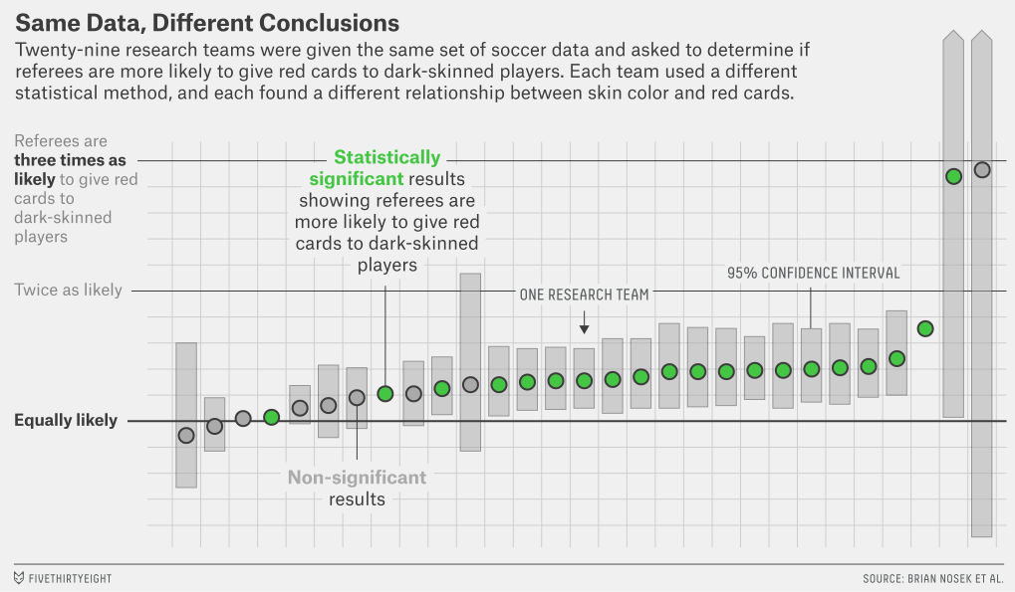
Estimated effect sizes ranged from 0.89 to 2.93 in odds ratio units, with a median of 1.31. Twenty teams (69%) found a significant positive effect and nine teams (31%) observed a nonsignificant relationship.
Silberzahn et al., 2016a
Notes:
And here are the results! 69% of teams found a significant positive effect and 31% observed a nonsignificant relationship. So there was some convergence. But look at the range of effect size estimates! Estimated effect sizes ranged from 0.89 to 2.93 in odds ratio units. Note that an odds ratio of 1.0 means no estimated difference in red cards based on skin tone, so effect sizes ranged from nonsignificantly negative to highly positive.

Slide 44
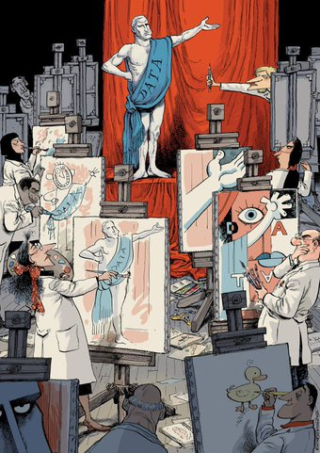
Explaining the Variability in Results
Similar range of effect sizes for expert analysts and analyses rated highly in round-robin evaluations (blind to results)
Variability in results primarily due to different choices of covariates
Notes:
A similar range of effect sizes was observed for expert analysts and analyses rated as high in quality by evaluators blind to the results. So these results are not due to some incompetent analysts making erroneous outlier estimates. The variability in results was primarily due to different choices of covariates.

Slide 45
Subjectivity and Science
Crowdsourcing data analysis is very different from standard science
  Data set is made publicly available
  Scientists at first analyze separately and then work together to reach a conclusion
  Subjectivity and ambiguity transparent
  This all happens prior to publication rather than after
Highlights the contingency of results on analytic choices
  In an era of increasingly open data such ambiguity may need to be accepted
  Potential to use wisdom of the crowds?
Notes:
Crowdsourcing data analysis is very different from the standard approach to data analysis. Rather than being closed and proprietary, a data set is made publicly available prior to publication. Scientists at first analyze separately and then work together to reach a conclusion, with subjectivity and ambiguity made transparent. Crowdsourcing data analysis highlights the contingency of research results on defensible, but subjective analytic choices. In an era of increasingly open data such ambiguity may need to be accepted.

Slide 46
Implications for Gaming the System
Crowdsourcing data analysis highlights the contingency of results on good-faith analytic choices
However, one researcher could also analyze the data 29 different ways and pick the “best one”
Notes:
Crowdsourcing data analysis highlights the contingency of results on good-faith analytic choices. But at the same time, these results have implications for gaming the publication system when publishing from archival datasets. One researcher could very easily analyze the data 29 different ways and pick the “best one.”

Slide 47
Why is this biased towards homogeneity of results?
Because we operationalized the key variables for the analysts instead of letting them do so themselves
Silberzahn et al., 2016a
Notes:
Why were our results biased towards homogeneity of results? (students provide reasons).

Slide 48
Why is this biased towards homogeneity of results?
Because we operationalized the key variables for the analysts instead of letting them do so themselves
Silberzahn et al., 2016a
Notes:
… because we operationalized the key variables for the analysts instead of letting them do so themselves. “Prejudice” was skin tone, but it could have been ethnicity or nationality. Bias was red cards, but it could have been yellow cards, stoppage time, and so on.

Slide 49
Crowdsourcing Data Analysis 2:
Gender, Status, and Science
(Silberzahn et al., 2016b)
Crowdsourced investigation of the roles of scientist gender and status on intellectual conversations on the website the Edge (3,802,455 words of text)
Researchers operationalize key variables (status, dominant language) themselves
“Hypothesis generation" phase in which analysts formulate their own predictions and vote on which ones to test
Notes:
In our second crowdsourcing data analysis project, researchers are operationalizing the key variables– in this case status and dominant language– on their own. We expect this will result in even more variability in effect size estimates than before. In this project we are also taking crowdsourcing a step further by having a “hypothesis generation" phase in which analysts formulate their own predictions and vote on which ones to test. So not only the data analysis stage but also the hypothesis generation stage of the research process are turned over to the crowd to a substantial degree.

Slide 50
Nature editor John Maddox was once asked how much of what his journal printed was wrong.
Do you know what he said?
Notes:
Nature editor John Maddox was once asked how much of what his journal printed was wrong. Do you know what he said? (students answer).
Relevant links:
Source for Maddox quote
http://www.senseaboutscience.org/pages/maddox-prize-2013.html

Slide 51
Nature editor John Maddox was once asked how much of what his journal printed was wrong.
Do you know what he said?
“All of it. That’s what science is about — new knowledge constantly arriving to correct the old.”
Notes:
“All of it. That’s what science is about — new knowledge constantly arriving to correct the old.” Why not do more of that re-analysis and reflection before the paper comes out? That is the spirit of crowdsourcing data analysis.
Relevant links:
Source for Maddox quote:
http://www.senseaboutscience.org/pages/maddox-prize-2013.html

Slide 52
Take-Aways:
The Open Data Movement
In practice, scientific data is rarely shared with outside research teams
Re-analysis of the same data by other researchers frequently reveals errors and results that diverge from the original analysis
Crowdsourcing the analysis of data prior to publication makes analysis-contingent results transparent
Notes:
Some take-aways from our lecture on the Open Data Movement. In practice, scientific data is rarely shared with outside research teams. Re-analysis of the same data by other researchers frequently reveals errors and results that diverge from the original analysis. Crowdsourcing the analysis of data prior to publication makes more transparent the remarkable extent to which research results are contingent on subjective analytic decisions.

