Slide 1
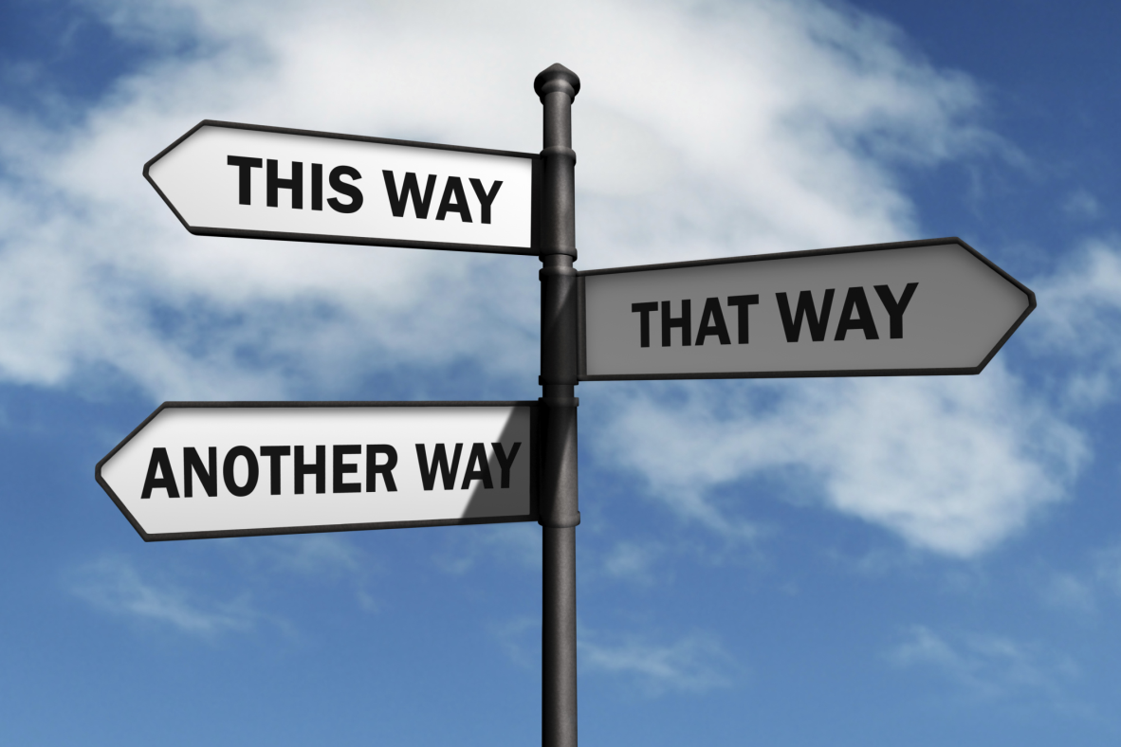
Course Wrap-Up
Martin Schweinsberg,
Neil Bearden, & Eric Luis Uhlmann
INSEAD
Notes:
Now I’d like to wrap up and discuss a few issues related to the overarching theme of the course. First, please take 5 minutes or so to think about what you will take away from the class as a whole. It doesn’t have to be what we taught you, but something that YOU learnt personally, what did YOU take out of this class? We’re doing this because this is a GREAT RETURN ON INVESTMENT: we’re spending 5 minutes on this now so you don’t lose all the time we have spent together (students quietly write down their take-aways from the class as a whole). Ok, let’s share some of your big take-aways (students share what they got from the class).
Note: This is a brief wrap-up lecture at the end of the last session of the course, not a stand-alone session.
Relevant links:
Asendorpf et al. (2013). Recommendations for increasing replicability in psychology. European Journal of Personality, 27, 108-119.
Full text available at: https://www.psychologie.hu-berlin.de/de/prof/per/pdf/2013/Replicability_target_Peer_commentary.pdf
Nosek, B. A., & Bar-Anan, Y. (2012). Scientific utopia: I. Opening scientific communication. Psychological Inquiry, 23, 217-243.
Full text available at: http://arxiv.org/ftp/arxiv/papers/1205/1205.1055.pdf
Finkel, E. J., Eastwick, P. W., & Reis, H. T. (in press). Best research practices in psychology: Illustrating epistemological and pragmatic considerations with the case of relationship science. Journal of Personality and Social Psychology.
Full text available at: http://faculty.wcas.northwestern.edu/eli-finkel/documents/2015_FinkelEastwickReis_JPSP.pdf
LeBel, E. P., Loving, T. J., & Campbell, L. (in press). Benefits of open and high-powered
research outweigh costs. Journal of Personality and Social Psychology.
http://papers.ssrn.com/sol3/papers.cfm?abstract_id=2616384

Slide 2
Course Review
The Crisis of Confidence in Science: Publication bias and Questionable research practices undermine the reliability of the scientific literature
The Replication Revolution: Many findings from the published literature are difficult to replicate in other laboratories
The Open Data Movement: Re-analysis of data frequently uncovers errors and suggests different conclusions
Themes: ethics, incentives, & crowdsourced solutions
Notes:
Thank you for sharing your take-aways. I’m glad to hear you got so much out of the class! We have covered three specific topics. In “The Crisis of Confidence in Science,” we talked about how publication bias and questionable research practices undermine the reliability of the scientific literature. In “The Replication Revolution,” we reviewed evidence that many findings from the published literature are difficult to replicate in other laboratories. Finally, in “The Open Data Movement,” we discussed how re-analysis of data frequently uncovers errors and suggests different conclusions. Through our sessions, we have returned regularly to our themes of ethical challenges, flawed incentive structures, and potential crowdsourced solutions. The current incentive structure of science often conflicts with our personal ethics as scientists, but researchers and journals are experimenting with ways of changing those incentives. Among the most promising of these are leveraging our community and the wisdom of the crowds to achieve a more reliable and robust science.

Slide 3
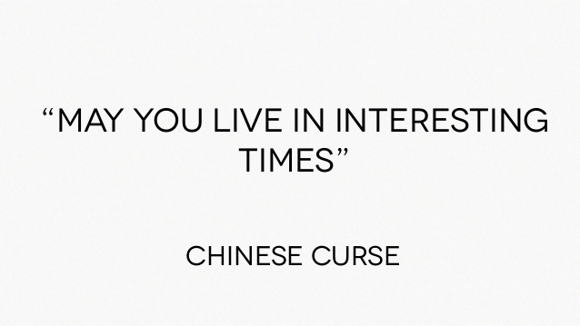
Notes:
In ancient China, there was a curse considered more terrible than all the others. “May you live in interesting times.” Talk about interesting, this is the great intellectual battle of our time! There are good things about both the traditional system and the new open system. We can retain the creativity and innovation valued in the traditional system and add the methodological rigor and transparency of the new ways of doing science. I am even more hopeful than I was on the first day of this class that we can have a better science and a better community of colleagues than we have seen in the past. We can take the best of what both sides have to offer, leverage the power of the crowd and build a better stronger, science that we can be proud of. The kind of science that we all thought we were signing up for.

Slide 4
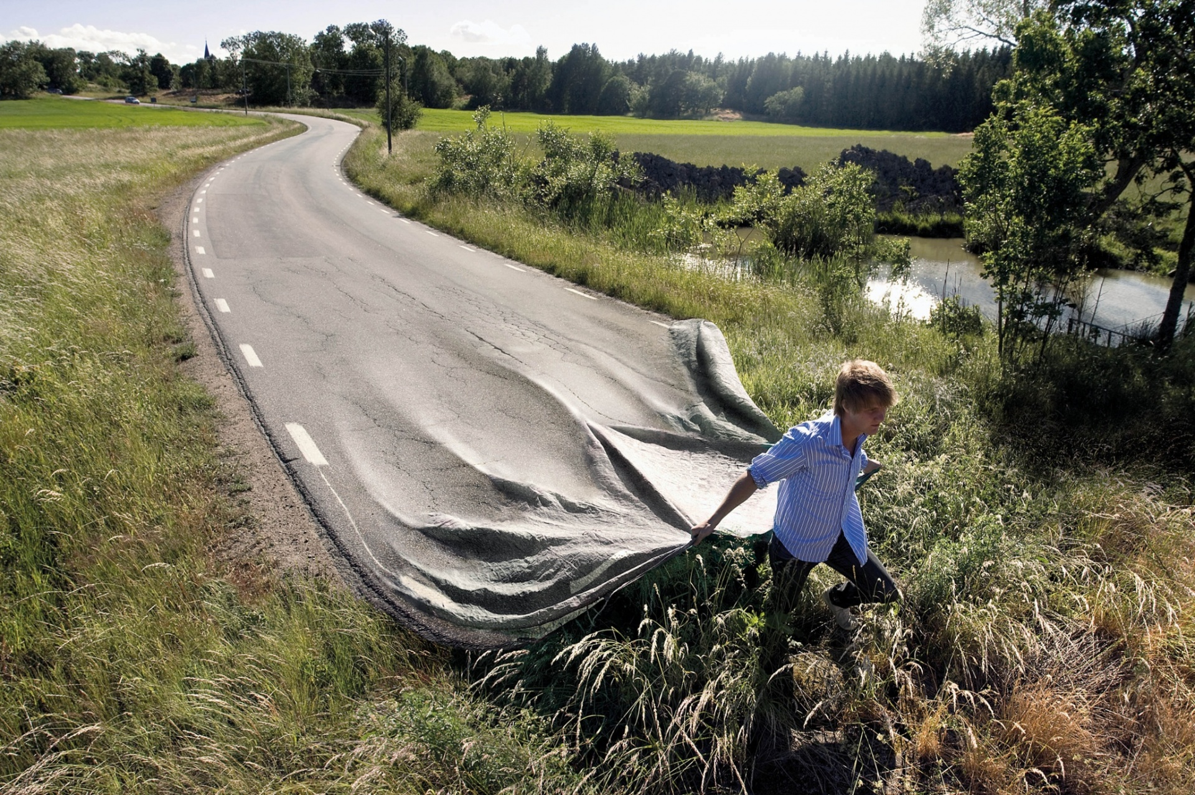
Notes:
This class hasn’t just been about the challenges facing science, it has also been about the solutions. Our goal here is not just to talk about improving science, but to actually do it by collaborating together on a crowdsourced project. I look forward to our road forward together on your pre-publication independent replications, to our final wrap-up session where you present your replication results, and to getting to know you all better and maybe even continuing to collaborate many years into the future. Thank you so much for coming.

